Slide 2
2 Kings 5

Slide 3
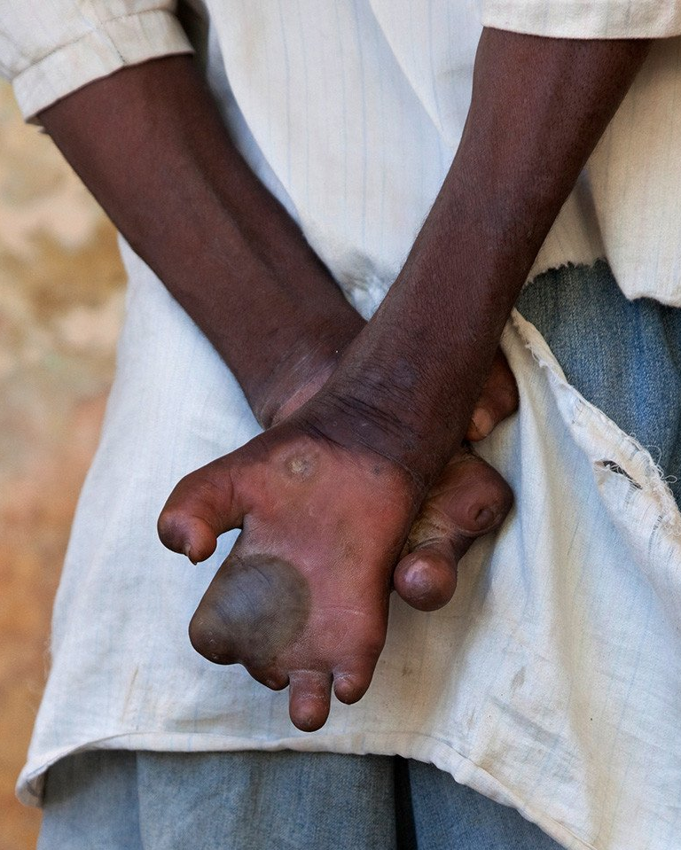
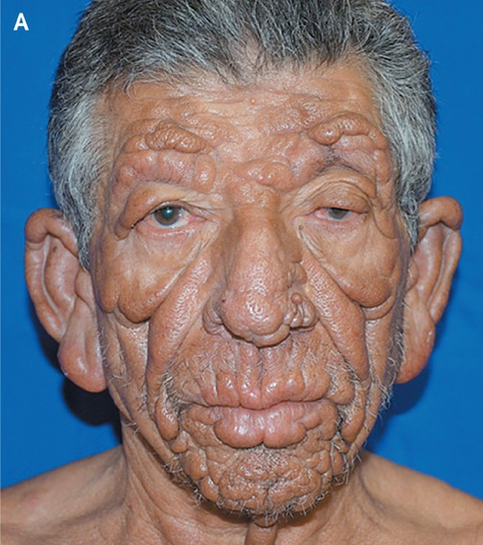
2 Kings 5:1-19 The Leprosy of Naaman
Notes:
GREATNESS: Vs. 1-3
Greatness is just not enough. Understand how long it had been since he held is wife’s hand – not wanting to spread the horrid disease. Understand the death he expected to face soon – as his body was eaten away. In so many ways he was a “dead man walking.” All the success in the world couldn’t undo his problem.
ANY PRICE: Vs. 4-7
FAITH & HUMILITY: Vs. 8-10
ALMOST MISSED: Vs. 11-13
OBEYS: 14-16
DEVOTION: 17-19

Slide 4
2 Kings 5:1-19 The Leprosy of Naaman
Naaman’s Pride…
kept himself sick
Prevented healing
Manifested in rage and racing off in disgust
Prevented common sense
His preconceived ideas did not fit into His haughty paradigm (box) of his mind
Notes:
GREATNESS: Vs. 1-3
Greatness is just not enough. Understand how long it had been since he held is wife’s hand – not wanting to spread the horrid disease. Understand the death he expected to face soon – as his body was eaten away. In so many ways he was a “dead man walking.” All the success in the world couldn’t undo his problem.
ANY PRICE: Vs. 4-7
FAITH & HUMILITY: Vs. 8-10
ALMOST MISSED: Vs. 11-13
OBEYS: 14-16
DEVOTION: 17-19

Slide 5
2 Kings 5:1-19 The Leprosy of Naaman
Are we too are highly influenced by society
worldly influence,
family,
upbringing,
experiences (good and bad)
Do they define us or will control us?
Notes:
GREATNESS: Vs. 1-3
Greatness is just not enough. Understand how long it had been since he held is wife’s hand – not wanting to spread the horrid disease. Understand the death he expected to face soon – as his body was eaten away. In so many ways he was a “dead man walking.” All the success in the world couldn’t undo his problem.
ANY PRICE: Vs. 4-7
FAITH & HUMILITY: Vs. 8-10
ALMOST MISSED: Vs. 11-13
OBEYS: 14-16
DEVOTION: 17-19

Slide 6
2 Kings 5:1-19 The Leprosy of Naaman
Naaman wanted healing deeply but…
On his terms
In his way
From his efforts of achievements and riches and resources
With something grand and glorious that would inflate him
Notes:
GREATNESS: Vs. 1-3
Greatness is just not enough. Understand how long it had been since he held is wife’s hand – not wanting to spread the horrid disease. Understand the death he expected to face soon – as his body was eaten away. In so many ways he was a “dead man walking.” All the success in the world couldn’t undo his problem.
ANY PRICE: Vs. 4-7
FAITH & HUMILITY: Vs. 8-10
ALMOST MISSED: Vs. 11-13
OBEYS: 14-16
DEVOTION: 17-19

Slide 7
2 Kings 5:1-19 The Leprosy of Naaman
God…
Sent a poor lowly messenger to covey the instruction of how to be healed.
Sent a common slave with the message how to overcome this mess age!

Slide 8
God sent to us a loving messenger:
to die and show us the way home
to pay the way and pave the way
to show us how to live and also serve Him to show others the way

Slide 9
The Message of healing …
Does not have to make sense.
Does not have to be one that we can immediately wrap our mind around it
God’s intention is for us to listen AND OBEY

Slide 10
Understanding can come later
Abraham to offer is son as a sacrifice – but he obeyed
Noah - what a flood was or even rain – but build the ark
Joshua - why march around Jericho

Slide 11
Complete wholehearted obedience must occur!
David said to his son…
1Ch 28:9 "As for you, my son Solomon,
know the God of your father, and
serve Him with a loyal heart and
with a willing mind; for
the LORD searches all hearts and understands all the intent of the thoughts.
If you seek Him, He will be found by you; but if you forsake Him, He will cast you off forever.

