Slide 1
Goodness (love) and
Severity
(Justice, Righteousness) of God

Slide 2
1 John 4:7-8; Rom. 8:35-39
1Jo 4:7 Beloved, let us love one another, for love is of God; and everyone who loves is born of God and knows God. 8 He who does not love does not know God, for God is love. (NKJV)
Ro 8:35 Who shall separate us from the love of Christ? Shall tribulation, or distress, or persecution, or famine, or nakedness, or peril, or sword?
36 As it is written: "For Your sake we are killed all day long; We are accounted as sheep for the slaughter."
37 Yet in all these things we are more than conquerors through Him who loved us.
38 For I am persuaded that neither death nor life, nor angels nor principalities nor powers, nor things present nor things to come,
39 nor height nor depth, nor any other created thing, shall be able to separate us from the love of God which is in Christ Jesus our Lord. (NKJV)

Slide 3


Slide 4
Psalm 36:5-7
Ps 36:5 Your mercy, O LORD, is in the heavens;
Your faithfulness reaches to the clouds.
6 Your righteousness is like the great mountains;
Your judgments are a great deep; O LORD, You preserve man and beast.
7 How precious is Your lovingkindness, O God!
Therefore the children of men put their trust under the shadow of Your wings.

Slide 5
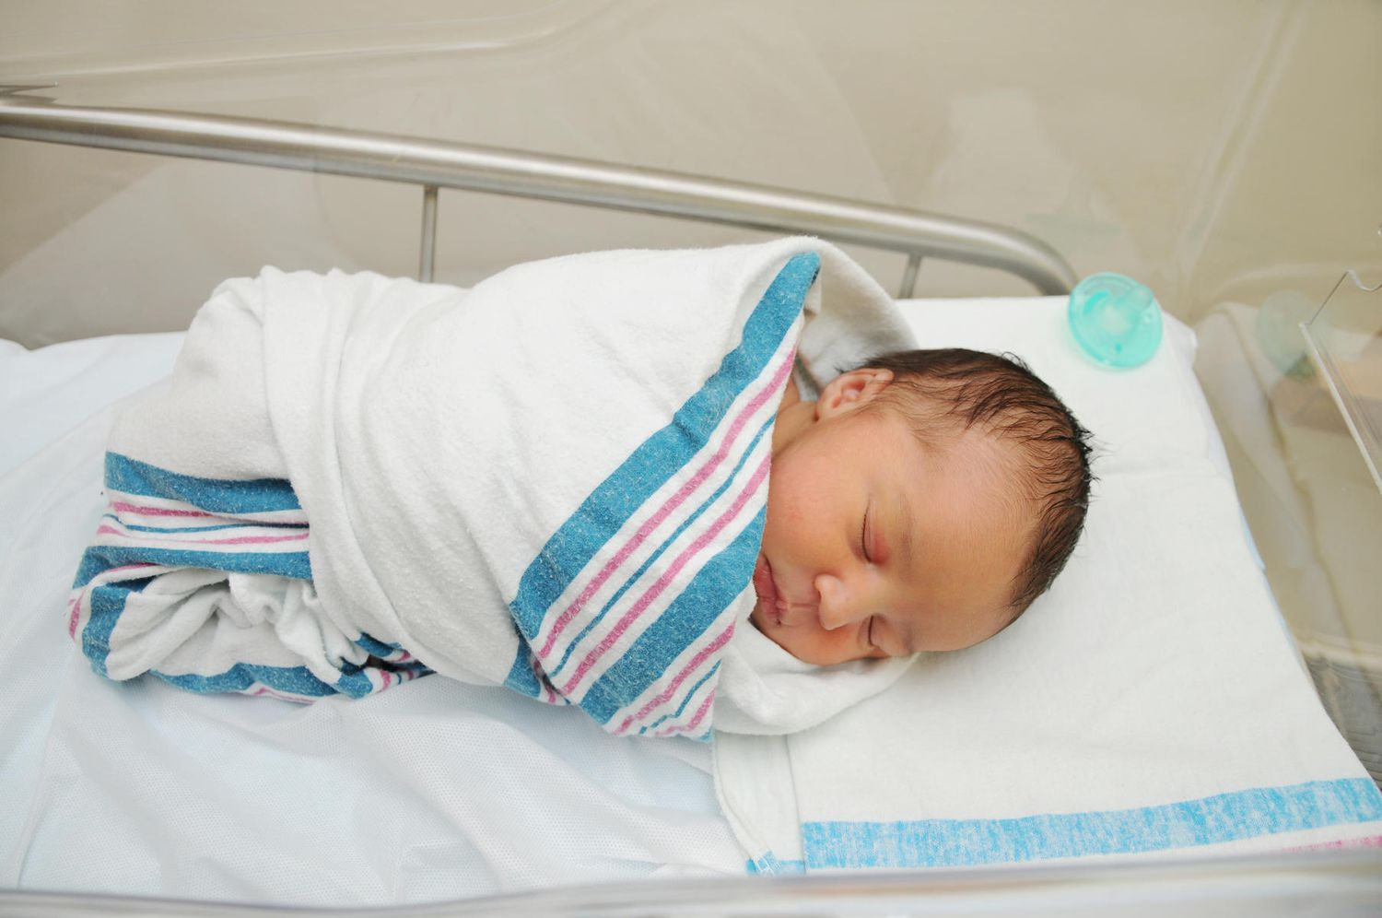

Slide 6
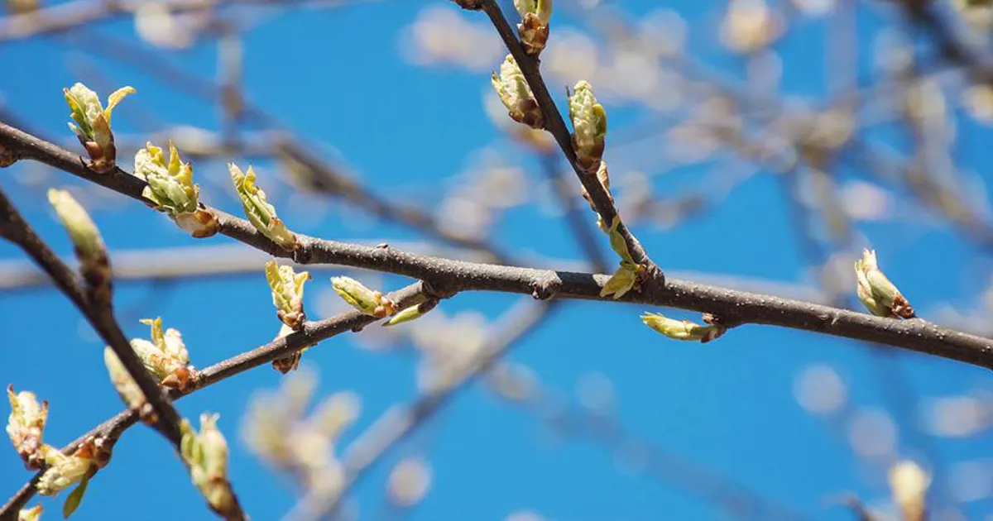

Slide 7
Eph. 2:4-7
Eph 2:4 But God, who is rich in mercy, because of His great love with which He loved us,
5 even when we were dead in trespasses, made us alive together with Christ (by grace you have been saved),
6 and raised us up together, and
made us sit together in the heavenly places in Christ Jesus, 7 that in the ages to come
He might show the exceeding riches of His grace in His kindness toward us in Christ Jesus. (NKJV)

Slide 8
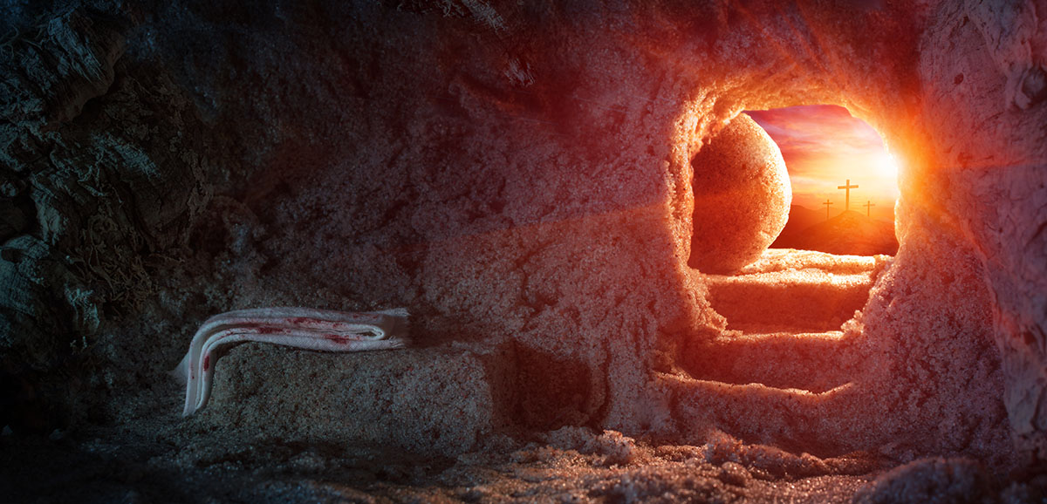

Slide 9
John 3:16; Rom. 5:7-8; Isa. 54:10
Joh 3:16 "For God so loved the world that He gave His only begotten Son, that whoever believes in Him should not perish but have everlasting life. (NKJV)
Ro 5:7 For scarcely for a righteous man will one die;
yet perhaps for a good man someone would even dare to die.
8 But God demonstrates His own love toward us, in that while we were still sinners, Christ died for us.
Isa 54:10 For the mountains shall depart; And the hills be removed, But My kindness shall not depart from you, Nor
shall My covenant of peace be removed,"
Says the LORD, who has mercy on you.

Slide 10
John 15:9-13
Joh 15:9 "As the Father loved Me,
I also have loved you; abide in My love.
10 "If you keep My commandments, you will abide in My love,
just as I have kept My Father's commandments and
abide in His love.
11 "These things I have spoken to you, that
My joy may remain in you, and
that your joy may be full.
12 "This is My commandment,
that you love one another as I have loved you.
13 "Greater love has no one than this, than to lay down one's life for his friends. (NKJV)

Slide 11
Lam. 3:22-23
Song 23

Slide 12
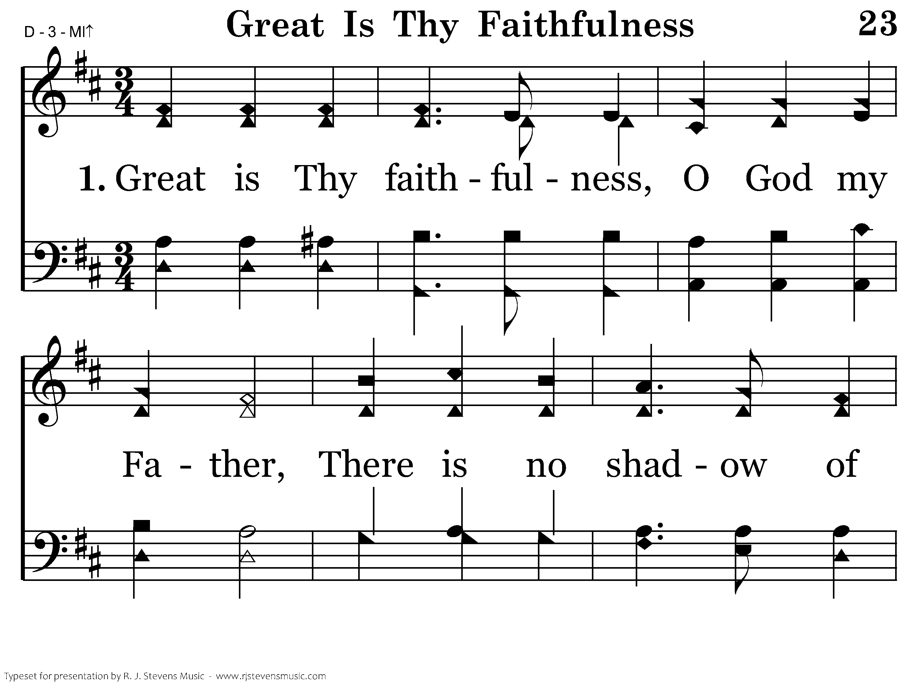
023 - Great Is Thy Faithfulness - 1.1

Slide 13
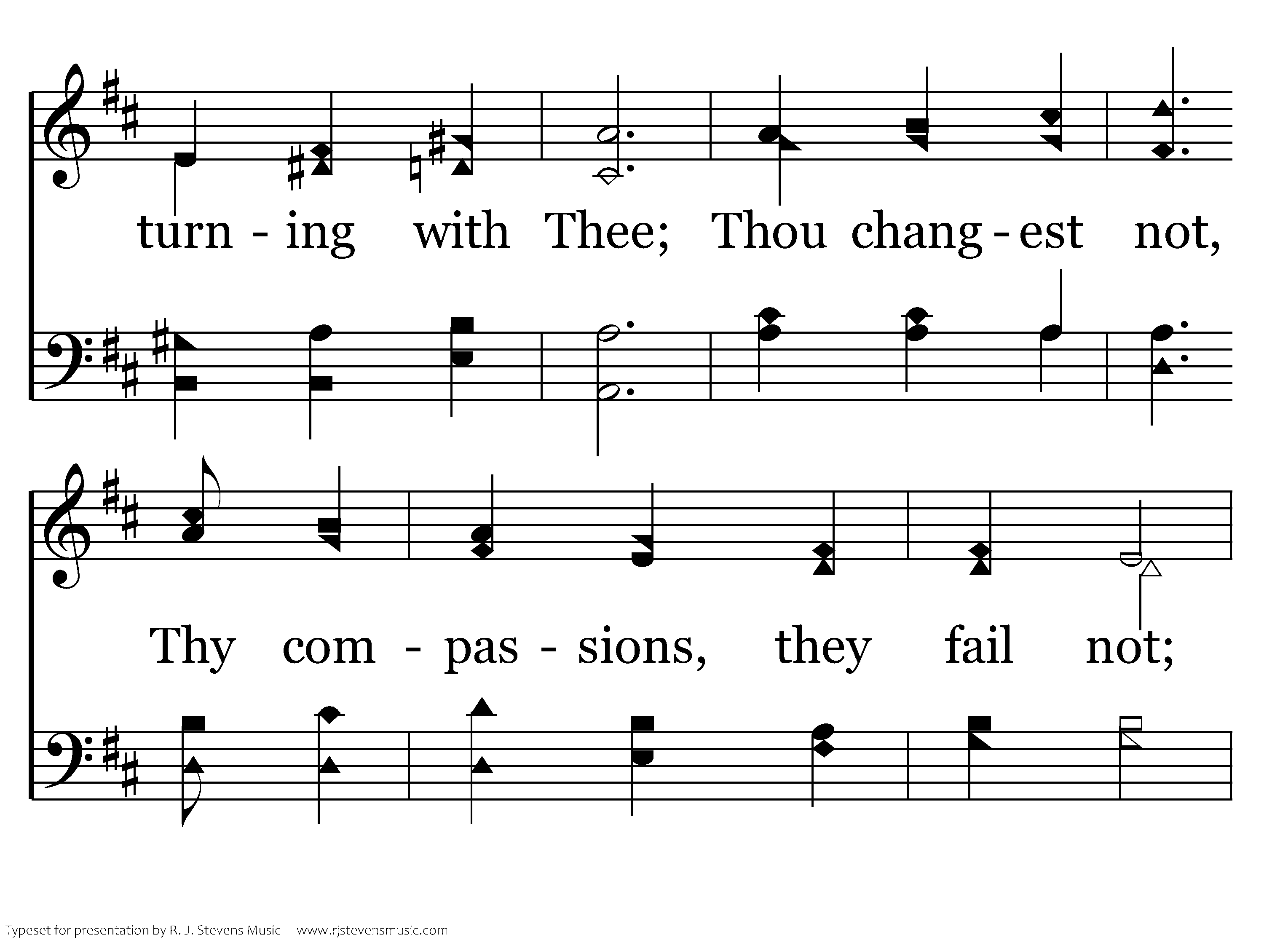
023 - Great Is Thy Faithfulness - 1.2

Slide 14
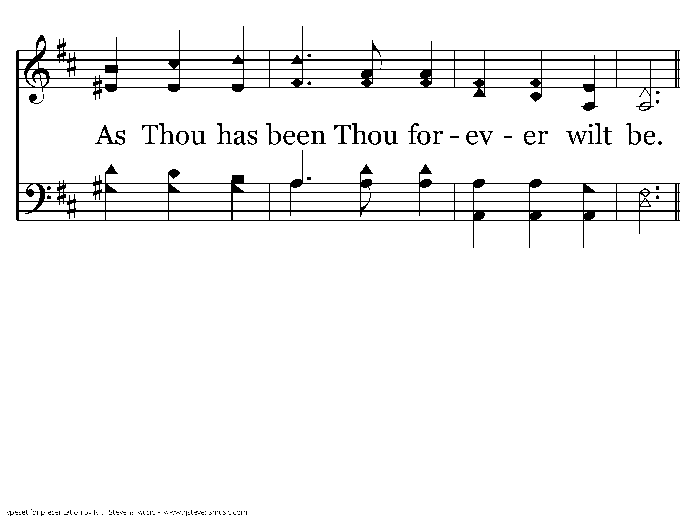
023 - Great Is Thy Faithfulness - 1.3

Slide 15
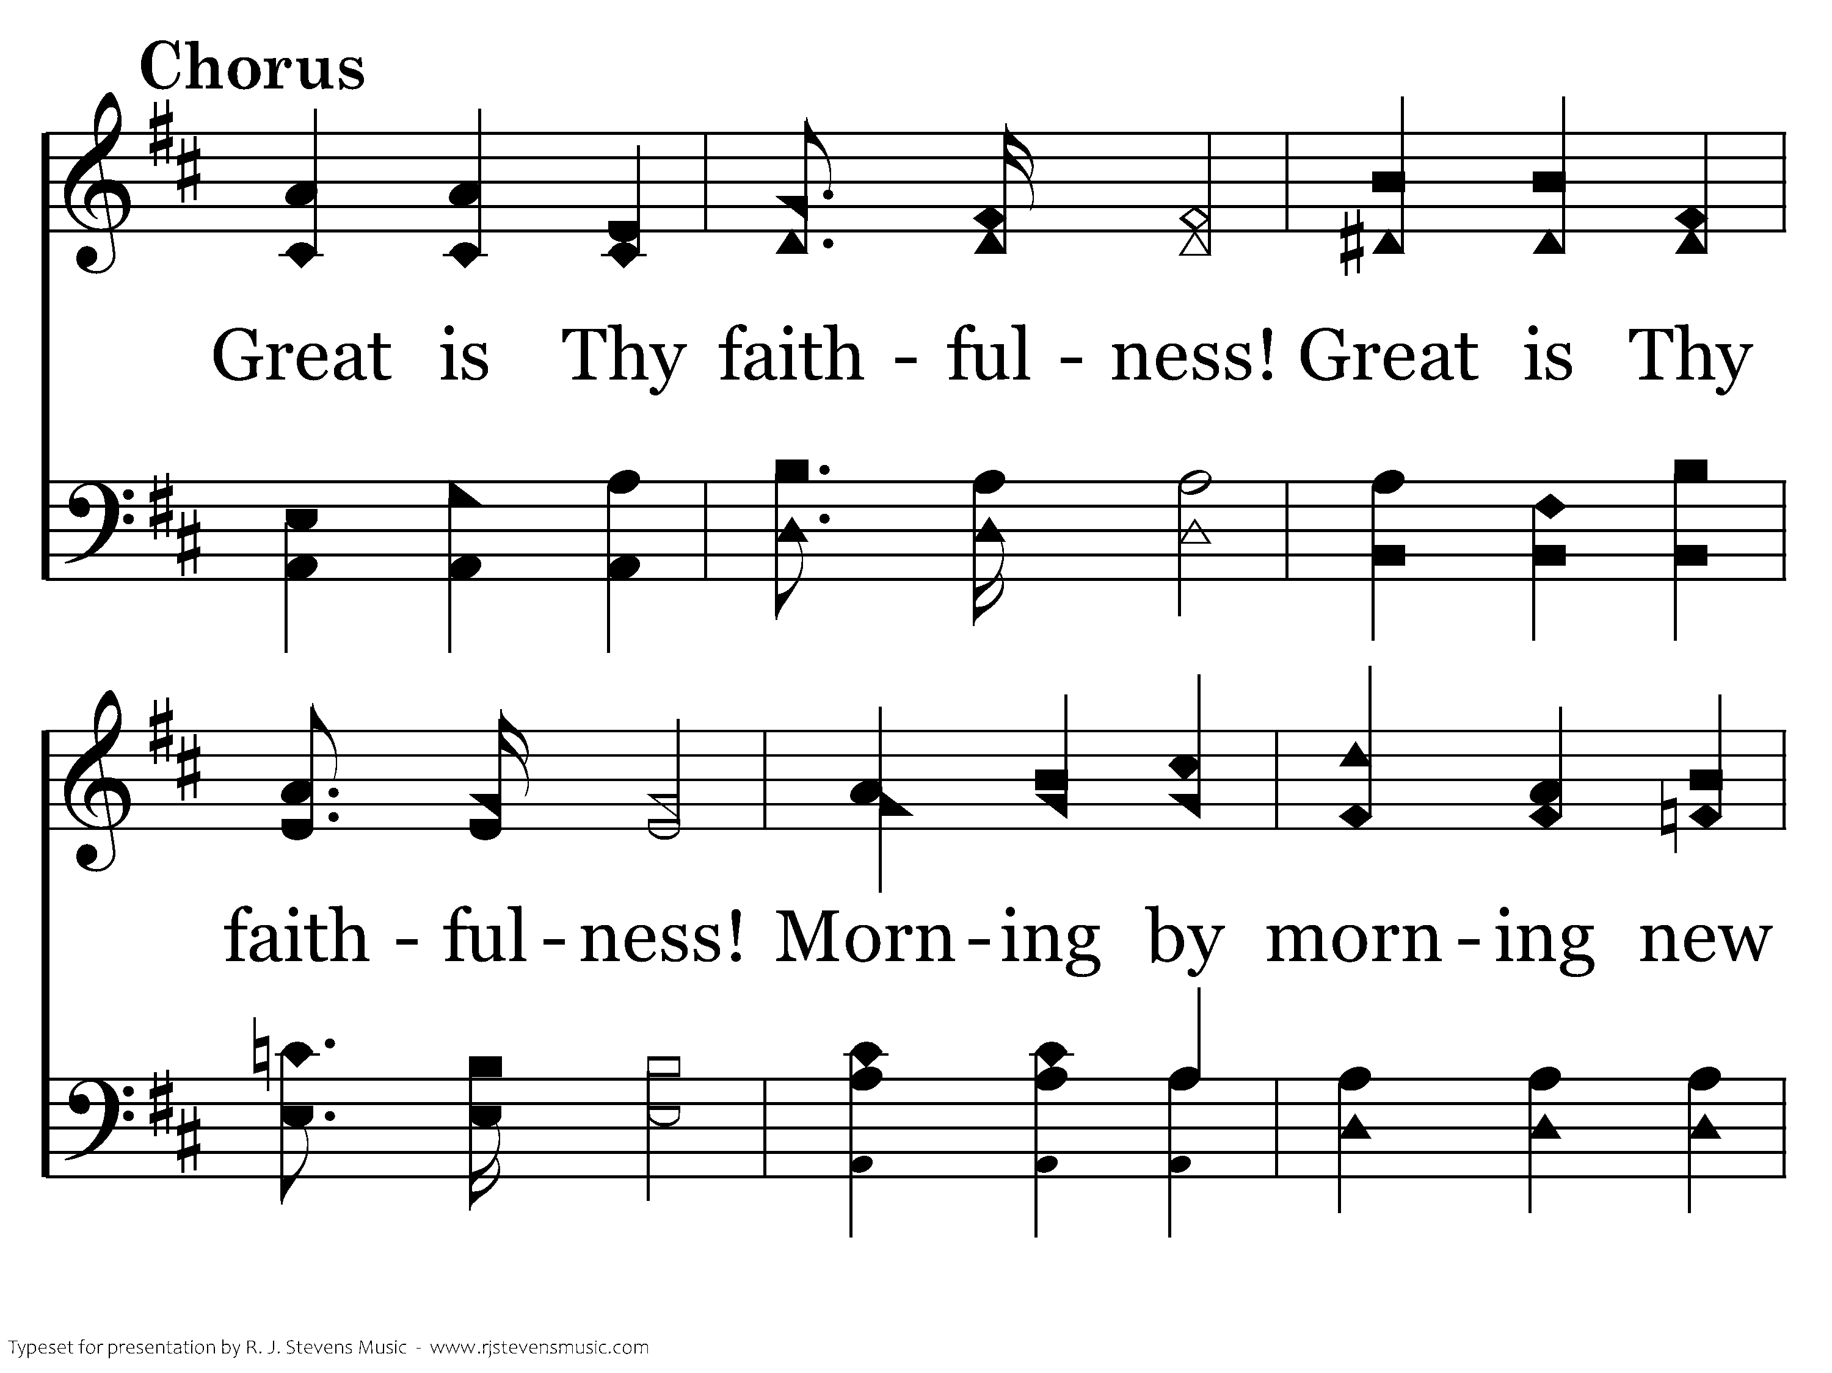
023 - Great Is Thy Faithfulness - C.1

Slide 16
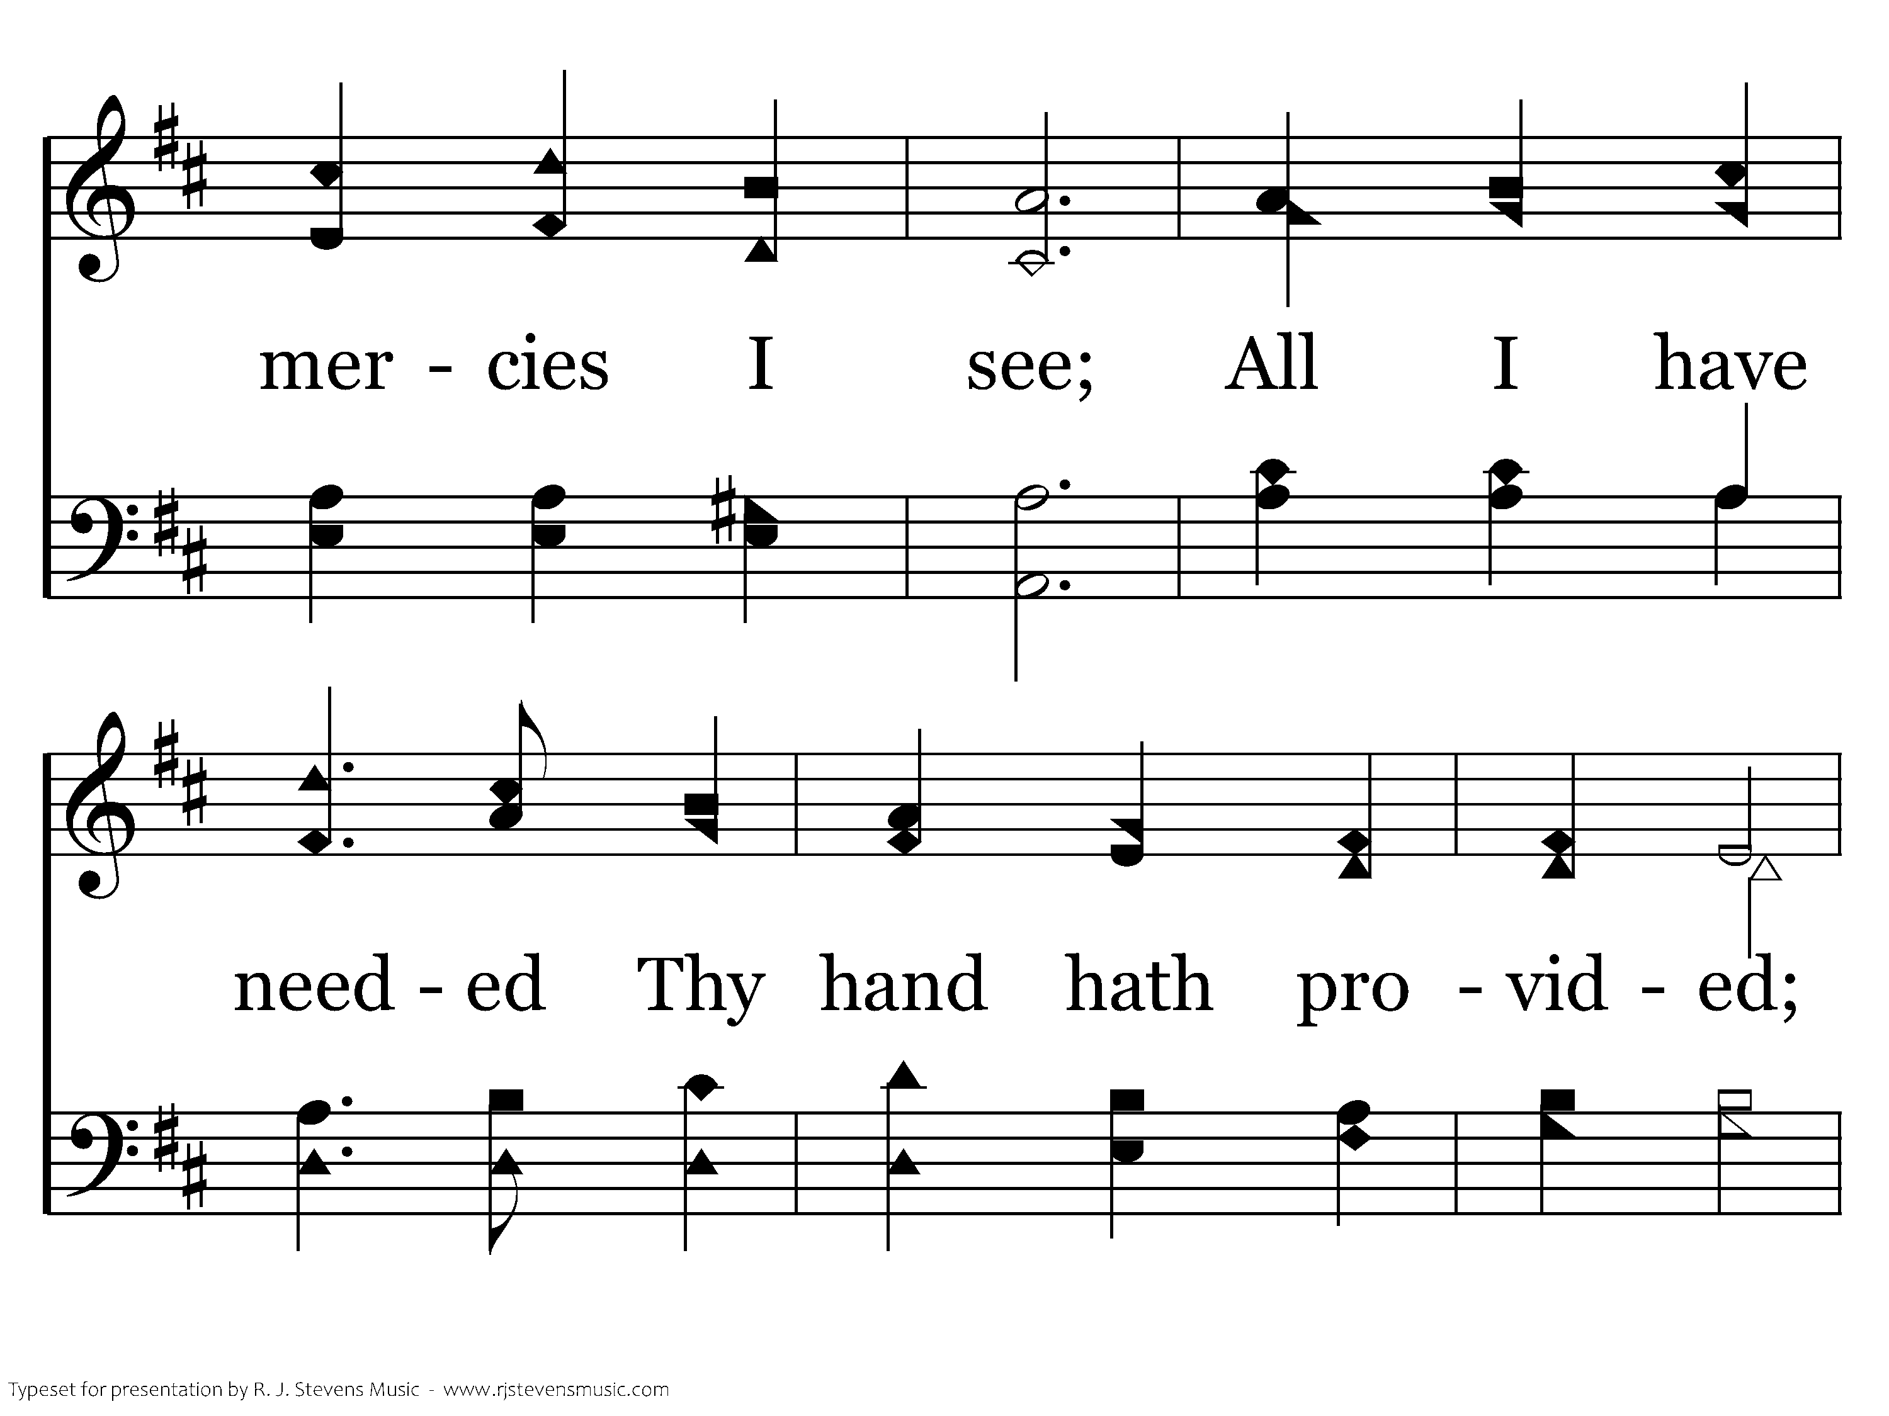
023 - Great Is Thy Faithfulness - C.2

Slide 17
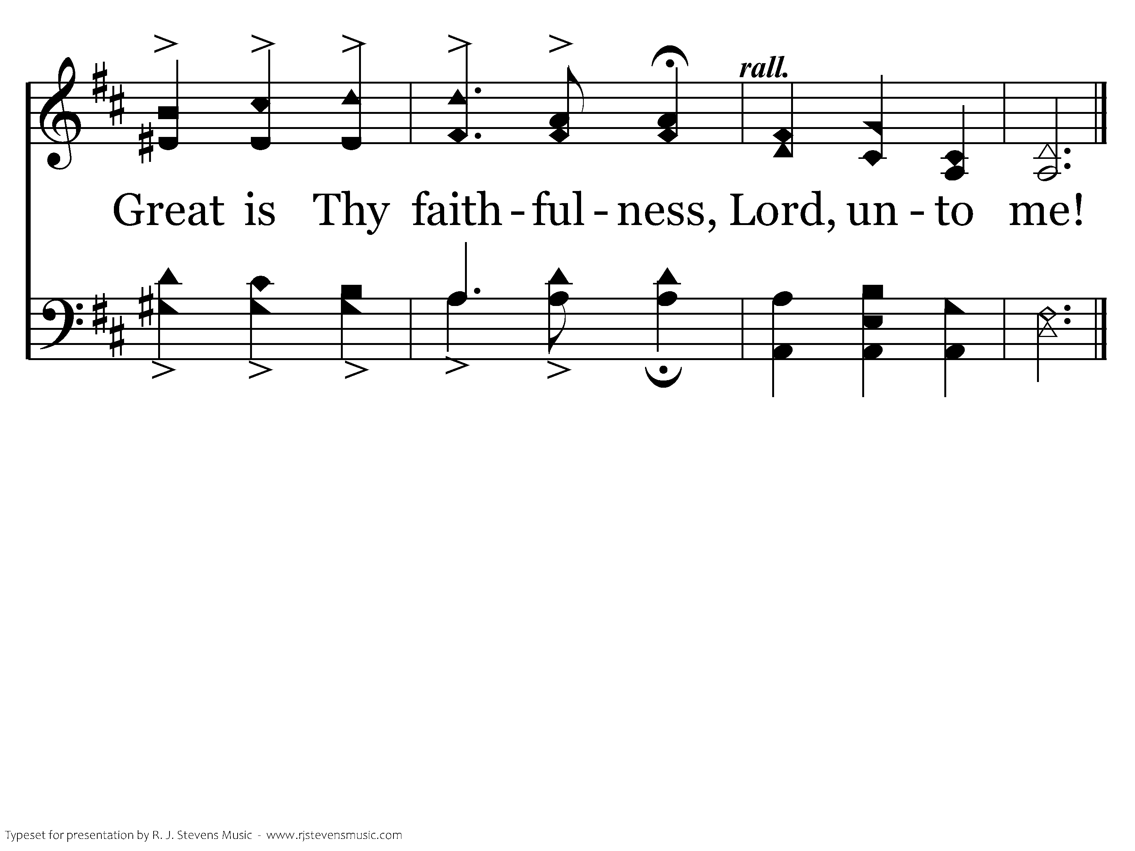
023 - Great Is Thy Faithfulness - C.3
End of Verse 1

Slide 18
Rom. 11:22
  Ro 11:22 Therefore consider the goodness and severity of God:
  on those who fell, severity;
but toward you, goodness,
If
you continue in His goodness.
Otherwise, you also will be cut off.

Slide 19
Psalm 139
Deut. 7

Slide 20
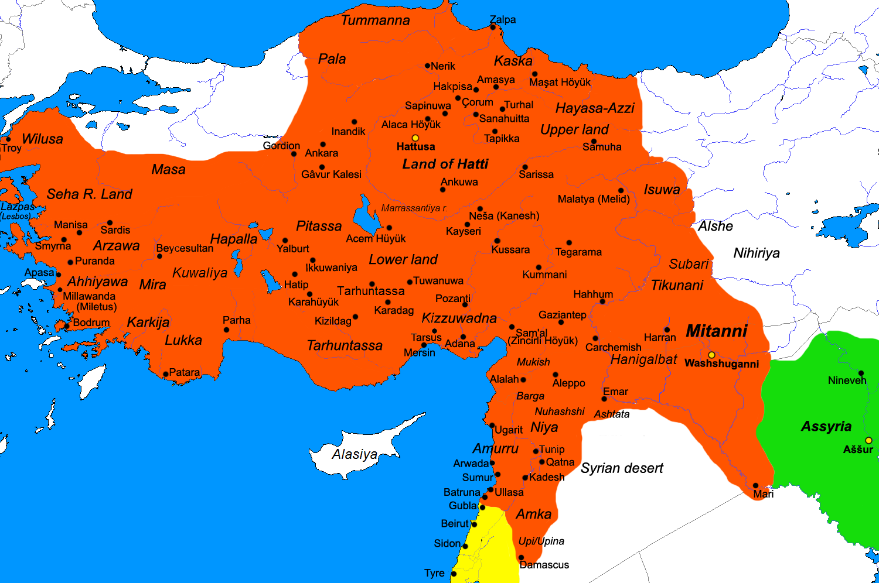
Hittite Empire: 1 of 7 to destroy

Slide 21
Gen 15:15-16
Ge 15:15 "Now as for you, you shall go to your fathers in peace; you shall be buried at a good old age.
16 "But in the fourth generation they shall return here, for the iniquity of the Amorites
is not yet complete."

Slide 22
Dan. 8:23
Da 8:23 "And in the latter time of their kingdom, When the transgressors have reached their fullness, A king shall arise, Having fierce features, Who understands sinister schemes. (NKJV)

Slide 23
Mt. 23:32; 1Thess. 2:16; Phil. 3:19
Mt 23:32 "Fill up, then, the measure of your fathers' guilt.
1Th 2:16 forbidding us to speak to the Gentiles that they may be saved, so as always to fill up the measure of their sins; but wrath has come upon them to the uttermost.
Php 3:19 whose end is destruction, whose god is their belly, and whose glory is in their shame-- who set their mind on earthly things. (NKJV)

Slide 24
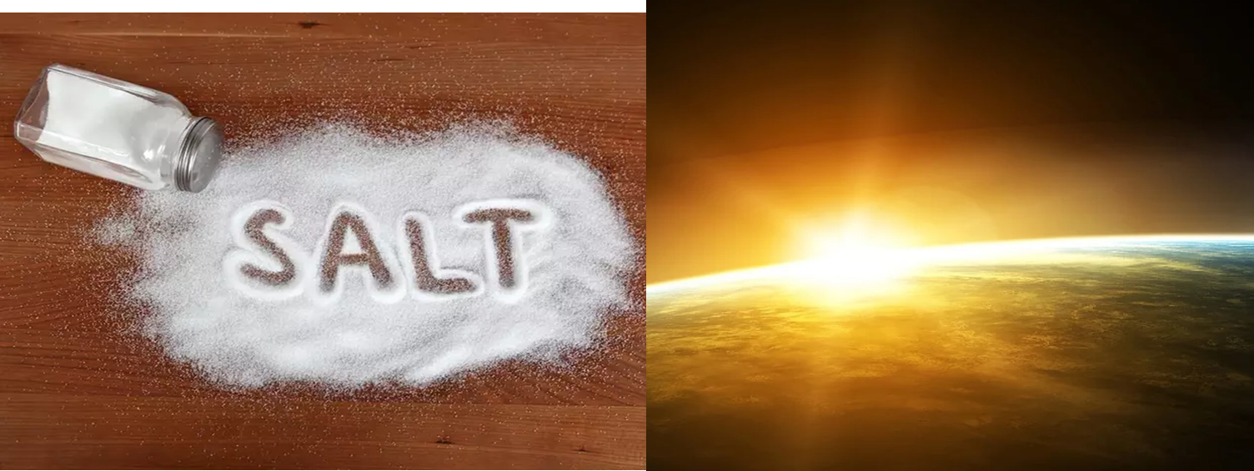
What we learn?
  Money
  Fame power or position
  Safety
  Career
  Tech, social media
  Appearance, weight
  Hobbies
  Relationships / romance
  Children
  Family
  Emotions / desires
  Covetousness
  Worry of future
There comes a time when people are beyond repentance. – “Overcome” 2Pet. 3:20-22
God knows – Psa. 139; Romans 1-3
God wants all to repent – 2 Pet. 3:9
We must give steadfast diligence to obey
  2Tim. 3:1-11; 1Cor :15:58
We must be living examples to world - Matt 5:16
Have complete TRUST in His righteous judgement
Have NO idols of this life!

Slide 25
Limit exposure to dark way of evil world
  1Cor 15:33; 1Pet 3:15; 2Cor 6; Eph. 5:11
Remember – ONLY 2 Options
  Luke 11:23
Ask ourselves DAILY
  “whose side am I on?”
  We can NOT be on both!

