Slide 1
Portrait of Christ
Revelation 1 – 3

Slide 2
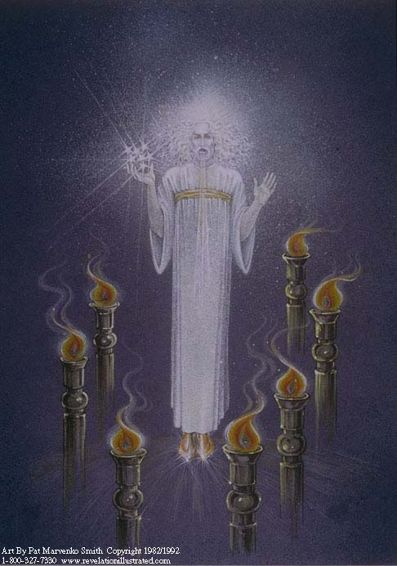

Slide 3
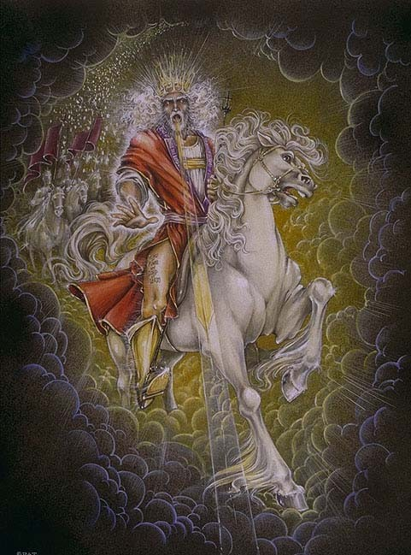

Slide 4
Depictions of Christ
Presence
Character
Authority
Word
Sight
Judge

Slide 5
Constant Presence
Rev. 1:11, 17; 22:13
Isa. 41:4; 44:6; 48:12
Timeless presence
never ending watchful care
Rev. 1:18

Slide 6
His Character
Holy & True
Rev. 3:7, 14
True, genuine, real
Light – John 1:9; 1 Jn 2:8
Bread – John 6:32
Vine – John 15:1

Slide 7
His Authority
Key of David - Rev. 3:7
Isa. 22:22; John 10:9; 14:6
Holding 7 spirits/stars
Rev. 1:4,16, 20; 3:1; 4:5; 5:6
Fullness – Physical & Spiritual

Slide 8
Stars
Often connected to:
Peace
Clarity
Order
Direction
Hope

Slide 9
His Word
Rev. 1:15-16; 2:12
To be revered as
Powerful
Awesome
Cutting to heart
Reveling
John 1:7-10;Heb. 4:12

Slide 10
His Sight Rev:2:23
Rev. 1:14; 2:18; 19:12
Dan. 10:6
Psa. 139:1-6
El Roi (Hebrew: אל ראי)) Gen. 16

Slide 11
His Judgment
Rev. 1:15; 2:18, 27; Psa. 2:9
Feet like blazing brass
Dan. 10:6

Slide 12
Christ Character is
Holy & True

Slide 13
Christ is
Sole Authority
Soul Authority

Slide 14
Who is God?
He is the FIRST AND LAST the Beginning and the End!
He is the Keeper of Creation and Creator of all!
He is the Architect of the universe and the manager of all times.

Slide 15
He always was, He always is, and He always will be…
Unmoved, Unchanged, Undefeated and NEVER undone!

Slide 16
He was bruised and brought healing
He was pierced and eases our pain!
He was persecuted, beaten yet brought freedom!
He was put to death and conquered it.
He, by His own power, LIVES and promised life eternal to His own.
He reigns as King and brings us Peace.

Slide 17
The world cannot understand Him
The armies could not defeat Him.
School teachers can’t explain Him.
Political leaders can’t ignore Him.

Slide 18
Herod couldn’t kill Him.
Pharisees couldn’t confuse Him.
Saducees could not defame Him
Nero could not crush Him
Hitler couldn’t silence Him
Humanism can’t replace Him

Slide 19
He is light, love, longevity and Lord
He is goodness, kindness, gentleness and God alone.
He is Holy, Righteous, mighty, powerful and pure.

Slide 20
His ways are right, His word is eternal.
His will is unchanging and His mind is on me.

Slide 21
He is our Redeemer, Savior and Guide.
He is our Peace, Joy and comfort.
He is our Friend and Lord and He leads us to eternal life!

Slide 22
Christ's Word
Is Powerful
Is Awesome
Is Convicting

Slide 23
Christ Can
See Deeper
Than We Can!

Slide 24
Christ Is The Judge!
He Has Final Say!

Slide 25
Are you ready
To meet your
maker?

Slide 26
Are you ready?
Repent &
Pray For Forgiveness

Slide 27
Are you ready?
Believe
Repent
Confess
Be Immersed

