Slide 1
Heartfelt Religion
Matt. 5:8; 6:20-21; 12:34-35
Notes:
Mt 5:8 Blessed are the pure in heart, For they shall see God.
(NKJV)
Mt 6:20 "but lay up for yourselves treasures in heaven, where neither moth nor rust destroys and where thieves do not break in and steal.
21 "For where your treasure is, there your heart will be also.
(NKJV)
Mt 12:34 "Brood of vipers! How can you, being evil, speak good things? For out of the abundance of the heart the mouth speaks.
35 "A good man out of the good treasure of his heart brings forth good things, and an evil man out of the evil treasure brings forth evil things.
(NKJV)

Slide 2
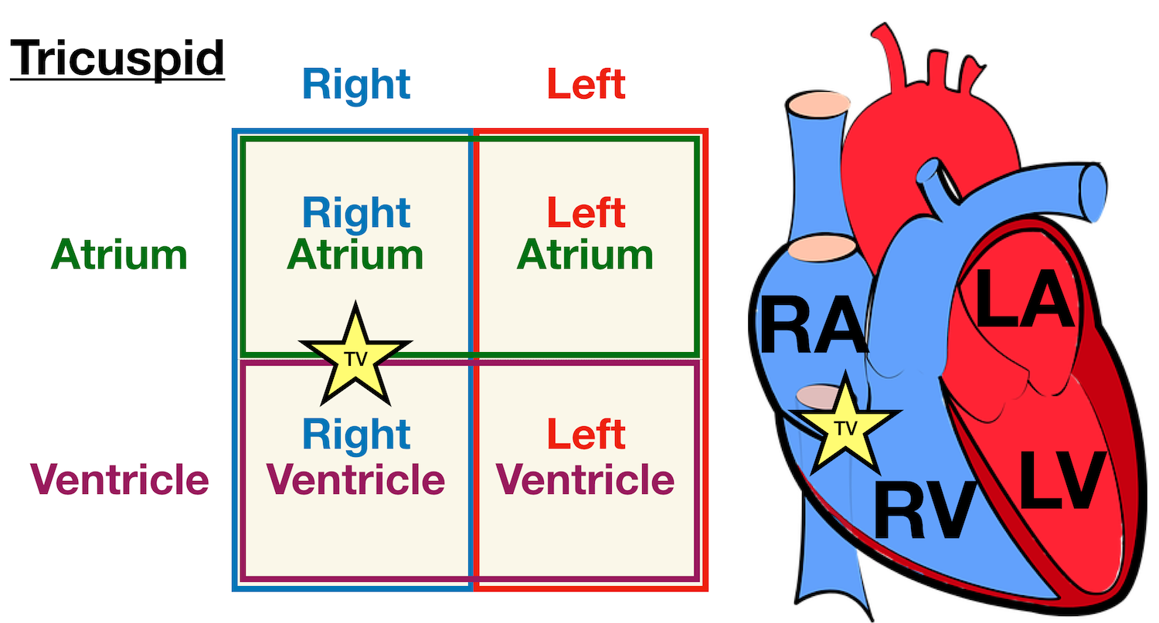
What Is The Heart?
Intellect
Emotions
Will
Conscience
Notes:
Intellect
Emotions
Will
Conscience

Slide 3
“Intellect”
Thinks Matt. 9:4; Heb. 4:12
Reasons Mark 2:8
Understands Matt. 13:15
Believes Romans 10:9-10
Notes:
Thinks Mt 9:4 But Jesus, knowing their
thoughts, said,
"Why do you think evil in your hearts?
Heb 4:12 For the word of God is
living and powerful, and
sharper than any two-edged sword,
piercing even to the division
of soul and spirit, and of joints and marrow, and is a discerner of the thoughts and intents of the heart. (NKJV)
Reasons Mr 2:8 But immediately, when Jesus perceived in His spirit that they reasoned thus within themselves, He said to them, "Why do you reason about these things in your hearts? (NKJV)
Understands Mt 13:15 For the hearts of this people have grown dull. Their ears are hard of hearing, And their eyes they have closed, Lest they should see with their eyes and hear with their ears, Lest they should understand with their hearts and turn, So that I should heal them.' (NKJV)
Believes Ro 10:9 that if you confess with your mouth the Lord Jesus and believe in your heart that God has raised Him from the dead, you will be saved.
10 For with the heart one believes unto righteousness, and with the mouth confession is made unto salvation. (NKJV)
We process information, learn “facts” (correct/incorrect)
It will produce eternal fruit if correct or sinful destruction in incorrect.
If this is only part of our heart used, it will be cold, hard facts and list.
But there is more to the heart than a computer dbase.

Slide 4
“Emotions”
Loves Matt. 22:37
Despises 2 Sam. 6:16
Rejoices Psalms 32:11
Suffers Anguish 2 Cor. 2:4
Stolen 2 Sam. 15:6
Notes:
Heart has emotions, feelings
This part of heart has the
longest memory!
Loves
Matt. 22:37 Greatest command
Despises
2Sa 6:16 Now as the ark of the LORD came into the City of David, Michal, Saul's daughter, looked through a window and saw King David leaping and whirling before the LORD; and she despised him in her heart.
Rejoices
Ps 32:11 Be glad in the LORD and rejoice, you righteous; And shout for joy, all you upright in heart!
Suffers Anguish
2Co 2:4 For out of much affliction and anguish of heart I wrote to you, with many tears, not that you should be grieved, but that you might know the love which I have so abundantly for you. (NKJV)
Stolen
2Sa 15:6 In this manner Absalom acted toward all Israel who came to the king for judgment. So Absalom stole the hearts of the men of Israel.
Feelings are critical but they grow from our thinking.
<Public speaking, burglar in house>
These feelings must be based on actual truth rather then perceptions.
They can be easily manipulated by the environment! (Yell loud!)
Many churches have mastered the ability to manipulate people’s emotions and the call it the spirit’s moving people.

Slide 5
Has “Will”
Purposes
Act. 11:23; 2 Cor. 9:7
Determines
1 Cor. 7:37
Notes:
Will is our
decision making
ability.
Purposes Ac 11:23 When he came and had seen the grace of God, he was glad, and encouraged them all that with purpose of heart they should continue with the Lord. (NKJV)
2Co 9:7 So let each one give as he purposes in his heart, not grudgingly or of necessity; for God loves a cheerful giver. (NKJV)
Determines
1Co 7:37 Nevertheless he who stands steadfast in his heart, having no necessity, but has power over his own will, and has so determined in his heart that he will keep his virgin, does well.
God allow us the freedom to make our own decisions.
These decisions are determined by our intellect and our emotions experiences.
If we have been programed with “incorrect “information = destructive decisions
If info based on truth (God’s word and will) directly or indirectly = eternal fruit
Conflict with God’s standard of truth = Conscience conflict , evil, darkness

Slide 6
“Conscience”
Pricked Acts 2:37
Cut Acts 5:33
Condemn 1 John 3:20-21
Hardened Exodus 7:22
Notes:
Pricked
Ac 2:37 Now when they heard this, they were cut to the heart, and said to Peter and the rest of the apostles, "Men and brethren, what shall we do?" (NKJV)
Cut
Ac 5:33 When they heard this, they were (cut to the heart,KJV) furious and plotted to kill them.
Condemn
1Jo 3:20 For if our heart condemns us, God is greater than our heart, and knows all things.
21 Beloved, if our heart does not condemn us, we have confidence toward God. (NKJV)
Hardened
Ex 7:22 Then the magicians of Egypt did so with their enchantments; and Pharaoh's heart grew hard, and he did not heed them, as the LORD had said. (NKJV)

Slide 7
Focal Point of Treasure
Effort
Cost
Rarity
God’s
Punishment
Only
Where’s Our Heart?
Notes:
Mt 6:21 "For where your treasure is, there your heart will be also. (NKJV)
What makes a treasure?
Where is our treasure…heart?

Slide 8
Condition of Heart
All Start Pure
Matt. 18:3; 19:14
Sin Poisons the Heart
Intellect corrupted
Emotions confused
Will disoriented
Conscience seared

Slide 9
How is Heart Changed?

Slide 10
“Intellect” Changed By Testimony
John 20:30-31
Notes:
Joh 20:30 And truly Jesus did many other signs in the presence of His disciples, which are not written in this book;
31 but these are written that you may believe that Jesus is the Christ, the Son of God, and that believing you may have life in His name.
(NKJV)

Slide 11
“Emotions” by Selfless Love
John 3:16; Rom. 5:8; 2 Cor. 8:9; 1 John 4:19
Notes:
Joh 3:16 "For God so loved the world that He gave His only begotten Son, that whoever believes in Him should not perish but have everlasting life. (NKJV)
Ro 5:8 But God demonstrates His own love toward us, in that while we were still sinners, Christ died for us. (NKJV)
2Co 8:9 For you know the grace of our Lord Jesus Christ, that though He was rich, yet for your sakes He became poor, that you through His poverty might become rich. (NKJV)
1Jo 4:19 We love Him because He first loved us. (NKJV)

Slide 12
“Will” Changed by Motivations
Goodness of God
Rom. 2:4
Fear of Judgement
Acts 17:30-31
Notes:
Love and Solid Truth
Remember picture of God in Exo 34
Goodness of God
Ro 2:4 Or do you despise the riches of His goodness, forbearance, and longsuffering, not knowing that the goodness of God leads you to repentance? (NKJV)
Fear of Judgement
Ac 17:30 "Truly, these times of ignorance God overlooked, but now commands all men everywhere to repent,
31 "because He has appointed a day on which He will judge the world in righteousness by the Man whom He has ordained. He has given assurance of this to all by raising Him from the dead.“ (NKJV)
God MEANS WHAT HE PROMISES!

Slide 13
“Conscience” changed by doing right
Hebrews 4:7
Psa. 6:2; 32:2; 38:3; 51:8!
Notes:
If we ignore our conscience, we do great harm to our heart!
1Ti 4:2 speaking lies in hypocrisy, having their own conscience seared with a hot iron, (NKJV)
Heb 4:7 again He designates a certain day, saying in David, "Today," after such a long time, as it has been said: "Today, if you will hear His voice, Do not harden your hearts."
(NKJV)
We must let WHAT GOD SAYS IS SIN HURT! To the bone.
David a man after God’s heart, His sin hurt to the bone!
Psa. 6:2; 32:2; 38:3; 51:8!
Sin is an action! YES
But it starts in the heart. ALL 4 parts get involved.
We MUST prevent heart disease

Slide 14
Keep Each Part of the heart
Intellect
Emotions
Will (decisions)
Conscience
Pure before God
Notes:
We MUST Keep
Each Part of the
heart HEALTHY
Intellect with proven truth.
You shall know the truth and the truth will set you free.
Joh 17:17 "Sanctify them by Your truth. Your word is truth. (NKJV)
Keep our emotions to respond only to truth
Make decisions based upon truth from God toward honoring Him!
And when we sin …
LET IT HURT AND CUT US TO THE BONE.
Let it drive us to our knees
seeking His God’s faithful mercy.

