Slide 2
Colossians 3
If then
you have been raised with Christ,

Slide 3
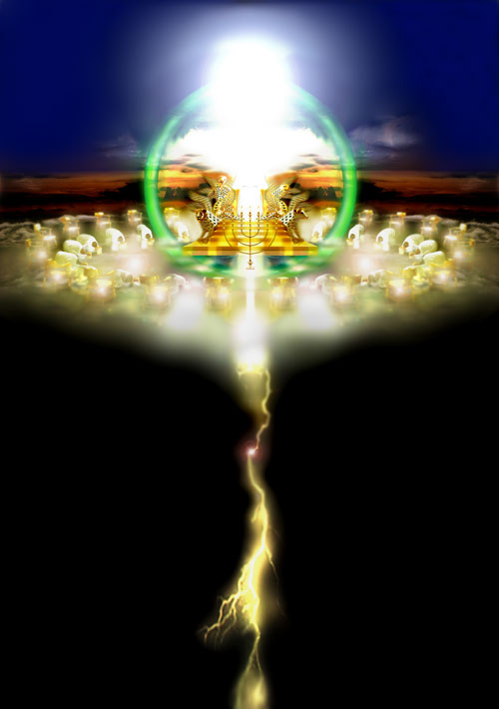
seek the things that are above,
where Christ is,
seated at the right hand of God.
² Set your minds on things that are above,
not on things that are on earth.

Slide 4
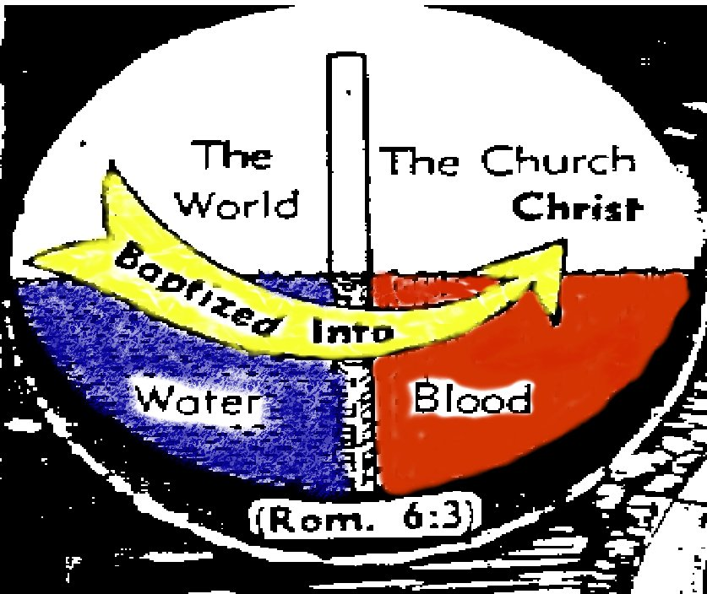
³ For you have died, and your life is hidden with Christ in God.

Slide 5
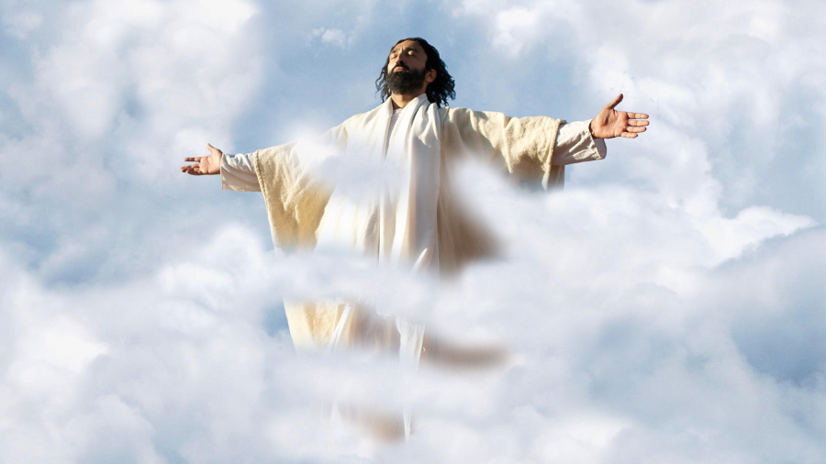
⁴ When Christ who is your life appears, then you also will appear with him in glory.

Slide 6
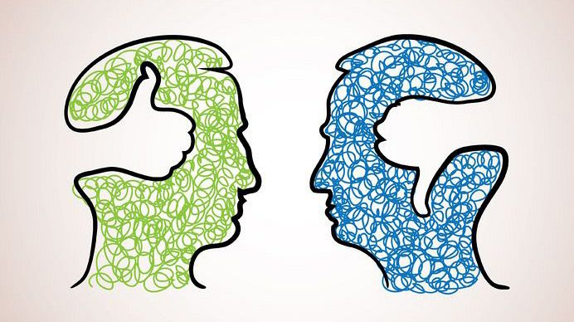
⁵ Put to death therefore what is earthly in you:
sexual immorality,
impurity,
passion,
evil desire, and
covetousness,
which is idolatry.

Slide 7
⁶ On account of these the wrath of God is coming.

Slide 8
⁷ In these you too once walked, when you were living in them.

Slide 9
⁸ But now you must put them all away:
anger,
wrath,
malice,
slander, and
obscene talk from your mouth.
⁹ Do not lie to one another,
seeing that you have put off the
old self with its practices

Slide 10
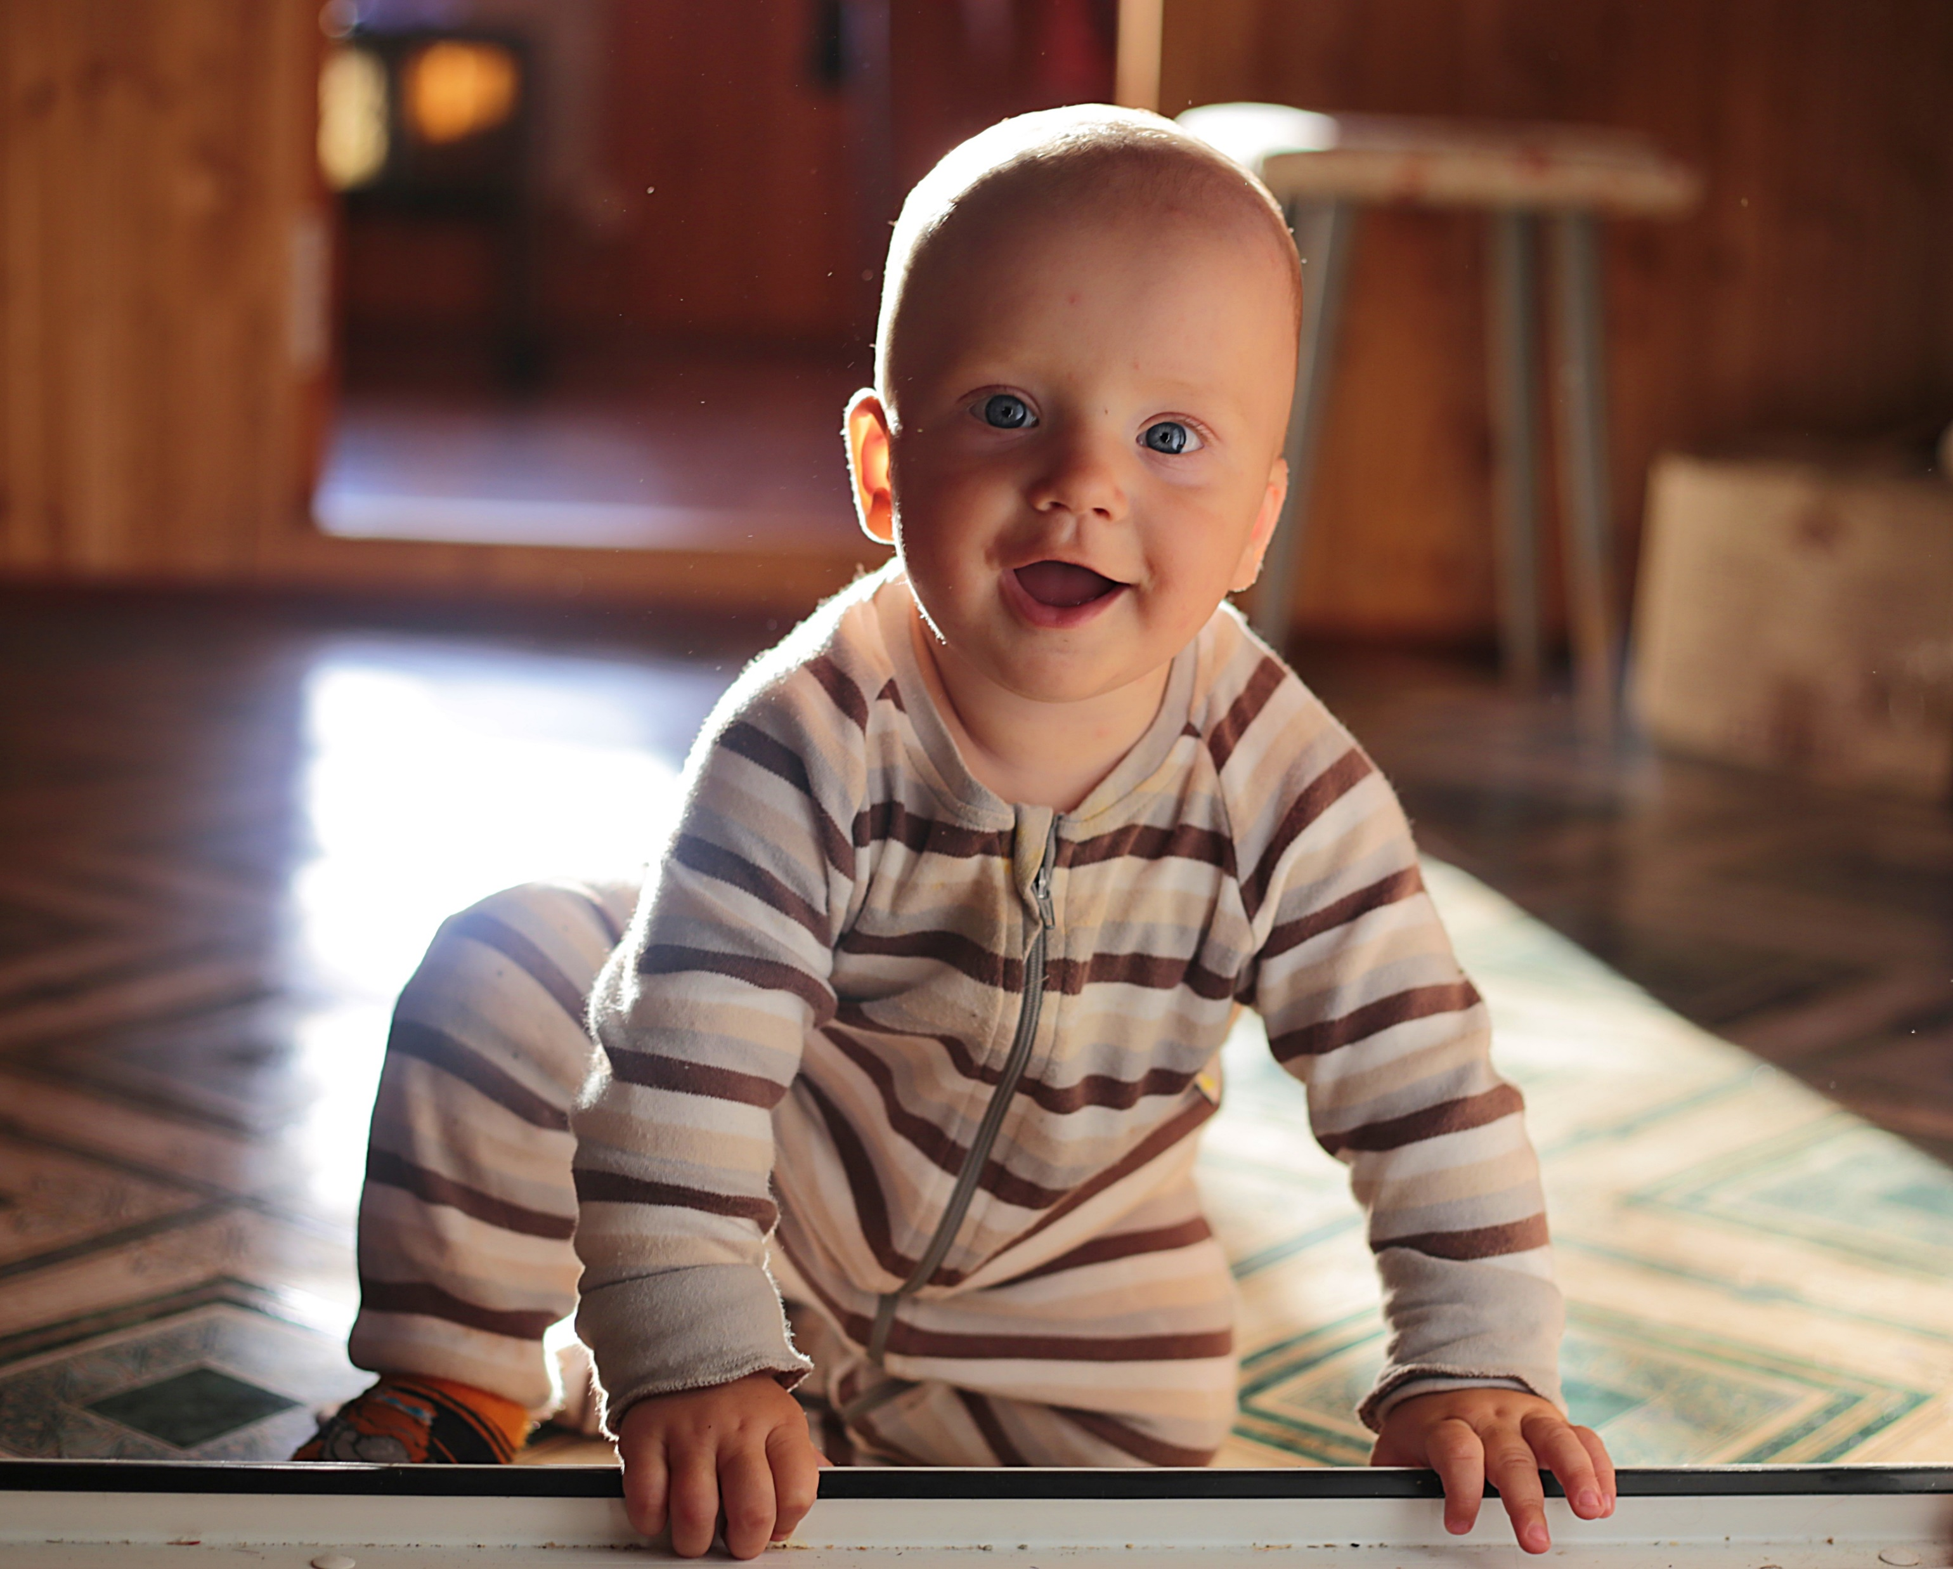
¹⁰ and have put on the new self, which is being renewed in knowledge after the image of its creator.

Slide 11
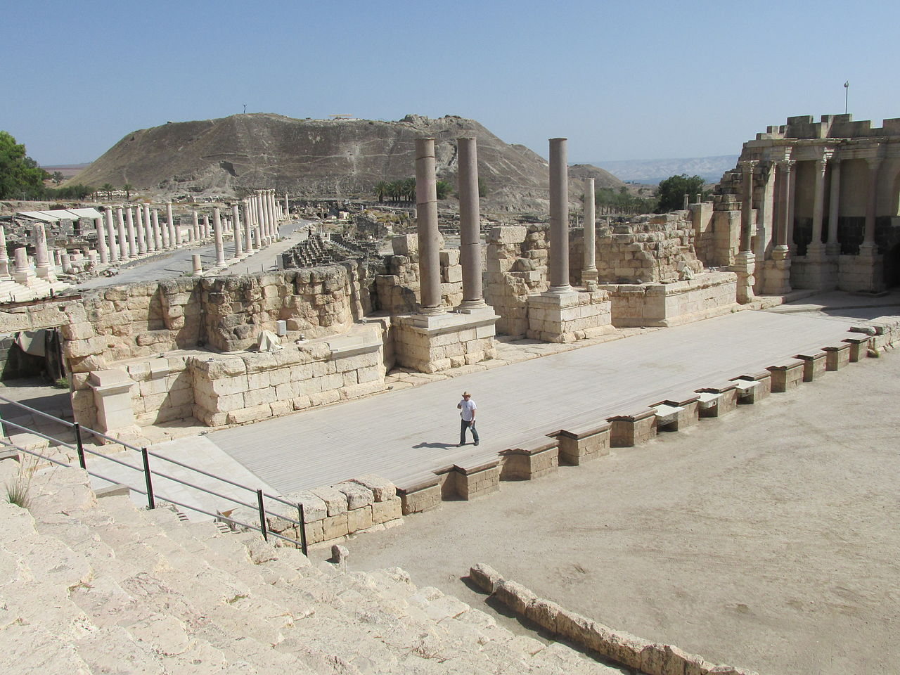
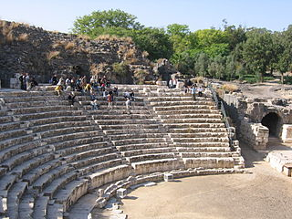
¹¹ Here there is not Greek and Jew, circumcised and uncircumcised, barbarian, Scythian, slave, free;

Slide 12
but Christ is all, and in all.

Slide 13
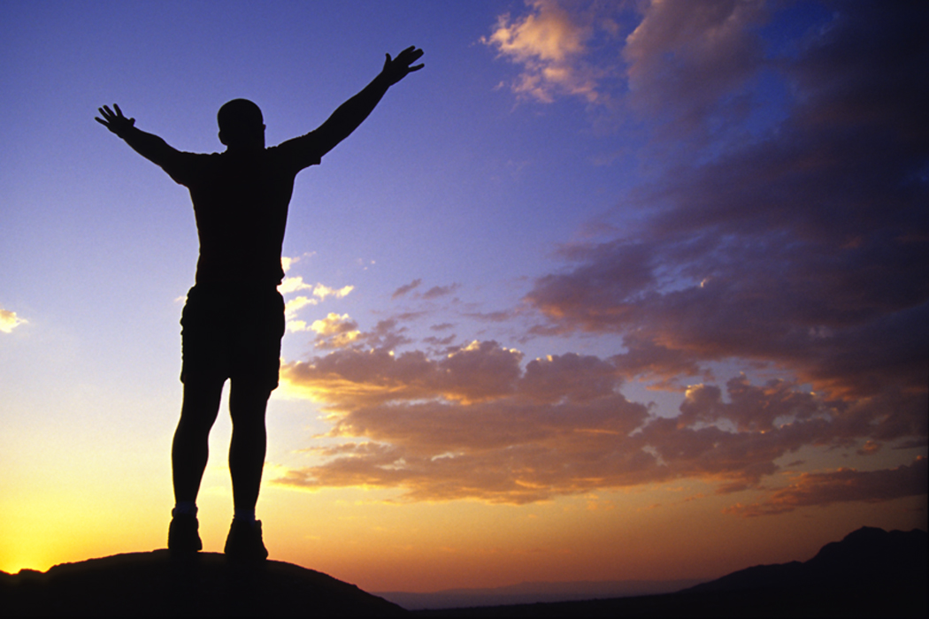
¹² Put on then, as God's chosen ones, holy and beloved,
compassionate hearts,
kindness,
humility,
meekness, and patience,
¹³ bearing with one another and,
if one has a complaint against another, forgiving each other;
as the Lord has forgiven you, so you also must forgive.

Slide 14
¹⁴ And above all these put on love, which binds everything together in perfect harmony.

Slide 15
¹⁵ And let
the peace of Christ
rule in your hearts,
to which indeed you were called in one body. And be thankful.

Slide 16
¹⁶ Let the word of Christ dwell in you richly,
teaching and admonishing one another
in all wisdom,
singing psalms and hymns and spiritual songs,
with thankfulness in your hearts to God.

Slide 17
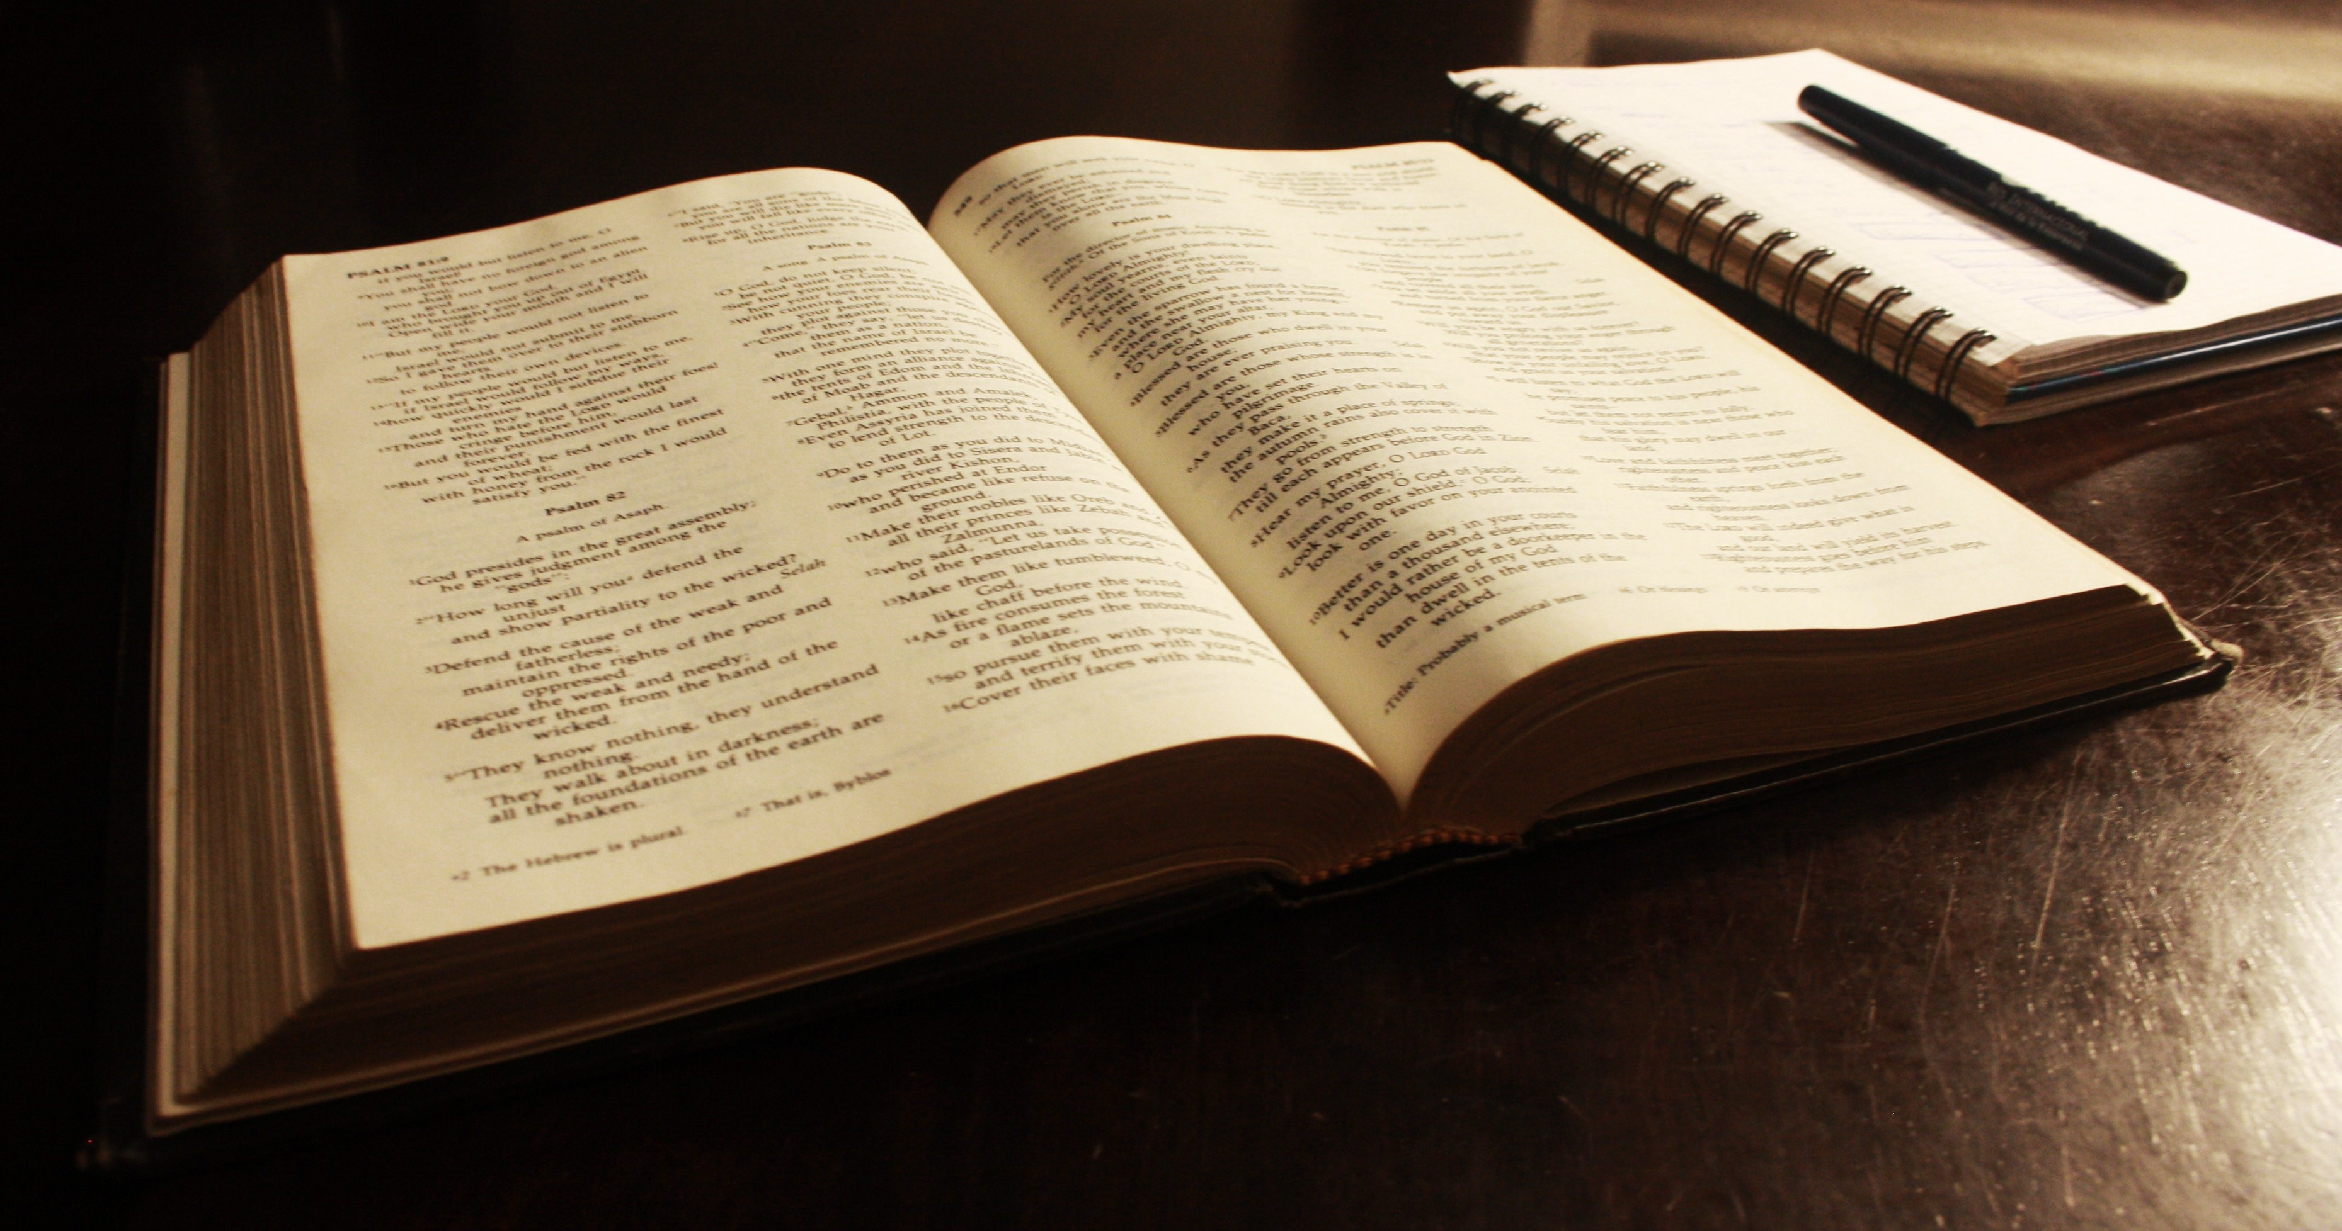
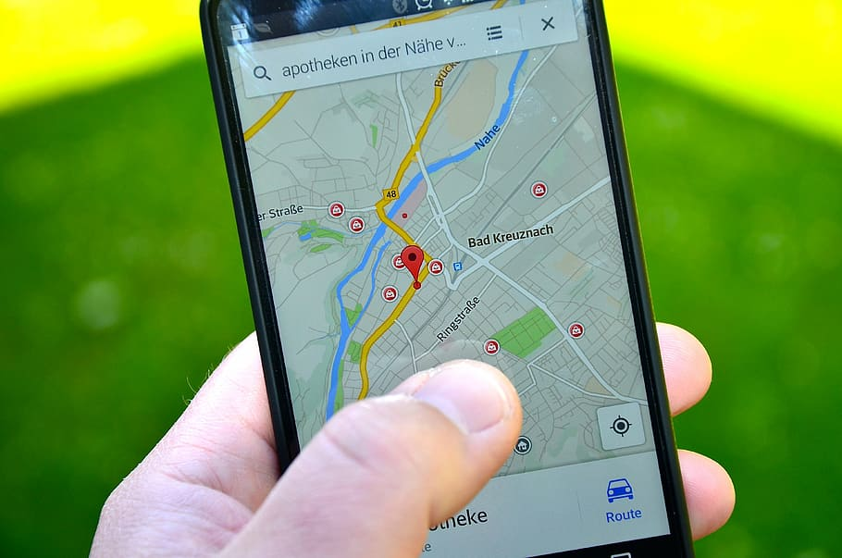
¹⁷ And whatever you do, in word or deed, do everything in the name of the Lord Jesus, giving thanks to God the Father through him.
¹⁷ And whatever you do, in word or deed, do everything in the name of the Lord Jesus, giving thanks to God the Father through him.

Slide 18
Colossians 3
If then
you have been raised with Christ,

