Slide 1
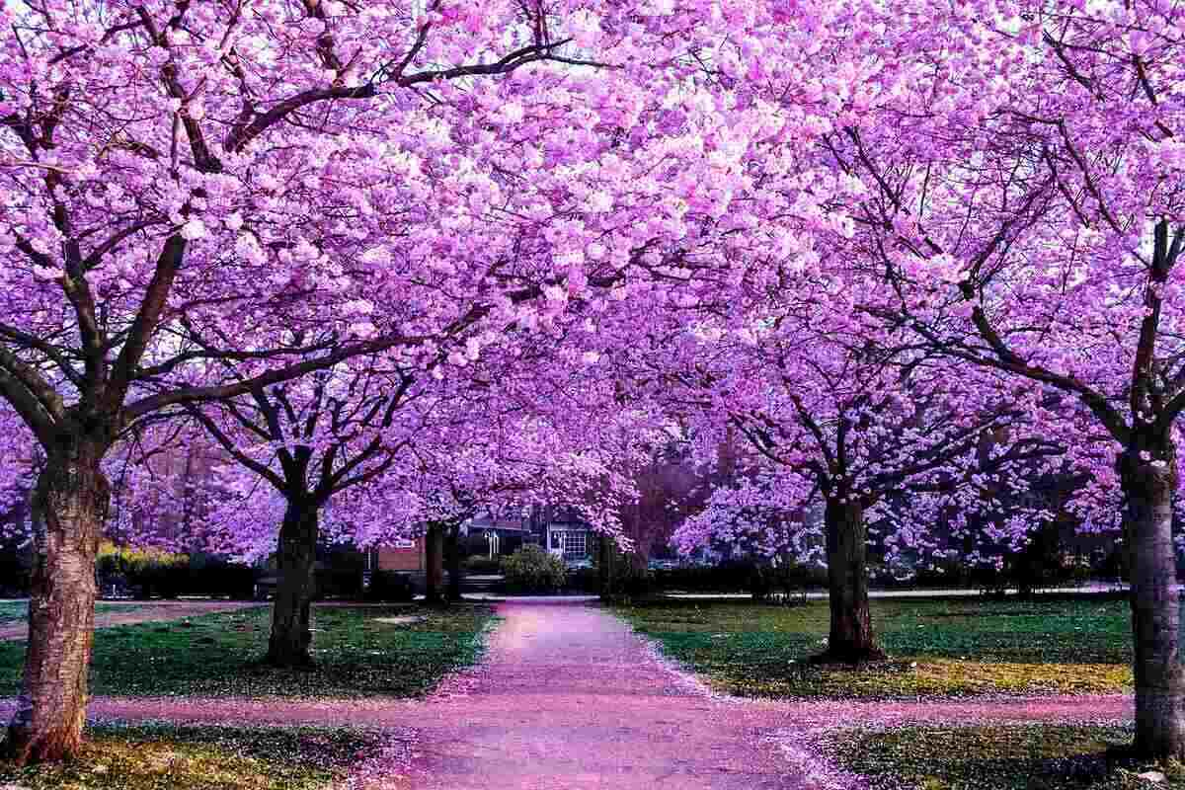

Slide 2
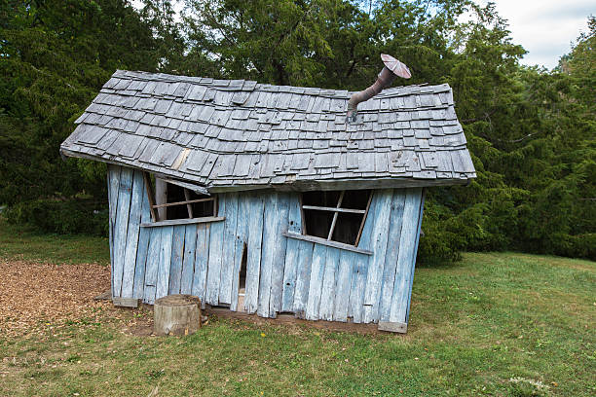

Slide 4
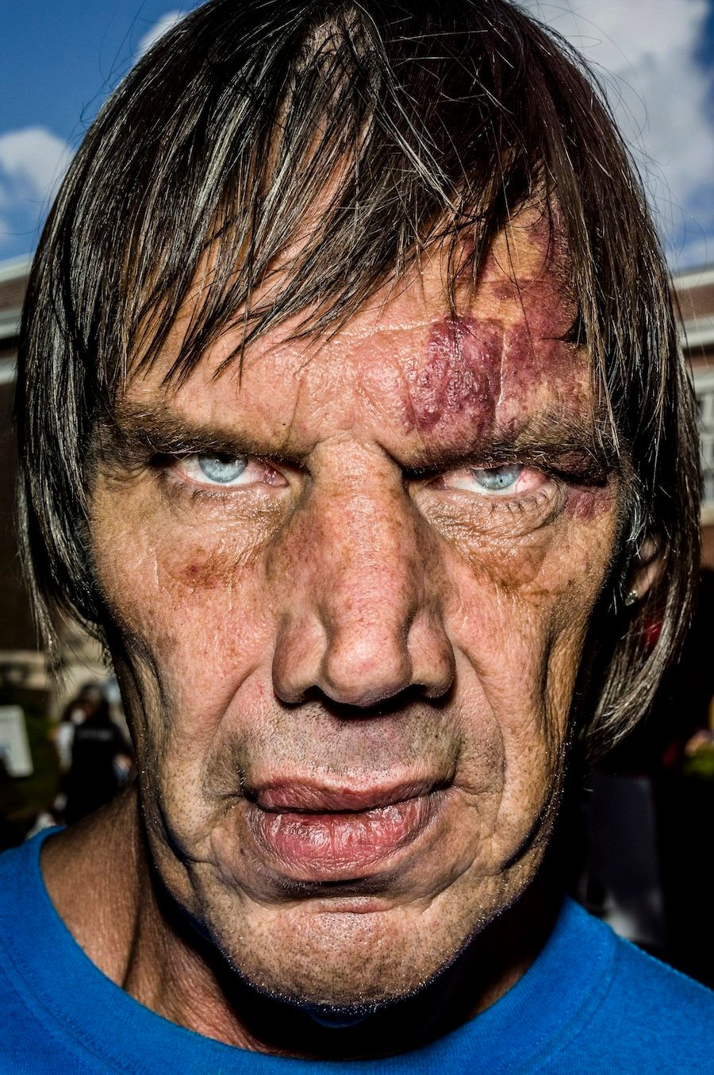
James 1:17
Notes:
God makes plans for us that
are EXTREME and beyond the normal.
But we can trust His plan because.
How can we know this?
Jas 1:17 Every good gift and every perfect gift is from above, and comes down from the Father of lights, with whom there is no variation or shadow of turning. (NKJV)
We need to realize that God’s desire for us is ONLY GOOD.
He is
faithful,
trustworthy, and
He does NOT look for ways to just catch us in our sin,
He wants us to live life with extreme joys
He alone can help us to fly high to the heavens.
His plan is the only plan that works.

Slide 5
God Made the Eternal Plan
1 John
He plans for our redemption 1:8-10
He plans for our purity 2:1-2
He plans for our righteousness 2:3-6
He plans for our holy 2:15-16
He plans for our love relationship 3:1-2
He plans for our empowered love 3:16-24
Notes:
God’s made eternal Plan clear:
People are made for relationships (with Him and each other)
People interfere with those relationships because of sin
His plan redeems us from our sin, our guilt, our bad attitudes (1 Jn 1.8-10)
His plan makes us pure (1 Jn 2.1-2)
His plan makes us righteous (1 Jn 2.3-6)
His plan makes us holy (1 Jn 2.15-16)
His plan gives us love (1 Jn 3.1-2)
His plan empower us to love as He loves (3:16-18, 23-24)
1Jo 3:16 By this we know love, because He laid down His life for us. And we also ought to lay down our lives for the brethren.
17 But whoever has this world's goods, and sees his brother in need, and shuts up his heart from him, how does the love of God abide in him?
18 My little children, let us not love in word or in tongue, but in deed and in truth.
1Jo 3:23 And this is His commandment: that we should believe on the name of His Son Jesus Christ and love one another, as He gave us commandment.
24 Now he who keeps His commandments abides in Him, and He in him. And by this we know that He abides in us, by the Spirit whom He has given us.
Blueprints #2 Page 5

Slide 6
God’s House Matches His Plan
God can make us what He wants
God can change us how He wants
God can use us when He wants
God can take us where He wants
We belong to God, not to ourselves!
Luke 17:7-10
Notes:
God can make us what He wants
God can change us how He wants
God can use us when He wants
God can take us where He wants
We belong to God, not to ourselves!
We belong to God, not to ourselves!
He has TOTAL say in the consequences coming
and where we will spend eternity
Lu 17:7 "And which of you, having a servant plowing or tending sheep, will say to him when he has come in from the field, 'Come at once and sit down to eat'?
8 "But will he not rather say to him, 'Prepare something for my supper, and gird yourself and serve me till I have eaten and drunk, and afterward you will eat and drink'?
9 "Does he thank that servant because he did the things that were commanded him? I think not.
10 "So likewise you, when you have done all those things which you are commanded, say, 'We are unprofitable servants. We have done what was our duty to do.'"
Lk 17.7-10 – “we are worthless servants; we’ve only done our duty!”
Respect for authority and learning to honor those in power over us, is disappearing quickly from our world.
This is supposed to be learned early in life!
The break down of homes has caused this cascade of disaster!
Blueprints #2 Page 6

Slide 7
Only God’s Plan Works
This is the difference between the two builders in Jesus’ story (Matthew 7.24-27)
Built God’s way has a foundation
Built God’s way last forever
Built God’s way stands up to adversity
We must be built according to God’s blueprints
Notes:
Mt 7:24 "Therefore whoever hears these sayings of Mine, and does them, I will liken him to a wise man who built his house on the rock:
25 "and the rain descended, the floods came, and the winds blew and beat on that house; and it did not fall, for it was founded on the rock.
26 "But everyone who hears these sayings of Mine, and
does not do them, will be like a foolish man who built his house on the sand:
27 "and the rain descended, the floods came, and the winds blew and beat on that house; and it fell. And great was its fall."
(NKJV)
When we let Him build us…
God’s way has a foundation
God’s way last forever
God’s way stands up to adversity
We must be built according to God’s blueprints

Slide 8
Which will it be for me?
Notes:
Jas 1:17 Every good gift and every perfect gift is from above, and comes down from the Father of lights, with whom there is no variation or shadow of turning. (NKJV)
We need to realize that God desires for us ONLY GOOD.
He is faithful, trustworthy, and look for ways to just catch us,
He causes us to fly. His plan is the only plan that works.
Blueprints #2 Page 8

Slide 9
Read Ezekiel 16 at home
Notes:
Some of the times, there is need for small repair on a house that is being fixed up but other times there is the need for a major overhaul. We’ll talk about the overhaul and next we’ll talk about the small repairs.
Transformation hurts
Isaiah having lips touch with hot coal in Is 6
Israelites having to be snake bit to learn not to complain Num. 21
Being made right hurts
A person must first be demolished and destroyed
Joseph with years in prison
Moses with 40 years in wilderness
David with 13 years on the run
Then one can be rebuilt or reborn
Ezekiel 16, I will not read it here due to it’s graphic intensity.
It gives shocking radical illustration of how God views His relationship with His broken people, His bride.
It screams with full visual volume how broken and despicable we treat Him after He gives us so much.
It shows in a physical illustration how He wants to treat His bride and how horrible we repay Him and yet His willingness to forgive again.

Slide 10
Death and then Life
John 12.24-26; Mt. 16:25
John 11:25; 1Cor. 15:28
John 3:1-13
Jesus’ speaking to Nicodemus
Baptism is this picture
Notes:
We must learn to die:
Joh 12:24 "Most assuredly, I say to you,
unless a grain of wheat falls into the
ground and dies, it remains alone;
but if it dies, it produces much grain.
25 "He who loves his life will lose it, and
he who hates his life in this world
will keep it for eternal life.
26 "If anyone serves Me, let him follow Me; and where I am, there My servant will be also. If anyone serves Me, him My Father will honor.
Mt 16:25 "For whoever desires to save his life will lose it, but whoever loses his life for My sake will find it.
Joh 11:25 Jesus said to her, "I am the resurrection and the life. He who believes in Me, though he may die, he shall live.
1Co 15:28 Now when all things are made subject to Him, then the Son Himself will also be subject to Him who put all things under Him, that God may be all in all. (NKJV)
Jesus and Nicodemus (Jn 3.1-13)
Born again - By water and spirit
Must be born of the spirit
He had free will to choose and did not believe.
Baptism is this picture - Ro 6:3 Or do you not know that as many of us as were baptized into Christ Jesus were baptized into His death?
4 Therefore we were buried with Him through baptism into death, that just as Christ was raised from the dead by the glory of the Father, even so we also should walk in newness of life. 5 For if we have been united together in the likeness of His death, certainly we also shall be in the likeness of His resurrection,
6 knowing this, that our old man was crucified with Him, that the body of sin might be done away with, that we should no longer be slaves of sin. 7 For he who has died has been freed from sin. Col 2:12 buried with Him in baptism, in which you also were raised with Him through faith in the working of God, who raised Him from the dead. (NKJV)

Slide 11
Once Someone is dead
How can they live for themselves again
How can they continue to sin
1John 3:9; 5:18-20
John 5:14; 8:11
Notes:
Dead people do not live for themselves
Dead people do not sin anymore
Once we die to self and sin,
how do we live for it again?
1Jo 3:9 Whoever has been born of God does not sin, for His seed remains in him; and he cannot sin, because he has been born of God.
1Jo 5:18 We know that whoever is born of God does not sin; but he who has been born of God keeps himself, and the wicked one does not touch him.
19 We know that we are of God, and the whole world lies under the sway of the wicked one.
20 And we know that the Son of God has come and has given us an understanding, that we may know Him who is true; and we are in Him who is true, in His Son Jesus Christ. This is the true God and eternal life.
Jesus tells blind man
Joh 5:14 …"See, you have been made well. Sin no more, lest a worse thing come upon you.“
… adulterous woman Joh 8:11 go and sin no more.

Slide 12
Rebirth is Glorious
We’ve had our slate made clean
Heb. 8:12; 10:17
We’ve had our sins forgotten
We’ve been reborn
Tit. 3:4-5; Rom. 6:4; 2Cor. 5:17
We’ve been recreated
Notes:
We’ve had our slate made clean (Acts 2.38; 1 Peter 3.21)
We’ve had our sins forgotten
Heb 8:12 "For I will be merciful to their unrighteousness, and their sins and their lawless deeds I will remember no more."
Heb 10:17 then He adds, "Their sins and their lawless deeds I will remember no more."
We’ve been reborn
Tit 3:4 But when the kindness and the love of God our Savior toward man appeared,
5 not by works of righteousness which we have done, but according to His mercy He saved us, through the washing of regeneration and renewing of the Holy Spirit,
Ro 6:4 Therefore we were buried with Him through baptism into death, that just as Christ was raised from the dead by the glory of the Father, even so we also should walk in newness of life.
We’ve been recreated 2Co 5:17 Therefore, if anyone is in Christ, he is a new creation; old things have passed away; behold, all things have become new. (NKJV)

Slide 13
Notes:
If I had a car with the engine that was ready for the grave,
I'd have a new engine put in.
I'd take the car into a mechanic who would put it in for me.
If when I got that car back, it ran just as poorly, I'd begin to wonder if the old really had been replaced or just cleaned up. It is not different with our new lives in Christ.

