Slide 2
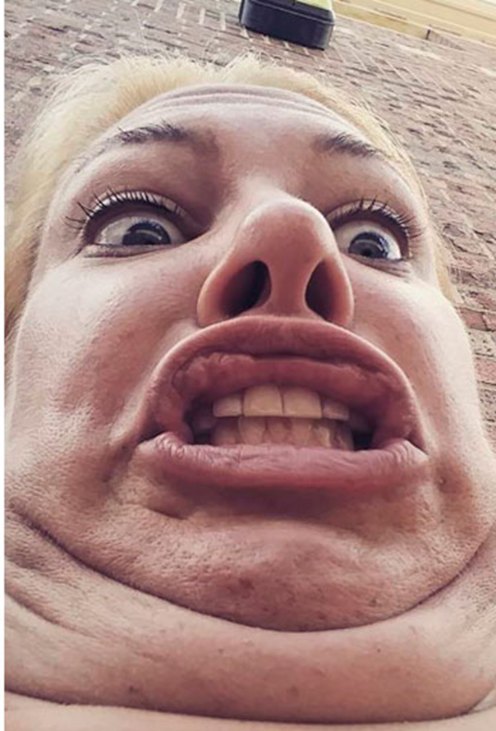
Read Ezekiel 16 at home
Notes:
Some of the times, there is need for small repair on a house that is being fixed up but other times there is the need for a major overhaul. First the overhaul and next we’ll talk about the small repairs.
Transformation hurts
Isaiah having lips touch with hot coal in Isa. 6
Israelites having to be snake bit to learn not to complain Num. 21
Being made right hurts
A person must first be demolished and destroyed
Joseph with years in prison
Moses with 40 years in wilderness
David with 13 years on the run
Then one can be rebuilt or reborn
Ezekiel 16, I will not read it here due to it’s graphic intensity.
It gives shocking radical illustration of how God views His relationship with His broken people, His bride.
It screams with full visual volume how broken and despicable we treat Him after He gives us so much.
It shows in a physical illustration how He wants to treat His bride and how horrible we repay Him and yet His willingness to forgive again.

Slide 3
Death and then Life
John 12.24-26; Mt. 16:25
John 11:25; 1Cor. 15:28
John 3:1-13
Jesus’ speaking to Nicodemus
Baptism is this picture
Notes:
We must learn to die:
Joh 12:24 "Most assuredly, I say to you,
unless a grain of wheat falls into the
ground and dies, it remains alone;
but if it dies, it produces much grain.
25 "He who loves his life will lose it, and
he who hates his life in this world
will keep it for eternal life.
26 "If anyone serves Me, let him follow Me; and where I am, there My servant will be also. If anyone serves Me, him My Father will honor.
Mt 16:25 "For whoever desires to save his life will lose it, but whoever loses his life for My sake will find it.
Joh 11:25 Jesus said to her, "I am the resurrection and the life. He who believes in Me, though he may die, he shall live.
1Co 15:28 Now when all things are made subject to Him, then the Son Himself will also be subject to Him who put all things under Him, that God may be all in all. (NKJV)
Jesus and Nicodemus (Jn 3.1-13)
Born again - By water and spirit
Must be born of the spirit
He had free will to choose and did not believe.
Baptism is this picture - Ro 6:3 Or do you not know that as many of us as were baptized into Christ Jesus were baptized into His death?
4 Therefore we were buried with Him through baptism into death, that just as Christ was raised from the dead by the glory of the Father, even so we also should walk in newness of life. 5 For if we have been united together in the likeness of His death, certainly we also shall be in the likeness of His resurrection,
6 knowing this, that our old man was crucified with Him, that the body of sin might be done away with, that we should no longer be slaves of sin. 7 For he who has died has been freed from sin. Col 2:12 buried with Him in baptism, in which you also were raised with Him through faith in the working of God, who raised Him from the dead. (NKJV)

Slide 4
Once Someone is dead
How can they “live for themselves” again
How can they continue to sin
1John 3:9; 5:18-20
John 5:14; 8:11
Notes:
Dead people do not live for themselves
Dead people do not sin anymore
Once we die to self and sin,
how do we live for it again?
1Jo 3:9 Whoever has been born of God does not sin, for His seed remains in him; and he cannot sin, because he has been born of God.
If we have died to sin, we WILL NOT EVER
become a servant of sin again
Sin again…yes; servant of sin again…NO!
1Jo 5:18 We know that whoever is born of God does not sin; but he who has been born of God keeps himself, and the wicked one does not touch him.
19 We know that we are of God, and the whole world lies under the sway of the wicked one.
20 And we know that the Son of God has come and
has given us an understanding,
that we may know Him who is true; and
we are in Him who is true, in His Son Jesus Christ. This is the true God and eternal life.
Jesus tells blind man
Joh 5:14 …"See, you have been made well. Sin no more, lest a worse thing come upon you.“
… adulterous woman Joh 8:11 go and sin no more.

Slide 5
Rebirth is Glorious
We’ve had our slate made clean
Heb. 8:12; 10:17
We’ve had our sins forgotten
We’ve been reborn
Tit. 3:4-5; Rom. 6:4; 2Cor. 5:17
We’ve been recreated
Notes:
We’ve had our slate made clean
(Acts 2.38; 1 Peter 3.21)
We’ve had our sins forgotten
Heb 8:12 "For I will be merciful to their unrighteousness, and their sins and their lawless deeds I will remember no more."
Heb 10:17 then He adds, "Their sins and their lawless deeds I will remember no more."
We’ve been reborn
Tit 3:4 But when the kindness and the love of God our Savior toward man appeared,
5 not by works of righteousness which we have done, but according to His mercy He saved us, through the washing of regeneration and renewing of the Holy Spirit,
Ro 6:4 Therefore we were buried with Him through baptism into death, that just as Christ was raised from the dead by the glory of the Father, even so we also should walk in newness of life.
We’ve been recreated 2Co 5:17 Therefore, if anyone is in Christ, he is a new creation; old things have passed away; behold, all things have become new. (NKJV)

Slide 7
Small Repairs
Often the most tedious of all repairs
Often the most time-consuming
Rarely gets the attention it deserves
Notes:
Often the most tedious of all repairs
Detail oriented
Blending into other work
Like blending in popcorn ceilings
Often the most time-consuming
Rarely brings satisfaction
People notice when a wall gets torn down
People rarely notice a great blend on a paint job
This is how it is for most Christians growing up in the church
We’ve lived decent lives
We’ve made small changes
We’ve never had to “tear down walls”
Highly influenced by parent/mentor’s judgements
Truth may have been instilled in from childhood, very little change.
Thus can not relate to the trauma of demo and rebuild job
Sometimes appear condescending or arrogant.
The major change needed in attitudes, perspective and understanding.
A great example of this is Joshua (does a lot right)
With Moses at the Mt.
With chosen men who spied the land
Saw the mighty works of God
When he starts to lead, he falters
Sends in spies
Promise to Rahab causes failure of God’s plan
Israel’s need for circumcision
Fails to check with God on the Gibeonites
While following Moses, he was faithful in every way, but when on his own, his faith faltered and caused trouble

Slide 8
Doing Small Repairs
Creates lasting change ONLY when motivated by God
Can bring the greatest good when it originates from faith from God’s word. Rom. 10:17
Only God can make the greatest long-term difference
Phil 2:14-17 – have real love for one another
Compare Romans 1 & 2
Notes:
We may come to think…
Doing the small repairs creates lasting change
When we make “our faith our own”
that faith will last
It is important
to study why we believe
to let kids ask questions and wonder
to encourage deep discussions and
not just continual overview of first principles
Doing the small repairs has the greatest influence when…
Phil 2.14 – no grumbling
Php 2:14 Do all things without complaining and disputing,
Deut 6
Shall be in your heart first then teach
Phil 2.15 – blameless, innocent, lights in the world
Php 2:15 that you may become blameless and harmless, children of God without fault in the midst of a crooked and perverse generation, among whom you shine as lights in the world,
Notice the influence comes from the perspective change that leads to no grumbling
Doing the small repairs is what makes the greatest long-term difference
Phil 2.16 –holding fast the word of life, so that I may rejoice in the day of Christ that I have not run in vain or labored in vain.
The small change also causes the person to hold fast
Phil 2.17 – even will lead to the willingness to suffer and die for faith
Php 2:17 Yes, and if I am being poured out as a drink offering on the sacrifice and service of your faith, I am glad and rejoice with you all.
We MUST NOT FORGET, KNOWING GOD and WALKING with Him in His Light is the ONLY light we should grope, seek!

Slide 9
Small Repairs
Requires a “deep down” change
Requires attention to details
Requires focus on the goal
Requires following His example
Notes:
Requires a “deep down” change
Changes in faith and perspective are
deep changes, even though they look small
“Faith must become their own”
The ones who change this way are truly disciples to the core
Requires attention to details
This types of change will cause someone to truly strive to live sinlessly (1 Jn 1.8-2.2)
Sinless living is not to exalt self (earn heaven) but is a result of these changes
What do you truly believe at your core?
Requires focus on the goal
Heb 12.1-2 – fixing our eyes on Jesus
Goal is not “heaven” but the glory of God
God is glorified by our lives lived for Him
God is glorified by our entering heaven
God is glorified by our baptisms, and faithful living
God is glorified by the small changes we make in our lives
God is glorified by the internal changes we make to HONOR HIM!
Requires following His example
Jesus made the small changes in our life to truly be what God intended Him to be
You never see Jesus let up on faithfulness because He truly understood and believed.

Slide 10
Serving God is never a life focused upon me.
Upon world
Upon family heritage or DNA.
Upon security in this world.
Upon conveniences.
Upon personal achievements that bring fame or $.
He will fix us up into His glory if we allow God to be our
Master and we become His slave
Potter and we become a soft clay yielding to His touch.
Carpenter and we let Him design, demolish, repair, fixup, build new, add on as much as possible to make us into a dwelling fit for a king.
Notes:
Serving God is never a life
focused upon me.
Upon world
Upon family heritage or DNA.
Upon security in this world.
Upon conveniences.
Upon personal achievements that bring fame or $.
It is ALL ABOUT…
Serving God and letting Him fix us up into His glory…
Must allow God to be our…
Master and we become His slave
Potter and we become a soft clay yielding to His touch.
Carpenter and we let Him
design,
demolish,
repair,
fixup,
build new,
add on as much as possible to make us into a dwelling fit for a king.

Slide 11
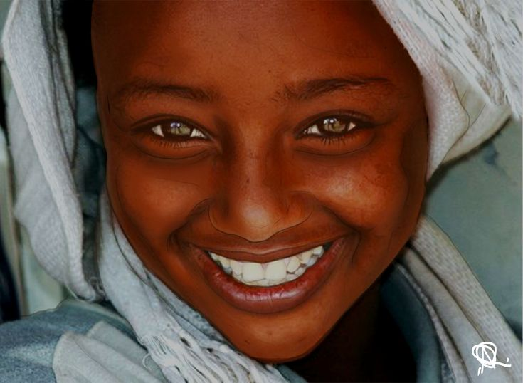
Romans 3:9-23; 6:23
Notes:
Nicodemus was leader among the Jews.
He probably thought he needed
some repairs,
tweaking,
To change a few things.
Jesus said “BORN AGAIN” – no clear record of what he did.
So what do we see that God needs to do
to us,
with us to make us more like Him?
Most people do not like change especially MAJOR changes.
Not matter how who we are, what kind of history or track record we have, we NOT done enough to deserve heaven.
Ro 3:9 What then? Are we better than they? Not at all
. For we have previously charged both Jews and Greeks that they are all under sin.
10 As it is written: "There is none righteous, no, not one;
11 There is none who understands; There is none who seeks after God.
12 They have all turned aside; They have together become unprofitable; There is none who does good, no, not one."
13 "Their throat is an open tomb; With their tongues they have practiced deceit"; "The poison of asps is under their lips";
14 "Whose mouth is full of cursing and bitterness."
15 "Their feet are swift to shed blood;
16 Destruction and misery are in their ways;
17 And the way of peace they have not known."
18 "There is no fear of God before their eyes.“
3:23 for all have sinned and fall short of the glory of God, (NKJV)
Ro 6:23 For the wages of sin is death, but the gift of God is eternal life in Christ Jesus our Lord. (NKJV)

