Slide 1
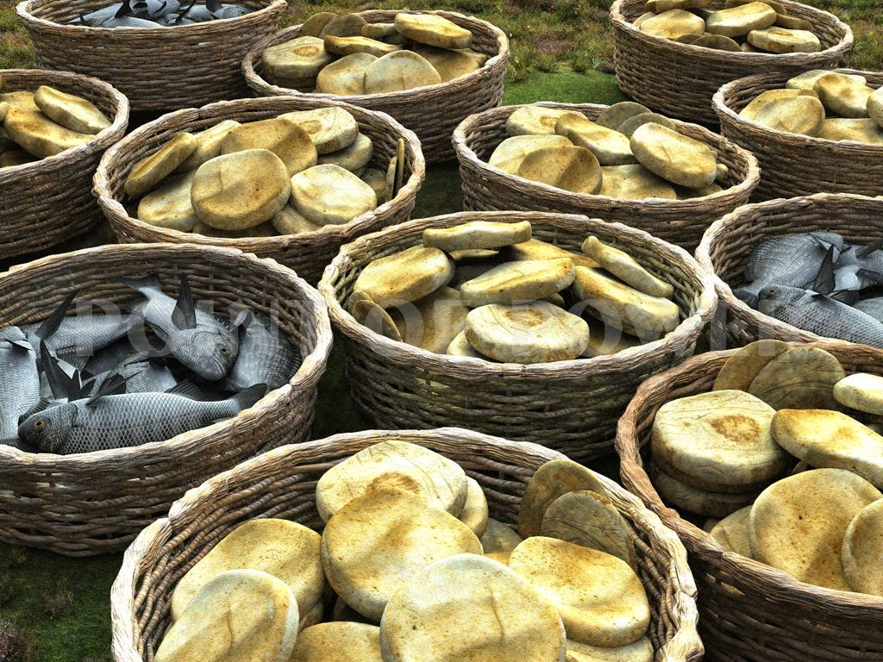
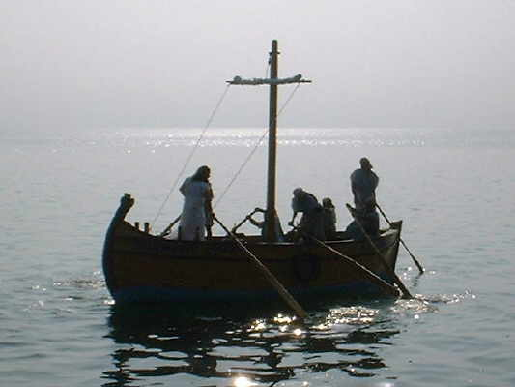
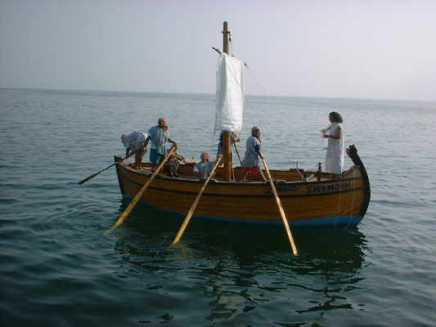
Notes:
Deep within,
do you think “there has got to me more to life?”
Is there something within you that says, I was made for something more than “this”?
Is there sometimes a gnawing feeling of “I have not reached my full potential yet?”
Jesus one day taught 1000s of people for the whole day & feeling compassion for them Jesus fed over 5000+ people with 5 loves and 2 fish. They liked that!
Joh 6:15 Therefore when Jesus perceived that they were about to come and
take Him by force to make Him king, He departed to the mountain by Himself alone.
Mt 14:22 Immediately Jesus made His disciples get into the boat and go before Him to the other side, while He sent the multitudes away.
23 And when He had sent the multitudes away, He went up on the mountain by Himself to pray. Now when evening came, He was alone there.
24 But the boat was now in the middle of the sea, tossed by the waves, for the wind was contrary.
25 Now in the fourth watch of the night Jesus went to them, walking on the sea.
26 And when the disciples saw Him walking on the sea, they were troubled, saying, "It is a ghost!" And they cried out for fear.
There were experienced fishermen afraid among them
27 But immediately Jesus spoke to them, saying, "Be of good cheer! It is I; do not be afraid."
28 And Peter answered Him and said, "Lord, if it is You, command me to come to You on the water."
29 So He said, "Come." And when Peter had come down out of the boat, he walked on the water to go to Jesus.
30 But when he saw that the wind was boisterous, (took eyes off Jesus) he was afraid; and beginning to sink he cried out, saying, "Lord, save me!"
31 And immediately Jesus stretched out His hand and caught him, and said to him, "O you of little faith, why did you doubt?“ Why did Jesu ask this?
32 And when they got into the boat, the wind ceased.
33 Then those who were in the boat came and worshiped Him, saying, "Truly You are the Son of God." (NKJV)
Mr 6:51 Then He went up into the boat to them, and the wind ceased. And they were greatly amazed in themselves beyond measure, and marveled.
52 For they had not understood about the loaves, because their heart was hardened.

Slide 2
Why would Peter do that?
Why did the 11 stay in the boat?
Matt 14:22-33
Notes:
Why would Peter do that?
Why did the eleven not do it?
As unlikely as it may seem, real security from God
comes when we have the ability to understand that
the ONLY REAL SECURITY is with God.
So Peter knew a better place to be was with the LORD, CREATOR & SUSTAINER
So he stepped out of the boat. And The others needed to learn this.
? Do we need to learn, this world is not a secure or safe place to put our trust?
How long will it take for us to learn that God alone can be fully trusted?!
Stepping out of the boat is the truest way to:
put our confidential trust and genuine deep faith in Him!
It is part of our developing our spiritual legs to walk with.
our heavenly focused eyes to see with…
our godly hands to work with…
our devoted hearts to serve with.
Today, just as he did that stormy night on the Sea of Galilee –
Christ seeks people willing to get out of the boat and walk with Him in faith.
Storms will come, nature happens and there will be risk, we may even fall, sink…
God promised us “I will never leave you nor forsake you”
What can man do to me?
What can this world do to me?
What do we have to fear?
But we can trust and reach out to our Savior and he will save us. He PROMISED
Also 1Cor. 10:13 No temptation…
But the truth is: if you want to walk on the water, put your eyes on Jesus and get out of OUR comfortable boat!

Slide 3
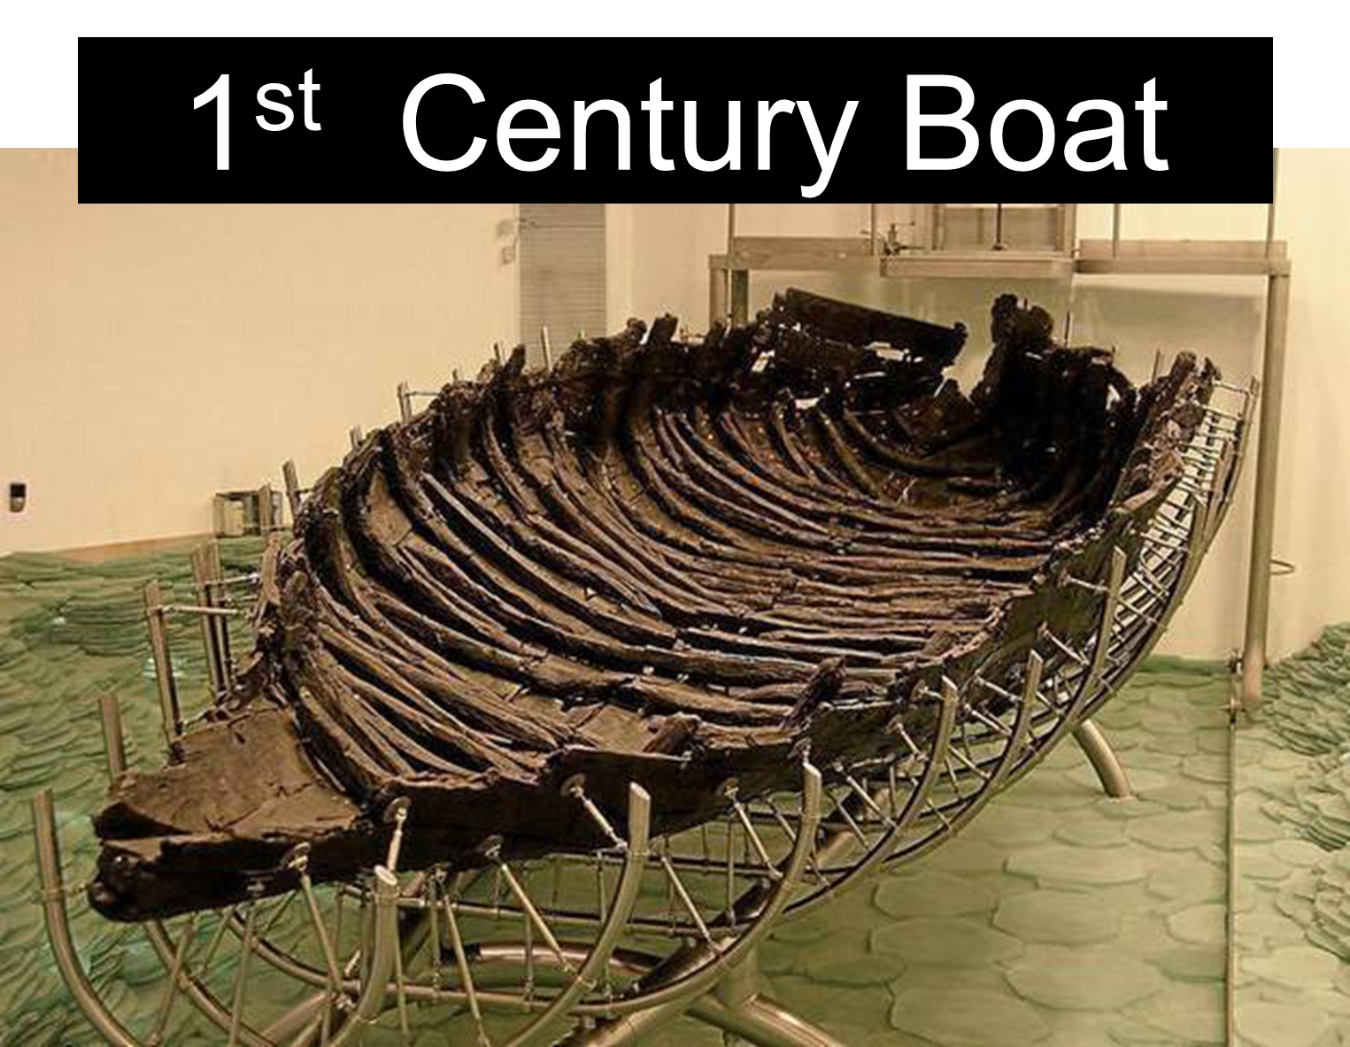
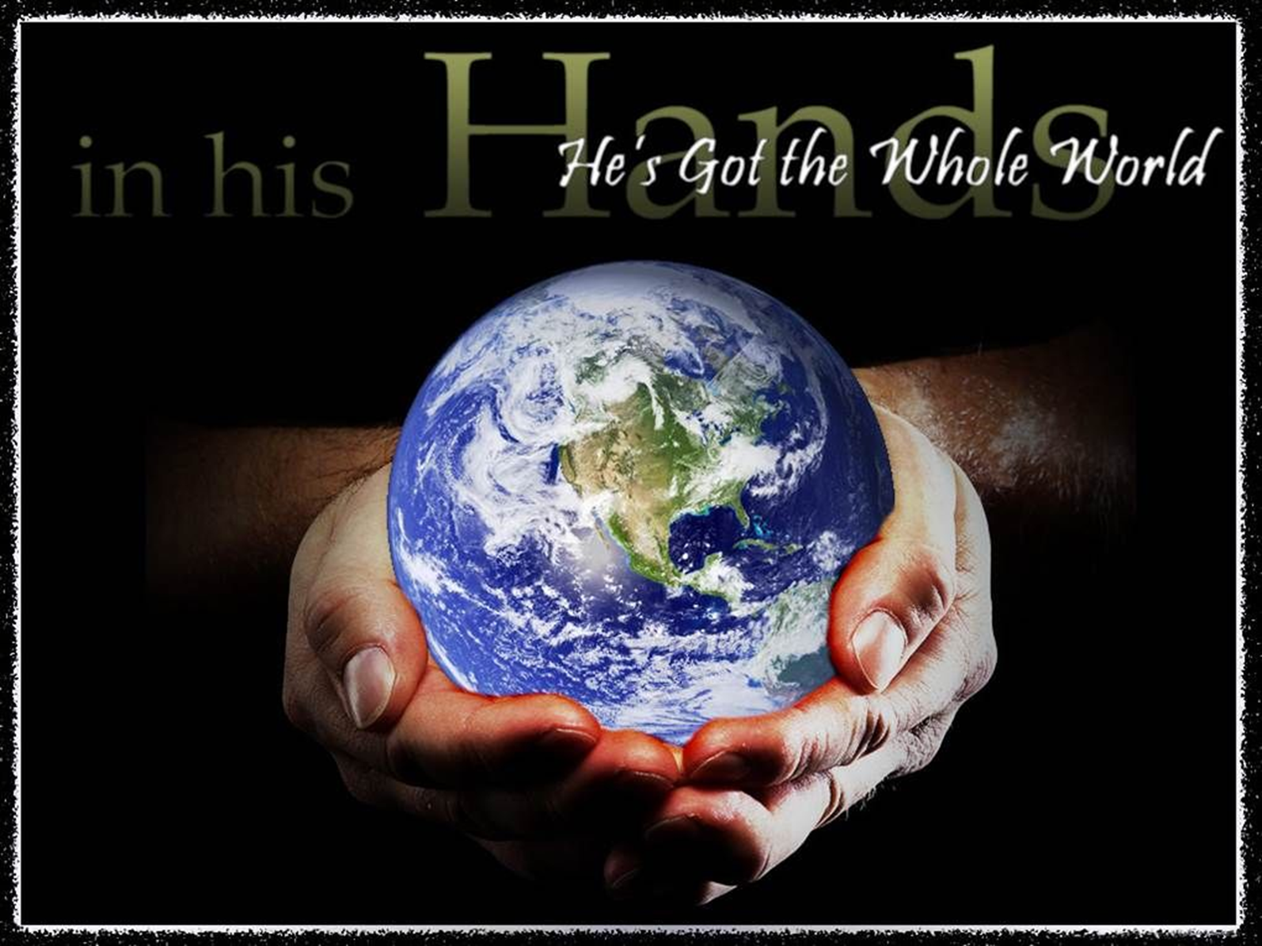
Notes:
When are we going realize…
Life is full of storms that tend handicap us with fear
We would like to believe it is limited to
food clothing as addressed in Matt. 6; 1Tim. 6 YET…
we let many other things stress us out and cause us to fear…
$ bills, politic, health, friends on social media, popularity, power, etc
We often put ourselves at risk of death and do not give it the smallest thought.
Why have we selected so many things to stress about to the point we will bump God to 2nd place maybe to back burner?
WHO gave us the freedom to do this? God!
?Where is our trust? Heart? Confidence?
Are we going to ever learn to step out of the boat and hold to God’s hand without filtering through our illogical minds?
OR… let the winds and trends lead us to destruction?
We forget Jesus commands the wind and storms!
<Earth day was yesterday was a festival at UNG. There was such great hype and all thinking man controls the earth>
God controls, commands and maintains this universe.
Man is the only creature on earth who can choice to deny His will.
So who will we follow, a world full of themselves or
A God who has maintained this universe for thousands of years.

Slide 4
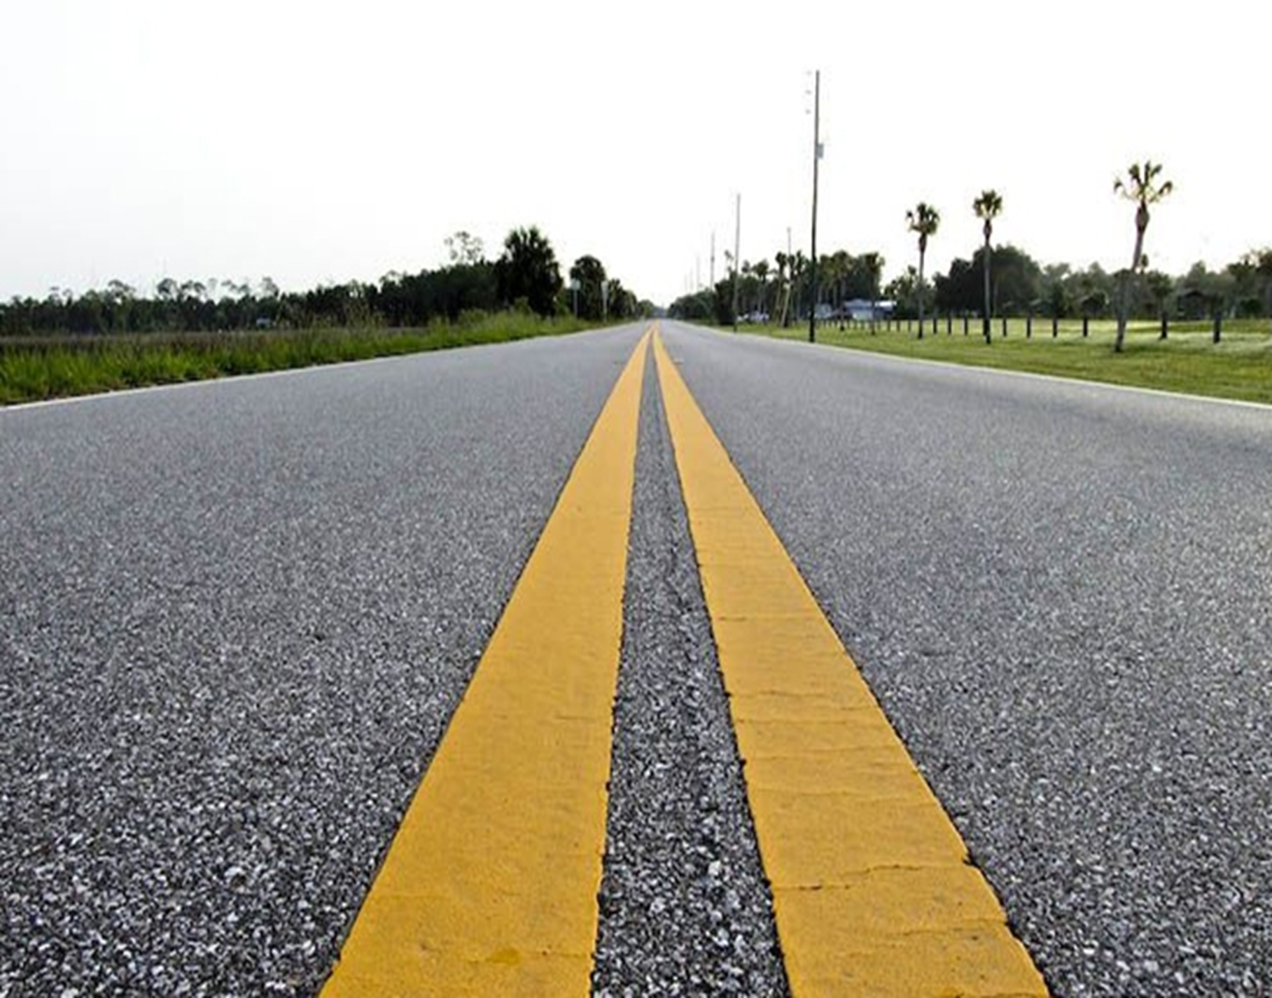
Notes:
Why should we put trust in the Boat?
Our boat that we trust in is:
Money, career path, investments, supportive relationship, self, education.
Why do we tend float in these boats?
Familiar
Expected-I do not want to look weird
Boat seems for the moment to be the safest place to be.
Easier, already here, why upset the other’s expectations?
It seems Reasonable course of action
Majority is here with me
Less stressful than going against nature.
No one has ever walked on water before
Just because Jesus does it, does not mean I can!
The old excuse “I tried it once and it not work, no need to try.”
Fear shackles us
Fear enslaves us
Fear keeps us from stepping out of the boat!
Yet …we commonly step out in faith with many things.
Every time ride in a car we literally are inches away from a head on collision of death. Only paint stripe prevents this? Really? Faith in other person respecting paint?!
We get on a plane knowing there is only one extremely difficult way of landing that will allow everyone to live. A plane goes against nature.
We trust powerful chemicals we put in our bodies just because a doctor prescribed them. One reasons Dr. are so expensive is because of malpractice insurance. Why? 100’s more

Slide 5
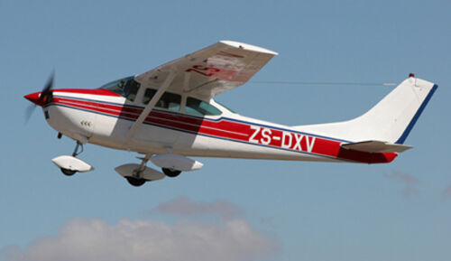
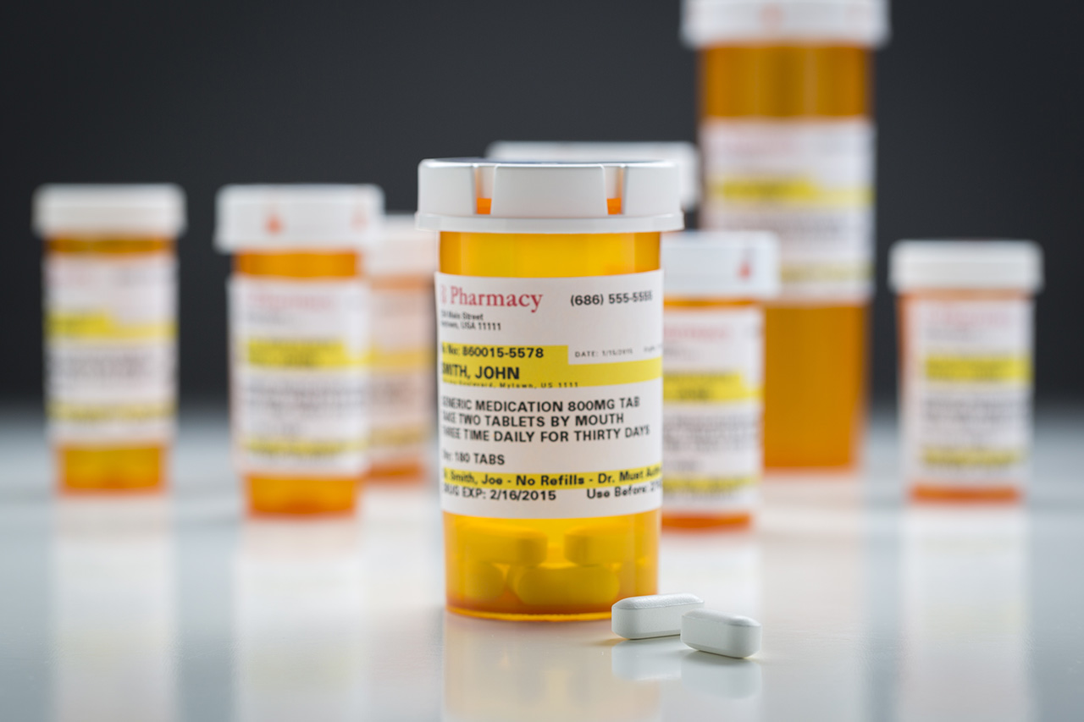
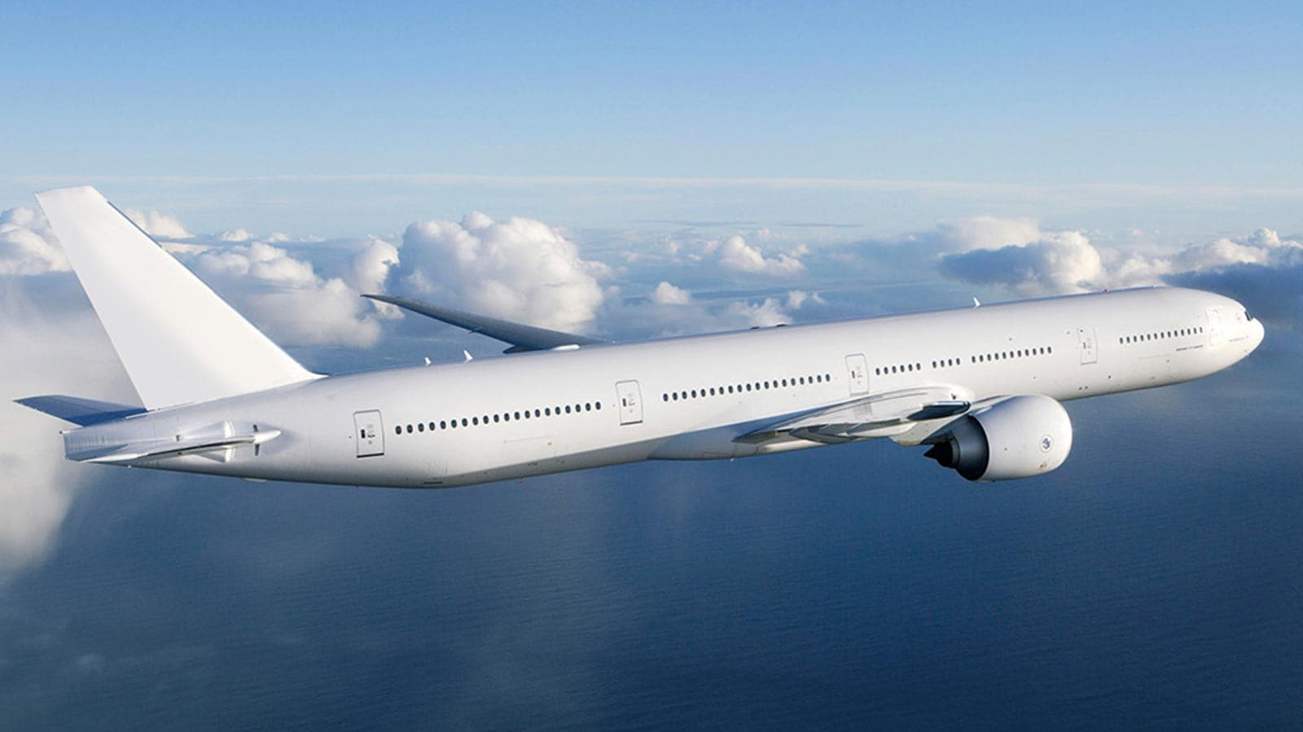
Notes:
A Friend of mine took me up in a plane. Once up
he asked me to tale over & fly it. I did but the stress caused
me to sweat till I was wet.
There are dozens of things to do & must constantly stay on
top of them. Airliner… 100s of things – and we still trust them.
Drive… only thing to keep you form certain death is a yellow line in the street???
So if We are willing to “step out” with physical things that risk life and death dangers.
Why not spiritual trust, why do we 2nd guess and even deny ourselves the blessing that God wants to give us.
Why Step Out? We have:
Opportunity to show our love and trust and our confidence in Jesus.
Is He trustworthy?
Is He able to protect from the storm?
Do we doubt He loves and care about us enough to lift us up if we fail?
Opportunity to stand WITH CHRIST when others are not willing!
Opportunity to be used in extraordinary ways that only God can make happen.
Opportunity to experience the glory that God wants to shine through me!
Opportunity to accomplish things God wants that never could be done alone!
To Overcome- Fear, weakness, cowardness, stress, feelings of helplessness.
To Overcome- A godless self centered independence that Americans thrive upon.
Why deny ourselves:
To experience true dependence upon a God who cares and will protect and help us when we fall.
To grow closer to God than ever before.
To have God smile and say… O ye of great faith

Slide 6
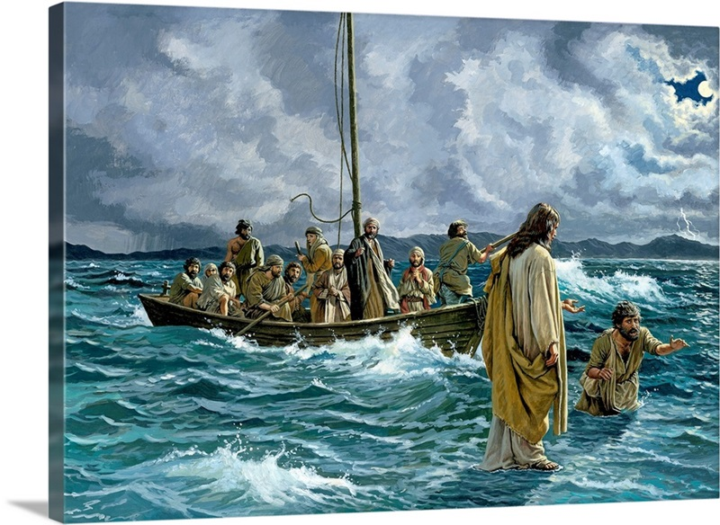
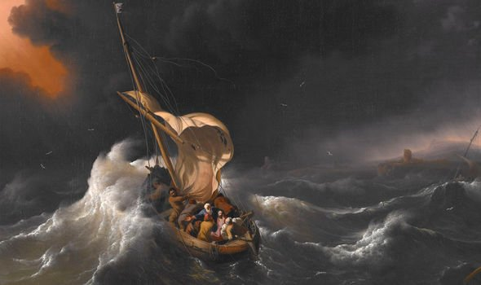
Make a difference Get Our of the Boat!
Notes:
So, do we can sit with the eleven
In perceived allusion of safety, security
-comfortable world approved way of carnal safety
-Let the wind and waves toss us about
-Continue to struggle with the forces of the world with our little ores to paddle with
-Make a lot of noise and just get no where
-Grow increasing more confused by perceptions of life
- Even sometimes seeing superstitious ghost being influenced by wrong interpretations of scriptures or experiences.
Or we can step out of the boat.
Run to Jesus
Hold to His hand
Do what He says
Shine with His glory
Be amazed at His power He commands
Overcome the world and turn it upstde down
Be more than conquerors in that He is our strength and shield
Our hope and comfort
Our light in a darkening world
Our vivid clarity in a confusing time of stress
Be victims or victors
Experience His Glory!
They fell down and worshiped Him then
Then so will we be able to.
Ps 20:6 Now I know that the LORD saves His anointed; He will answer him from His holy heaven With the saving strength of His right hand.
7 Some trust in chariots, and some in horses; But we will remember the name of the LORD our God. (NKJV)

