Slide 1
Our Sacrifices To God

Slide 2
Sacrifice in Worship
Gen. 4:3-4 – Heb. 11:4
Lev. 22:19-24
Perfect without blemish!
Malachi 1:6-14
Malachi 1:6-14
Notes:
Ge 4:3 And in the process of time it came to pass
that Cain brought an offering of the
fruit of the ground to the LORD.
4 Abel also brought of the firstborn of his flock and
of their fat. And the LORD respected Abel
and his offering, (NKJV)
Heb 11:4 By faith Abel offered to God a
more excellent sacrifice than Cain,
through which he obtained witness that
he was righteous, God testifying of his gifts; and
through it he being dead still speaks. (NKJV)
Mal 1:6 "A son honors his father, And a servant his master. If then I am the Father, Where is My honor? And if I am a Master, Where is My reverence? Says the LORD of hosts To you priests who despise My name. Yet you say, 'In what way have we despised Your name?'
7 "You offer defiled food on My altar. But say, 'In what way have we defiled You?' By saying, 'The table of the LORD is contemptible.'
8 And when you offer the blind as a sacrifice, Is it not evil? And when you offer the lame and sick, Is it not evil? Offer it then to your governor! Would he be pleased with you? Would he accept you favorably?" Says the LORD of hosts.
9 "But now entreat God's favor, That He may be gracious to us. While this is being done by your hands, Will He accept you favorably?" Says the LORD of hosts.
10 "Who is there even among you who would shut the doors, So that you would not kindle fire on My altar in vain? I have no pleasure in you," Says the LORD of hosts, "Nor will I accept an offering from your hands.
11 For from the rising of the sun, even to its going down, My name shall be great among the Gentiles; In every place incense shall be offered to My name, And a pure offering; For My name shall be great among the nations," Says the LORD of hosts.
12 "But you profane it, In that you say, 'The table of the LORD is defiled; And its fruit, its food, is contemptible.'
13 You also say, 'Oh, what a weariness!' And you sneer at it," Says the LORD of hosts. "And you bring the stolen, the lame, and the sick; Thus you bring an offering! Should I accept this from your hand?" Says the LORD.
14 "But cursed be the deceiver Who has in his flock a male, And takes a vow, But sacrifices to the Lord what is blemished-For I am a great King," Says the LORD of hosts, "And My name is to be feared among the nations.
(NKJV)

Slide 3
Sacrifice of Praise
Psa. 107:22; Psa. 116:17; Jer. 17:26
Jer. 33:11
Heb. 13:10-16
Notes:
Ps 107:22 Let them sacrifice the sacrifices of
thanksgiving, And declare His works with rejoicing.
Ps 116:17 I will offer to You the sacrifice of thanksgiving,
And will call upon the name of the LORD. (NKJV)
Jer 17:26 "And they shall come from the cities of Judah
and from the places around Jerusalem,
from the land of Benjamin and from the lowland, from the mountains and from the South,
bringing burnt offerings and sacrifices, grain offerings and incense,
bringing sacrifices of praise to the house of the LORD. (NKJV)
Jer 33:11 'the voice of joy and the voice of gladness,
the voice of the bridegroom and the voice of the bride,
the voice of those who will say:
"Praise the LORD of hosts, For the LORD is good, For His mercy endures forever" -and of those who will bring the sacrifice of praise into the house of the LORD. For I will cause the captives of the land to return as at the first,' says the LORD.
Heb 13:12 Therefore Jesus also, that He might sanctify the people with His own blood, suffered outside the gate.
13 Therefore let us go forth to Him,
outside the camp,
bearing His reproach.
14 For here we have no continuing city, but we seek the one to come.
15 Therefore by Him let us continually offer the sacrifice of praise to God, that is, the fruit of our lips, giving thanks to His name.
16 But do not forget to do good and to share,
for with such sacrifices God is well pleased. (NKJV)

Slide 4
My Jesus I Love Thee
1. My Jesus, I love Thee, I know Thou art mine; For Thee all the follies of sin I resign;
My gracious Redeemer, my Savior art Thou; If ever I loved Thee, my Jesus, 'tis now.
2. I love Thee, because Thou hast first loved me, And purchased my pardon on Calvary's tree;
I love Thee for wearing the thorns on Thy brow; If ever I loved Thee, my Jesus, 'tis now.
3. In mansions of glory and endless delight, I'll ever adore Thee in heaven so bright;
I'll sing with the glittering crown on my brow; If ever I loved Thee, my Jesus, 'tis now.

Slide 5
God’s View
Angered
Disgraced
Dishonors
Disgust
Appalling
Who will shut the doors…I have no pleasure in you. Mal. 1:10

Slide 6
“Prepare”
Exo. 19:10-11
Purification and Clean
Penalty – expelled out of the camp, death & damnation
My name will reverenced & great & glorified
Mal. 1:11-14; Rev. 15:4
Notes:
Mal 1:11 For from the rising of the sun, even to its going down,
My name shall be great among the Gentiles;
In every place incense shall be offered to My name, And a pure offering;
For My name shall be great among the nations," Says the LORD of hosts.
12 "But you profane it, In that you say, 'The table of the LORD is defiled;
And its fruit, its food, is contemptible.'
13 You also say, 'Oh, what a weariness!'
And you sneer at it," Says the LORD of hosts.
"And you bring the stolen, the lame, and the sick;
Thus you bring an offering! Should I accept this from your hand?" Says the LORD.
14 "But cursed be the deceiver
Who has in his flock a male, And takes a vow,
But sacrifices to the Lord what is blemished-
For I am a great King," Says the LORD of hosts,
"And My name is to be feared among the nations. (NKJV)
Re 15:4 Who shall not fear You, O Lord, and glorify Your name?
For You alone are holy.
For all nations shall come and worship before You,
For Your judgments have been manifested." (NKJV)

Slide 7
Today
Sacrifice = to make sacred
Are there penalties if we do not?
Lord’s Supper – sacred
God’s name – sacred
Worship – sacred

Slide 8
Worship Comes From
Passionate,
Committed,
Devoted,
Grateful saints who are humbled in the presence of God

Slide 9
God Wants
Sincere praise and glorification
Humble hearts expressing gratitude
Passionate expressions of love
Song leaders help this happen

Slide 11
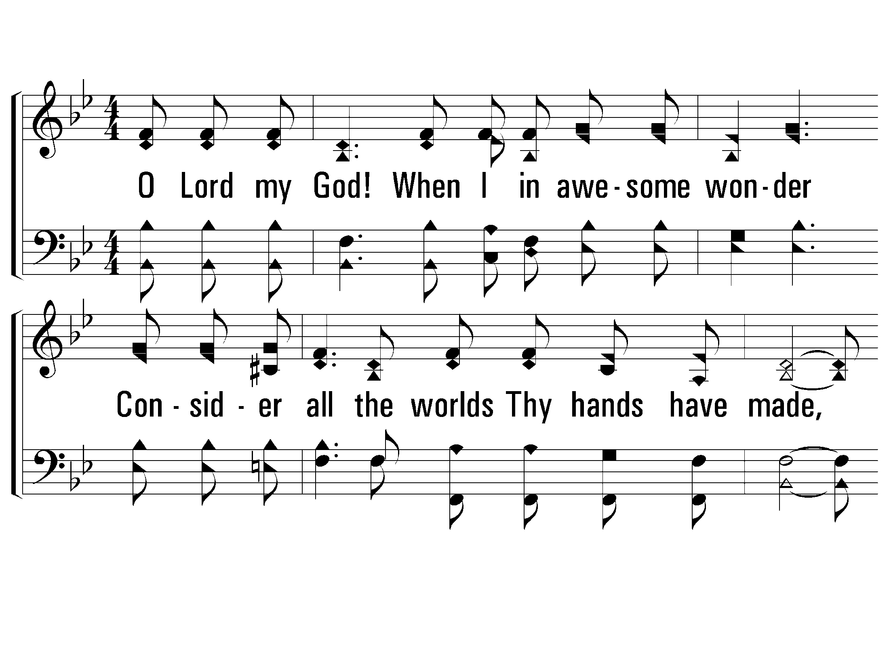
1 – How Great Thou Art
1.
O Lord my God! When I in awesome wonder
Consider all the worlds Thy hands have made,
I see the stars, I hear the rolling thunder,
Thy power throughout the universe displayed.
Words by: Stuart K. Hine
Music by: Swedish Folk melody, Arrangement by: Stuart K. Hine
Copyright © 1953 by Stuart K. Hine. Assigned to Manna Music, Inc., 35255 Brooten Road, Pacific City, OR 97135.
All Rights Reserved. Used by Permission.
© 2001 The Paperless Hymnal™

Slide 12
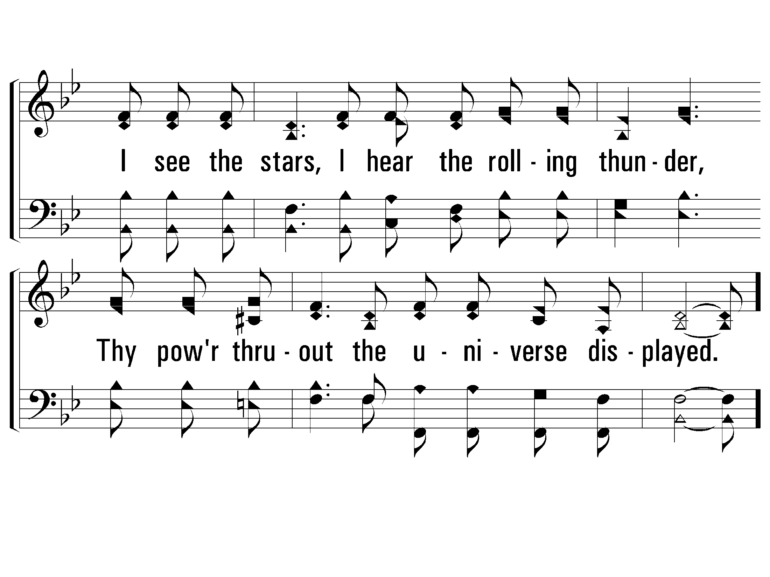
1 – How Great Thou Art
© 2001 The Paperless Hymnal™

Slide 13
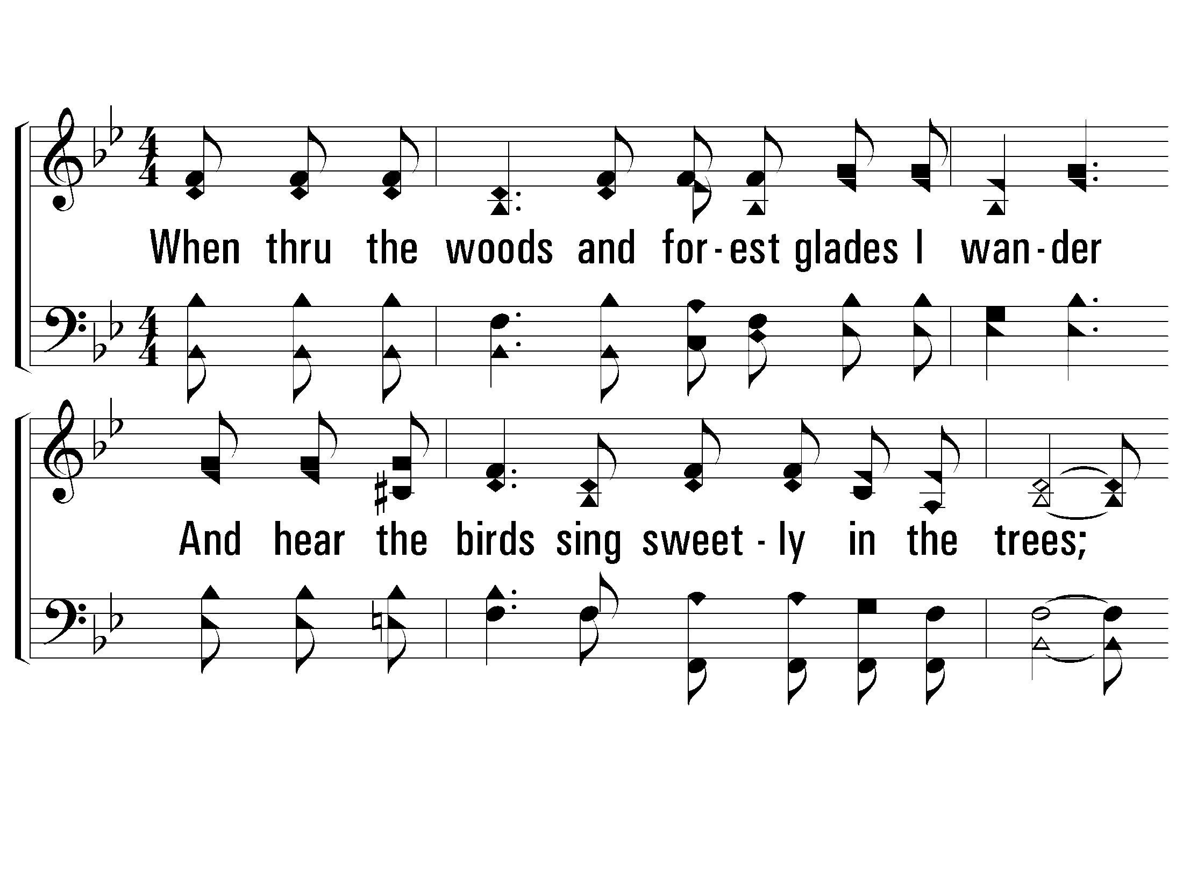
2 – How Great Thou Art
2.
When thru the woods and forest glades I wander
And hear the birds sing sweetly in the trees;
When I look down from lofty mountain grandeur
And hear the brook and feel the gentle breeze;
Words by: Stuart K. Hine
Music by: Swedish Folk melody, Arrangement by: Stuart K. Hine
Copyright © 1953 by Stuart K. Hine. Assigned to Manna Music, Inc., 35255 Brooten Road, Pacific City, OR 97135.
All Rights Reserved. Used by Permission.
© 2001 The Paperless Hymnal™

Slide 14
2 – How Great Thou Art
© 2001 The Paperless Hymnal™

Slide 15
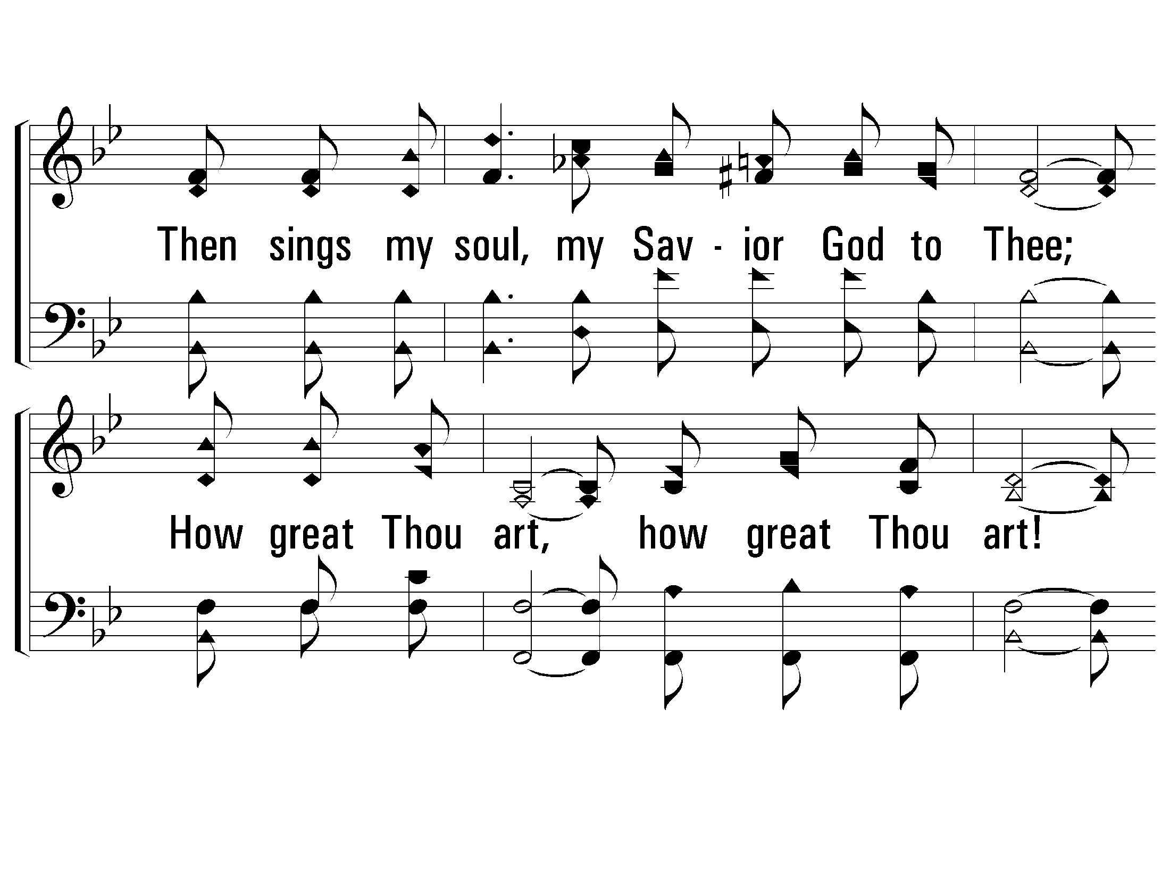
c – How Great Thou Art
Then sings my soul, my Savior God to Thee;
How great Thou art, how great Thou art!
Then sings my soul, my Savior God to Thee;
How great Thou art, how great Thou art!
© 2001 The Paperless Hymnal™

Slide 16
c – How Great Thou Art
© 2001 The Paperless Hymnal™

Slide 17
3 – How Great Thou Art
3.
And when I think that God, His son not sparing,
Sent Him to die, I scarce can take it in;
That on the cross, my burden gladly bearing,
He bled and died to take away my sin;
Words by: Stuart K. Hine
Music by: Swedish Folk melody, Arrangement by: Stuart K. Hine
Copyright © 1953 by Stuart K. Hine. Assigned to Manna Music, Inc., 35255 Brooten Road, Pacific City, OR 97135.
All Rights Reserved. Used by Permission.
© 2001 The Paperless Hymnal™

Slide 18
3 – How Great Thou Art
© 2001 The Paperless Hymnal™

Slide 19
4 – How Great Thou Art
4.
When Christ shall come with shout of acclamation
And take me home, what joy shall fill my heart!
Then I shall bow in humble adoration
And there proclaim, my God, how great Thou art!
Words by: Stuart K. Hine
Music by: Swedish Folk melody, Arrangement by: Stuart K. Hine
Copyright © 1953 by Stuart K. Hine. Assigned to Manna Music, Inc., 35255 Brooten Road, Pacific City, OR 97135.
All Rights Reserved. Used by Permission.
© 2001 The Paperless Hymnal™

Slide 20
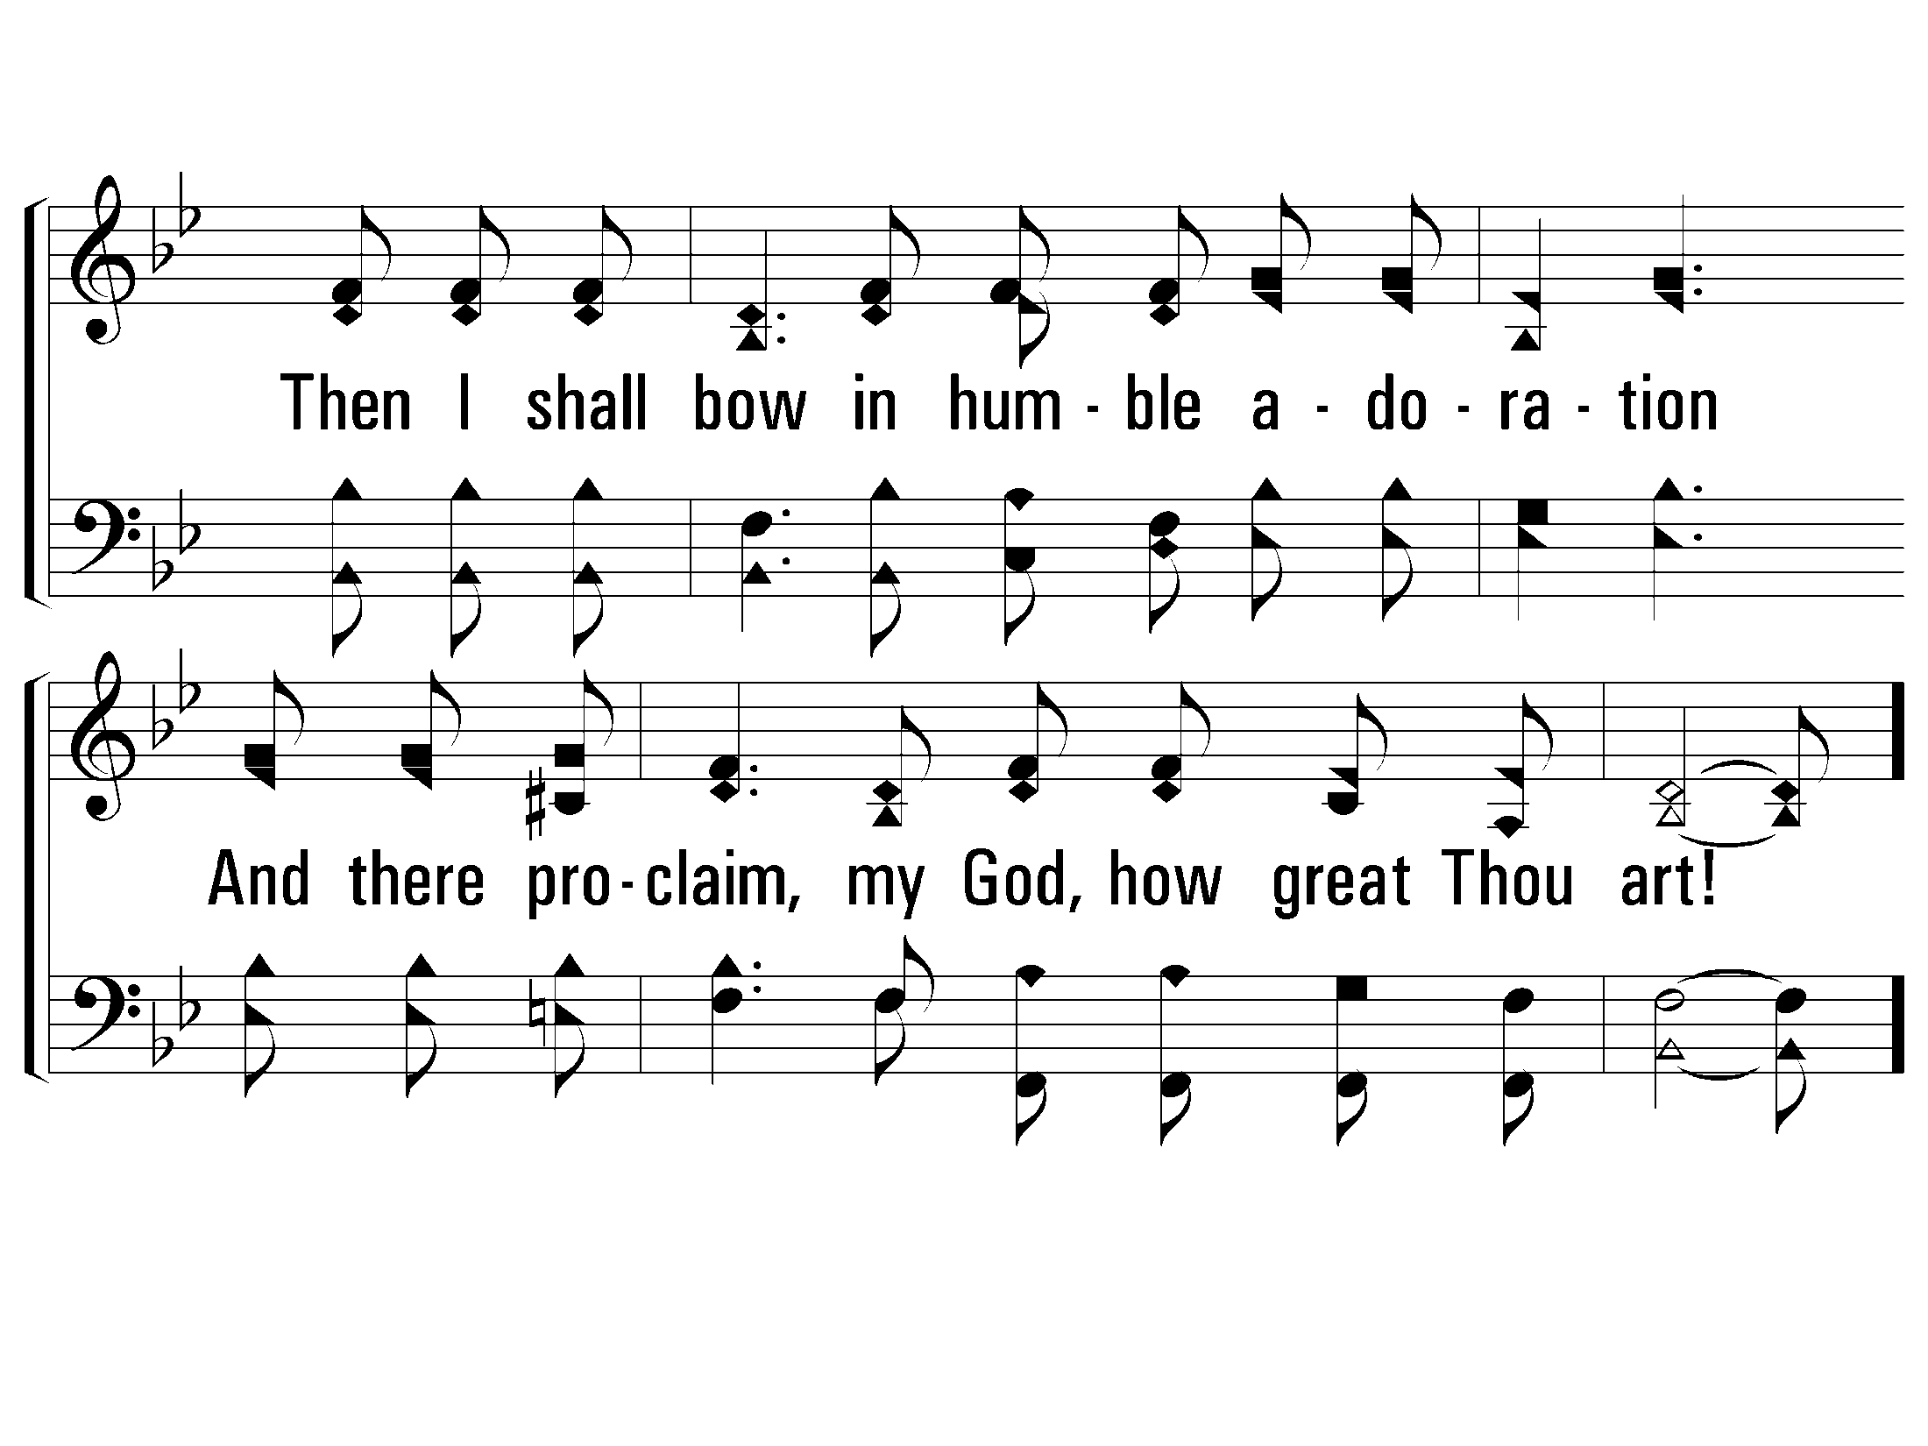
4 – How Great Thou Art
© 2001 The Paperless Hymnal™

Slide 21
c – How Great Thou Art
Then sings my soul, my Savior God to Thee;
How great Thou art, how great Thou art!
Then sings my soul, my Savior God to Thee;
How great Thou art, how great Thou art!
© 2001 The Paperless Hymnal™

Slide 22
c – How Great Thou Art
© 2001 The Paperless Hymnal™

Slide 24
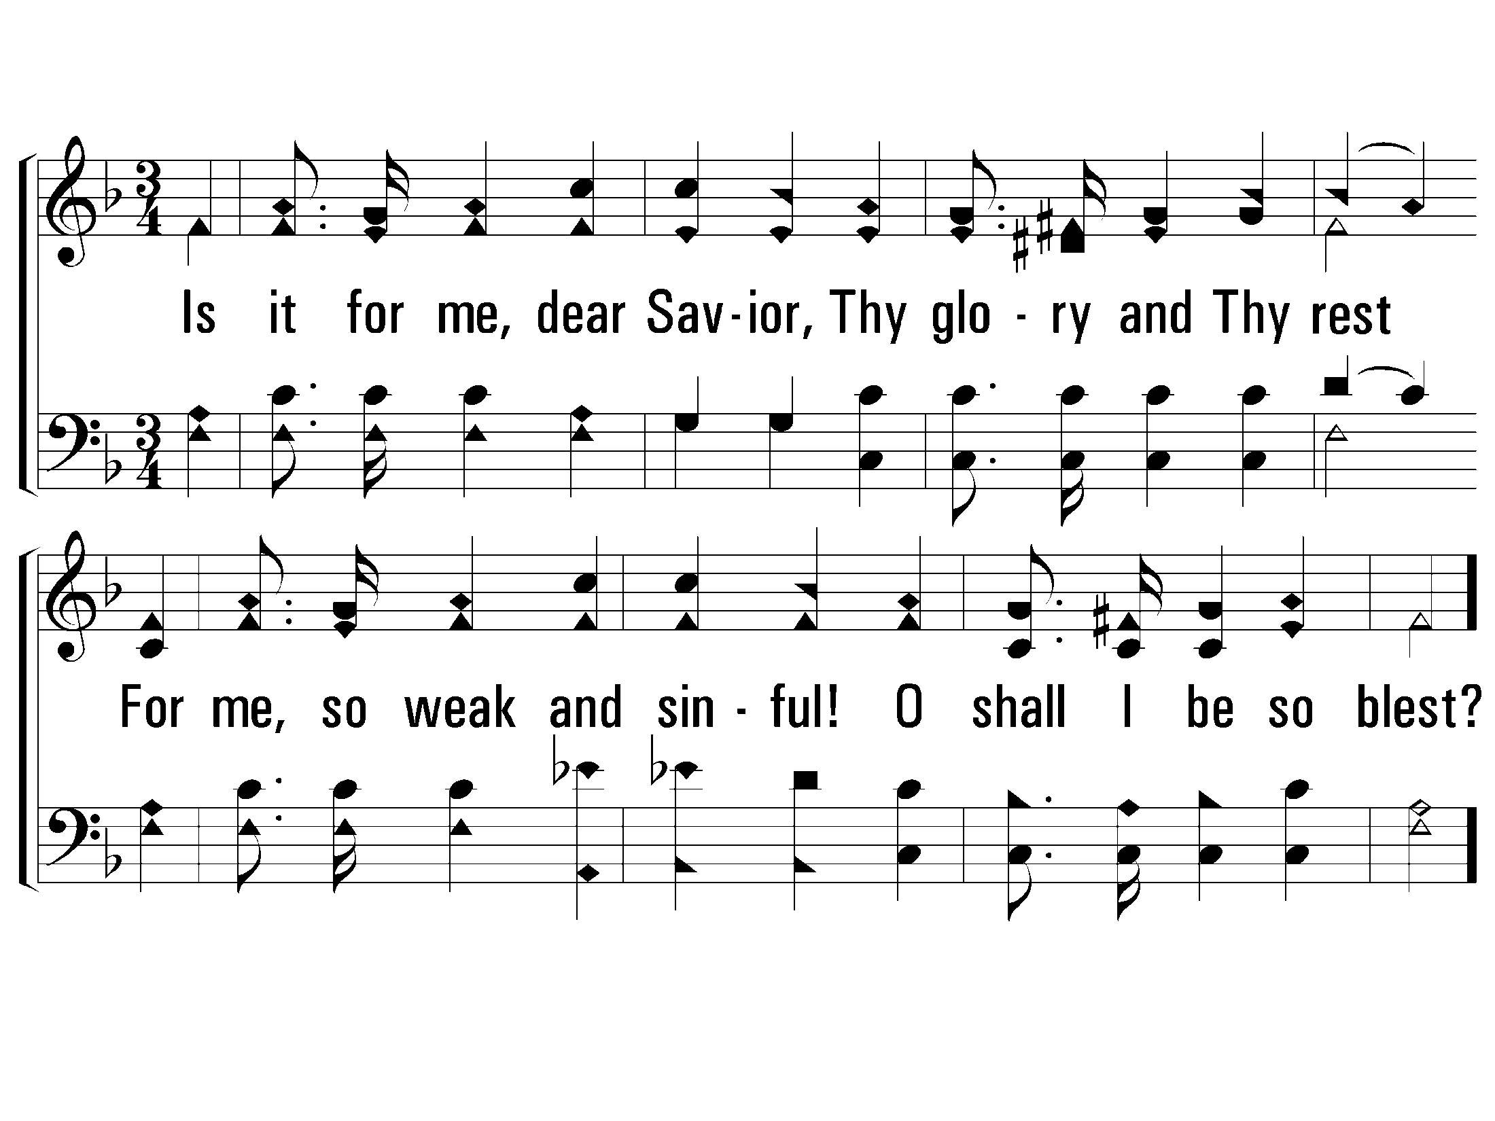
1 – Is It For Me?
1.
Is it for me, dear Savior,
Thy glory and Thy rest
For me, so weak and sinful!
O shall I be so blest?
Words: Frances R. Havergal
Music: Tullius C. O’Kane
© 2002 The Paperless Hymnal™

Slide 25
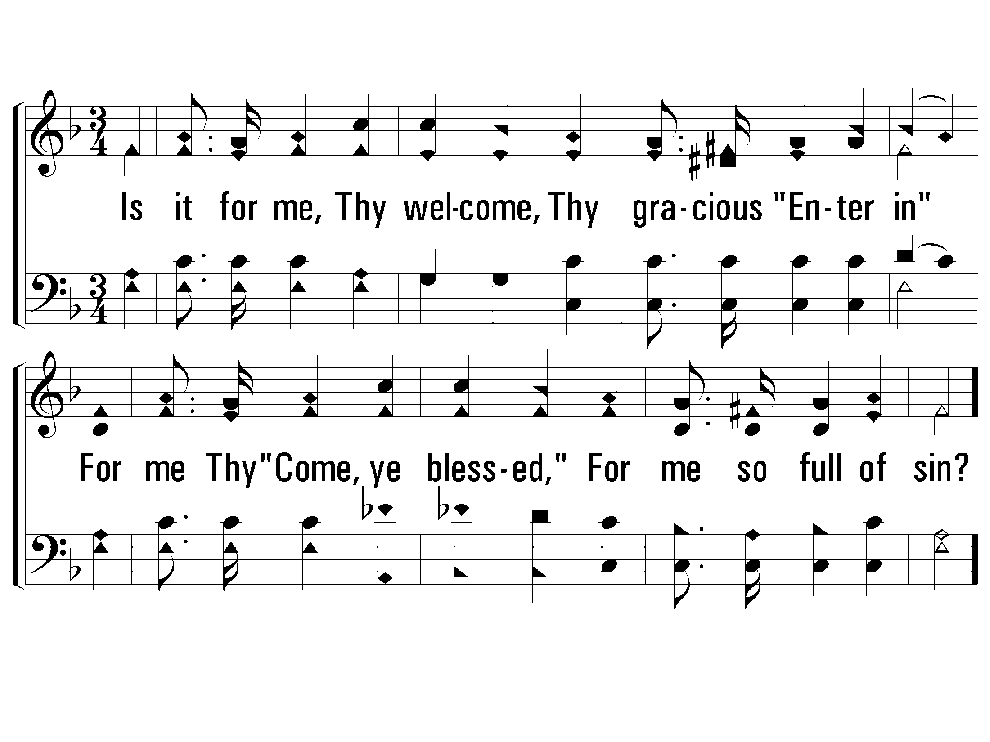
2 – Is It For Me?
2.
Is it for me, Thy welcome,
Thy gracious "Enter in"
For me Thy "Come, ye blessed,"
For me so full of sin?
Words: Frances R. Havergal
Music: Tullius C. O’Kane
© 2002 The Paperless Hymnal™

Slide 26
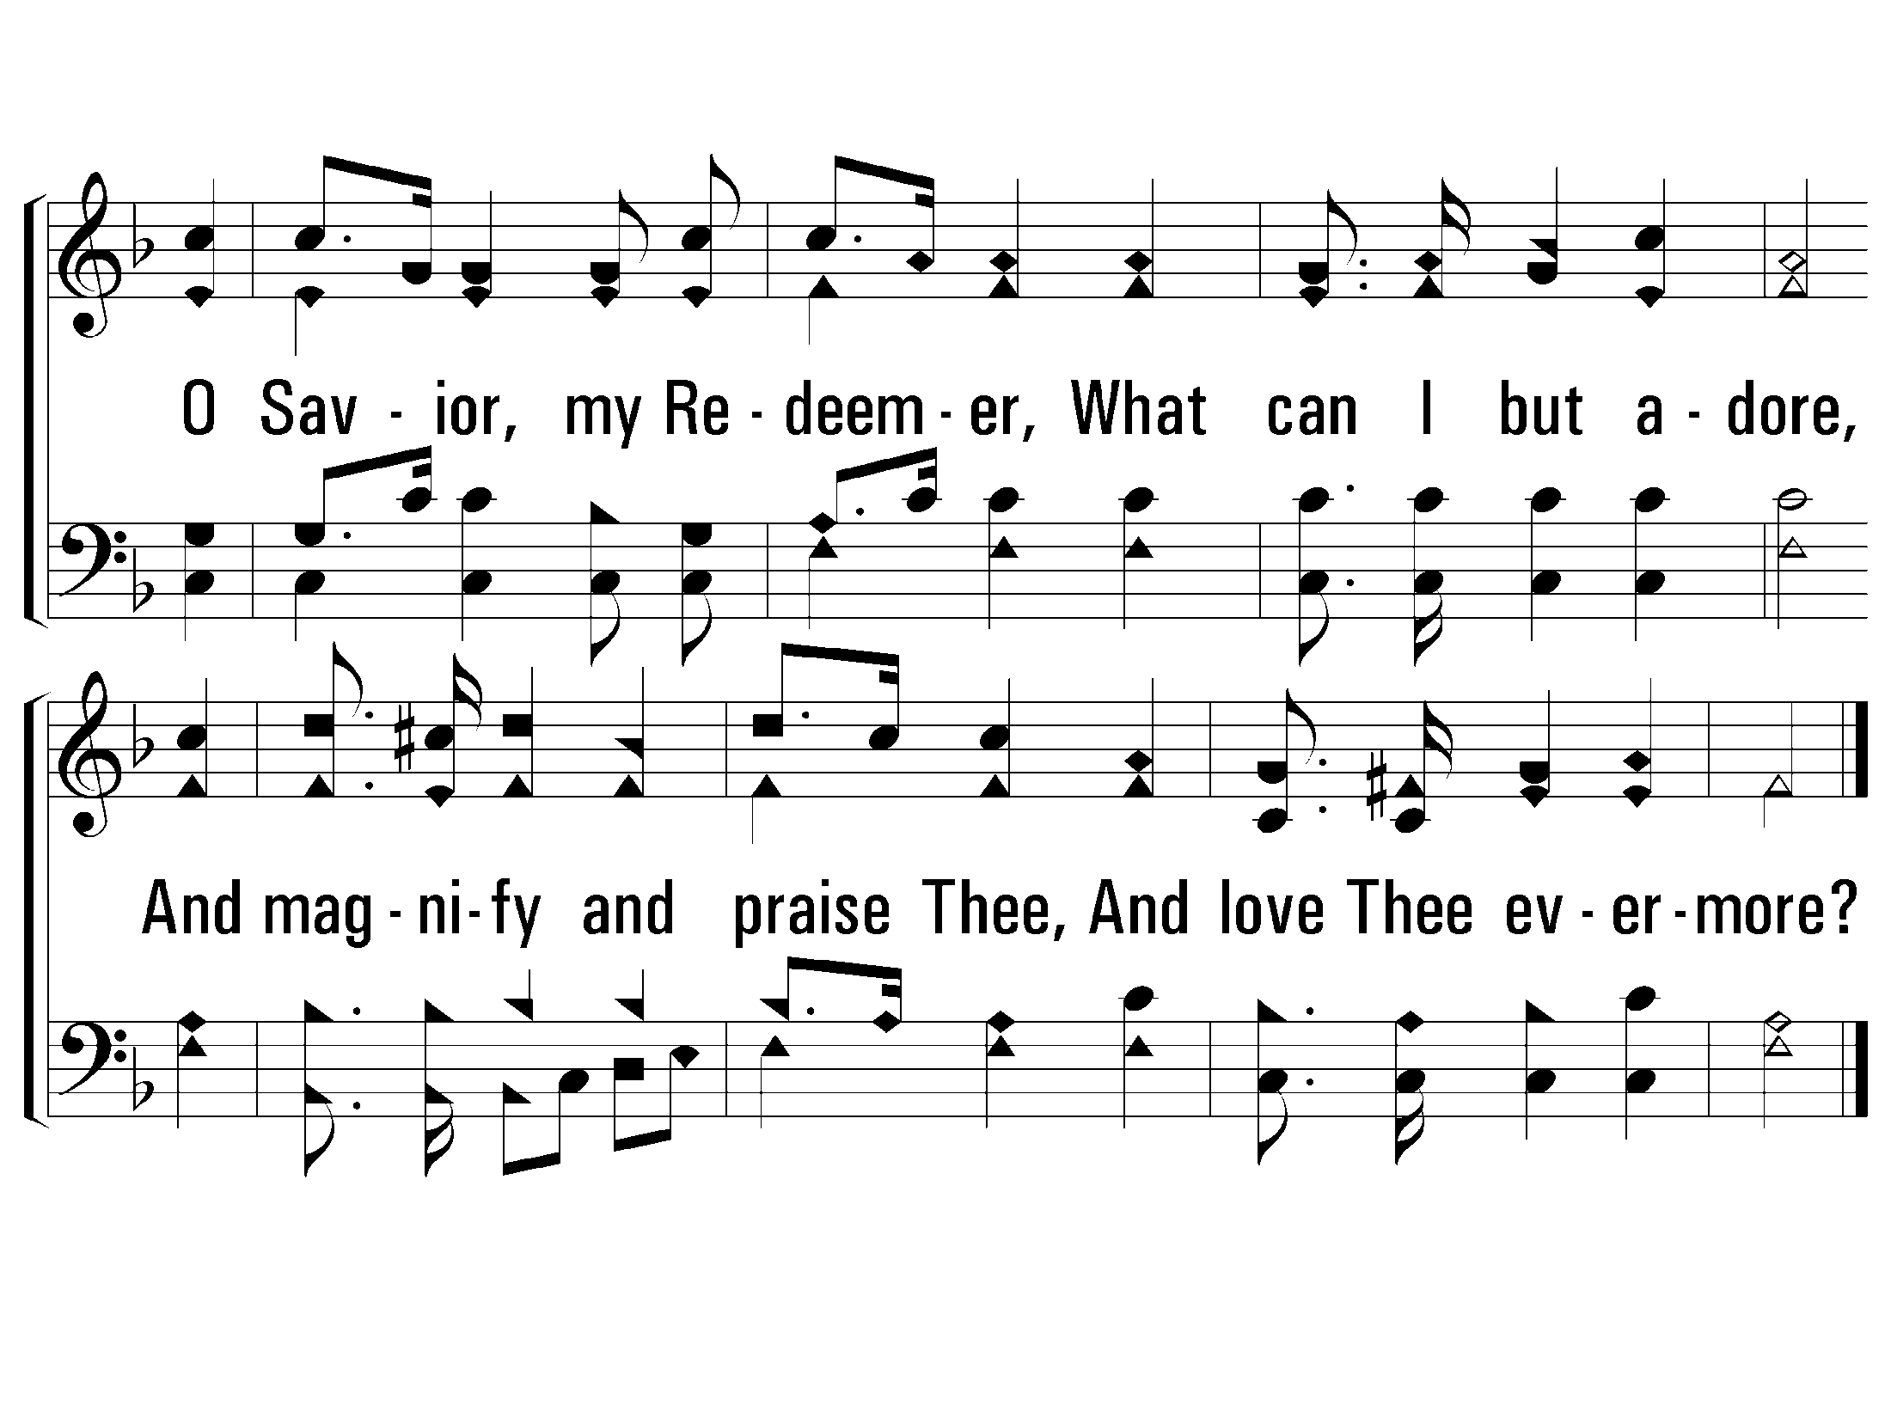
c – Is It For Me?
O Savior, my Redeemer,
What can I but adore,
And magnify and praise Thee,
And love Thee evermore?
© 2002 The Paperless Hymnal™

Slide 27
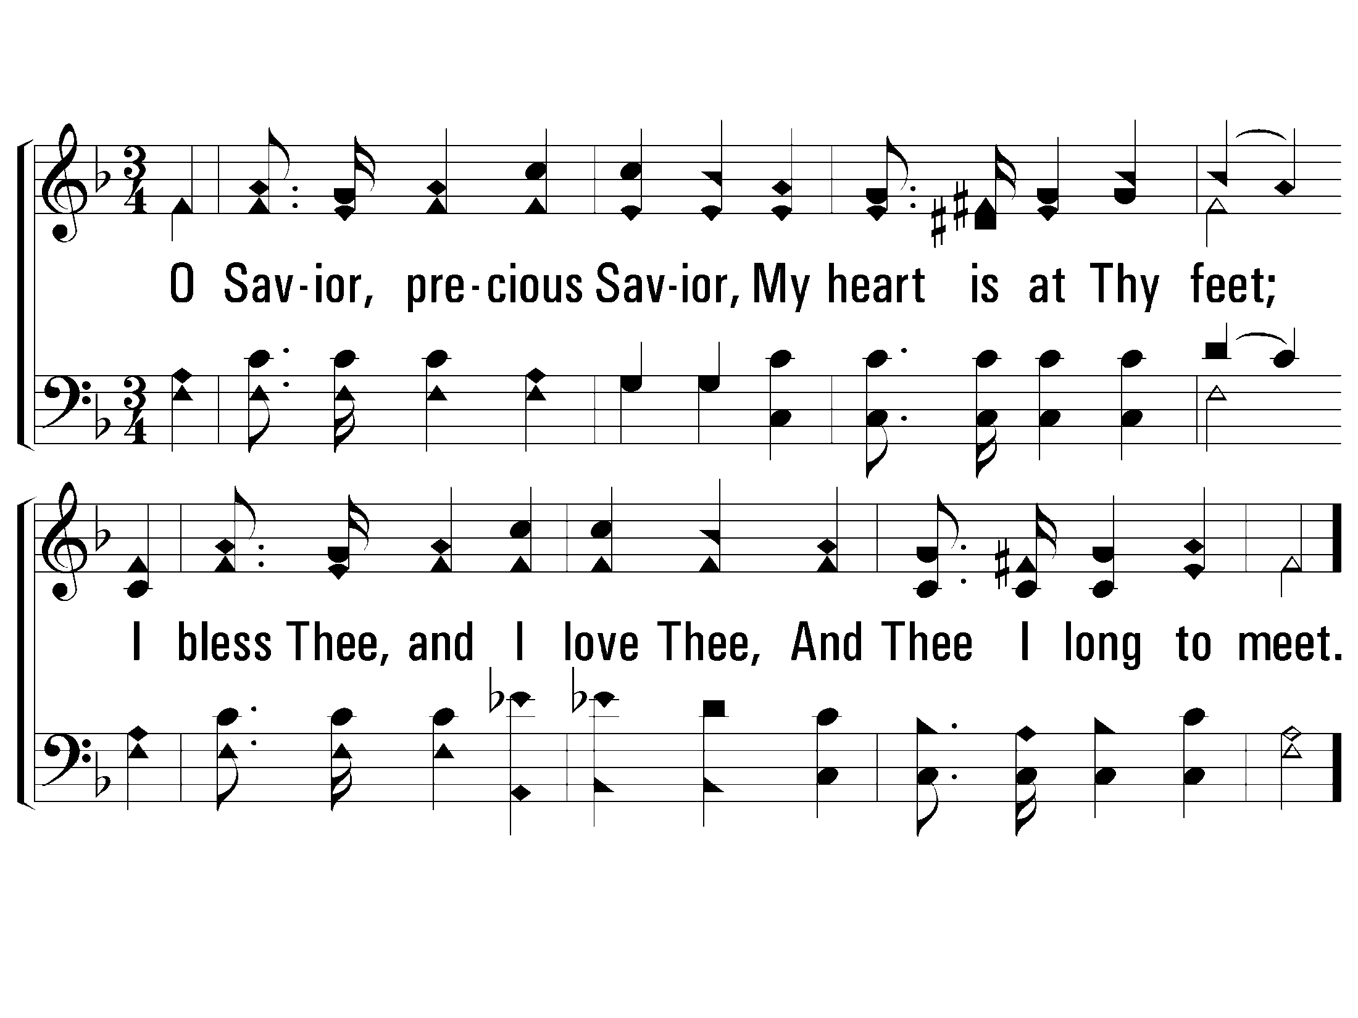
3 – Is It For Me?
3.
O Savior, precious Savior,
My heart is at Thy feet;
I bless Thee, and I love Thee,
And Thee I long to meet.
Words: Frances R. Havergal
Music: Tullius C. O’Kane
© 2002 The Paperless Hymnal™

Slide 28
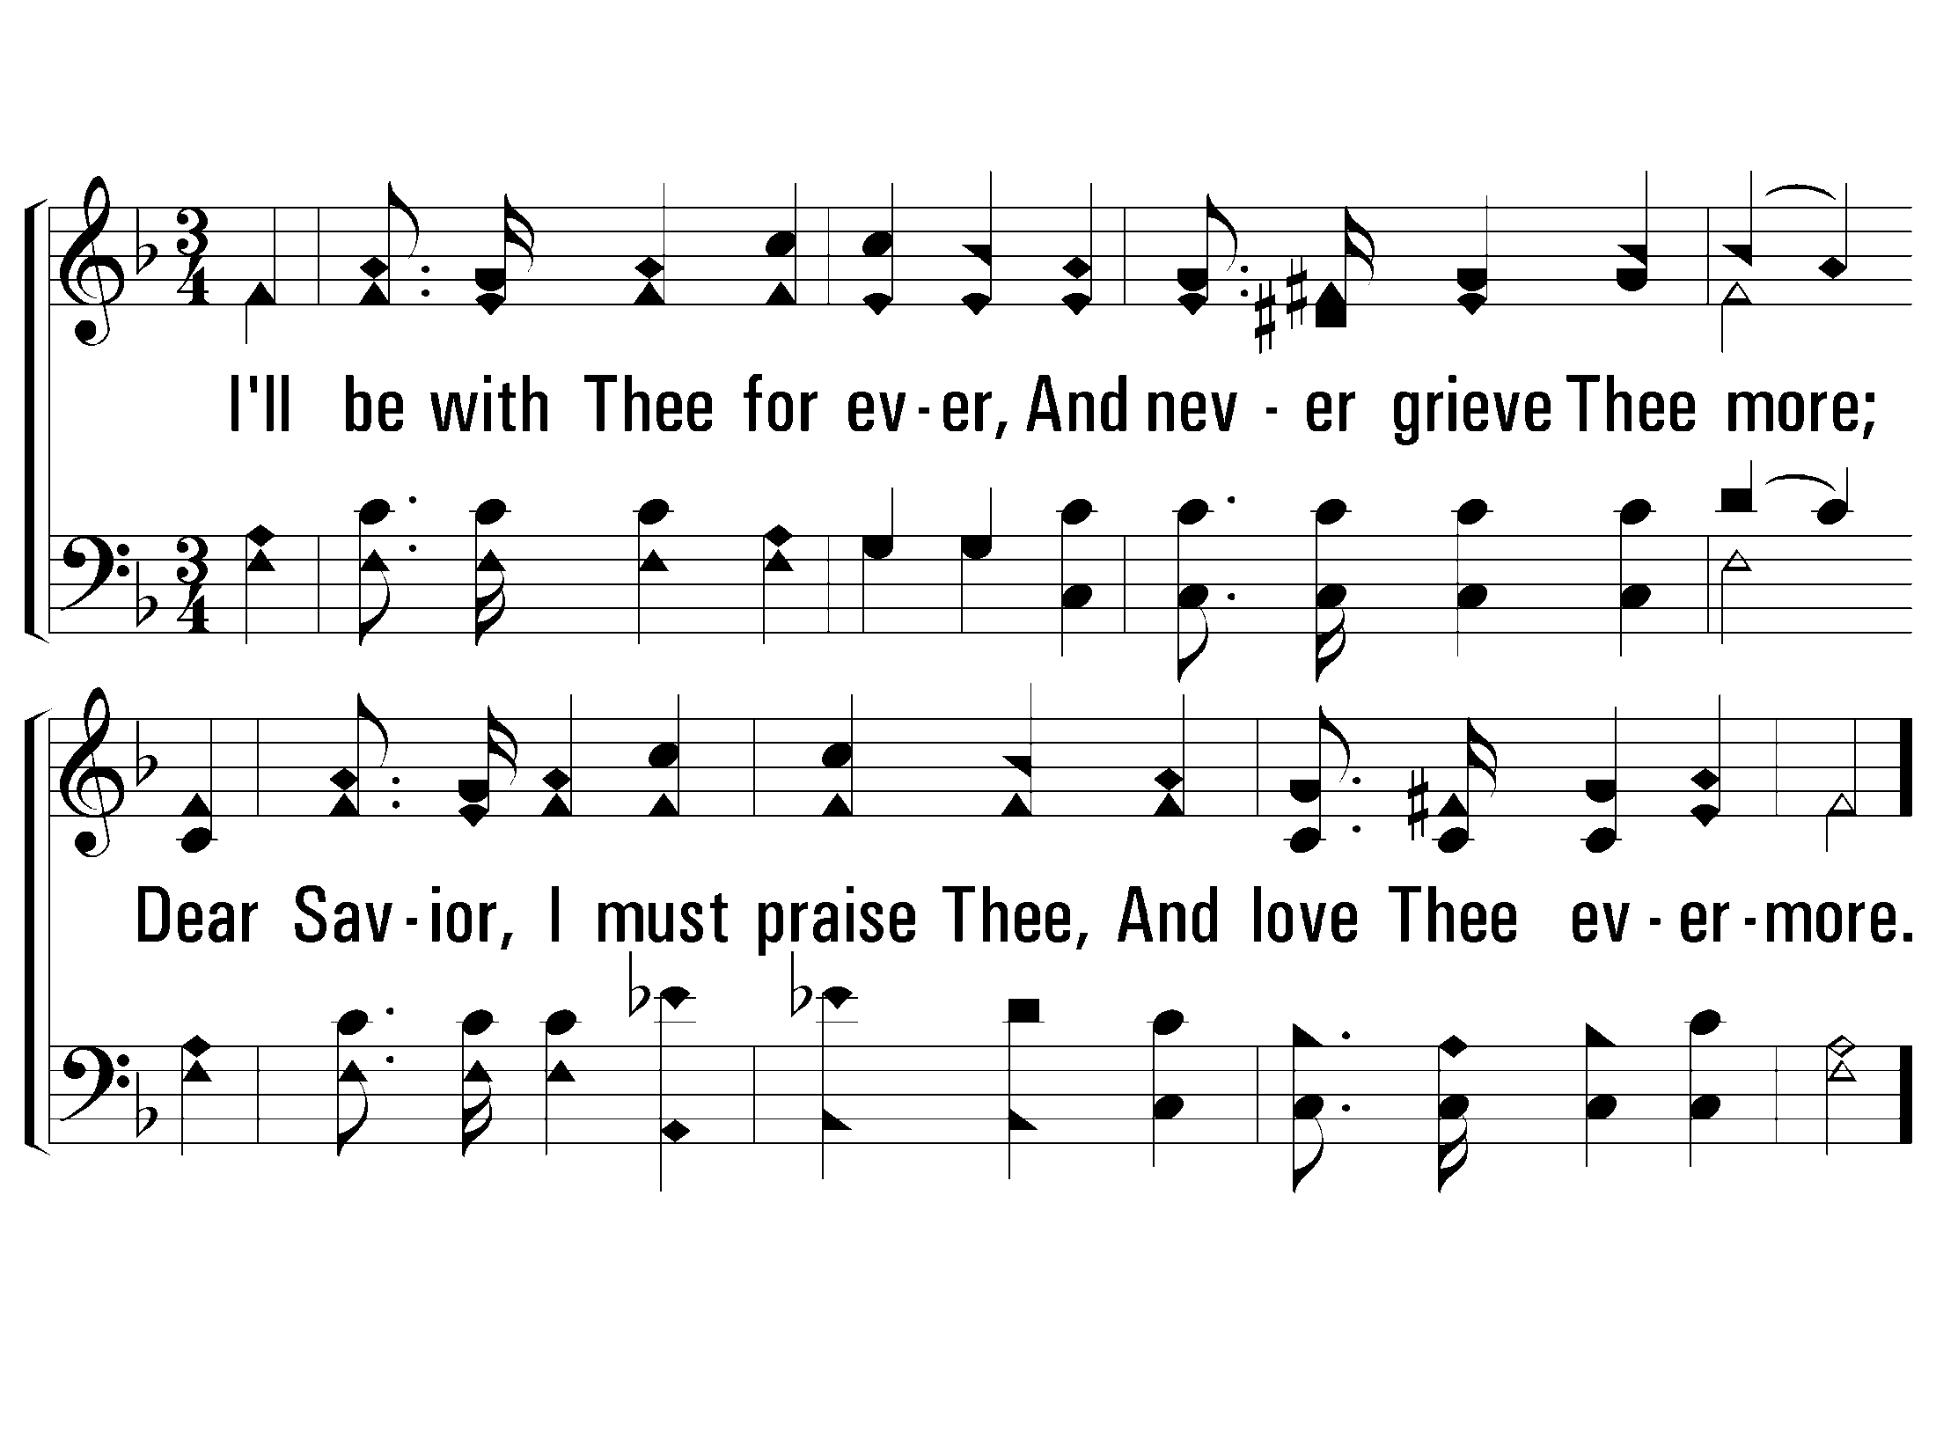
4 – Is It For Me?
4.
I'll be with Thee for ever,
And never grieve Thee more;
Dear Savior, I must praise Thee,
And love Thee evermore.
Words: Frances R. Havergal
Music: Tullius C. O’Kane
© 2002 The Paperless Hymnal™

Slide 29
c – Is It For Me?
O Savior, my Redeemer,
What can I but adore,
And magnify and praise Thee,
And love Thee evermore?
© 2002 The Paperless Hymnal™

Slide 31
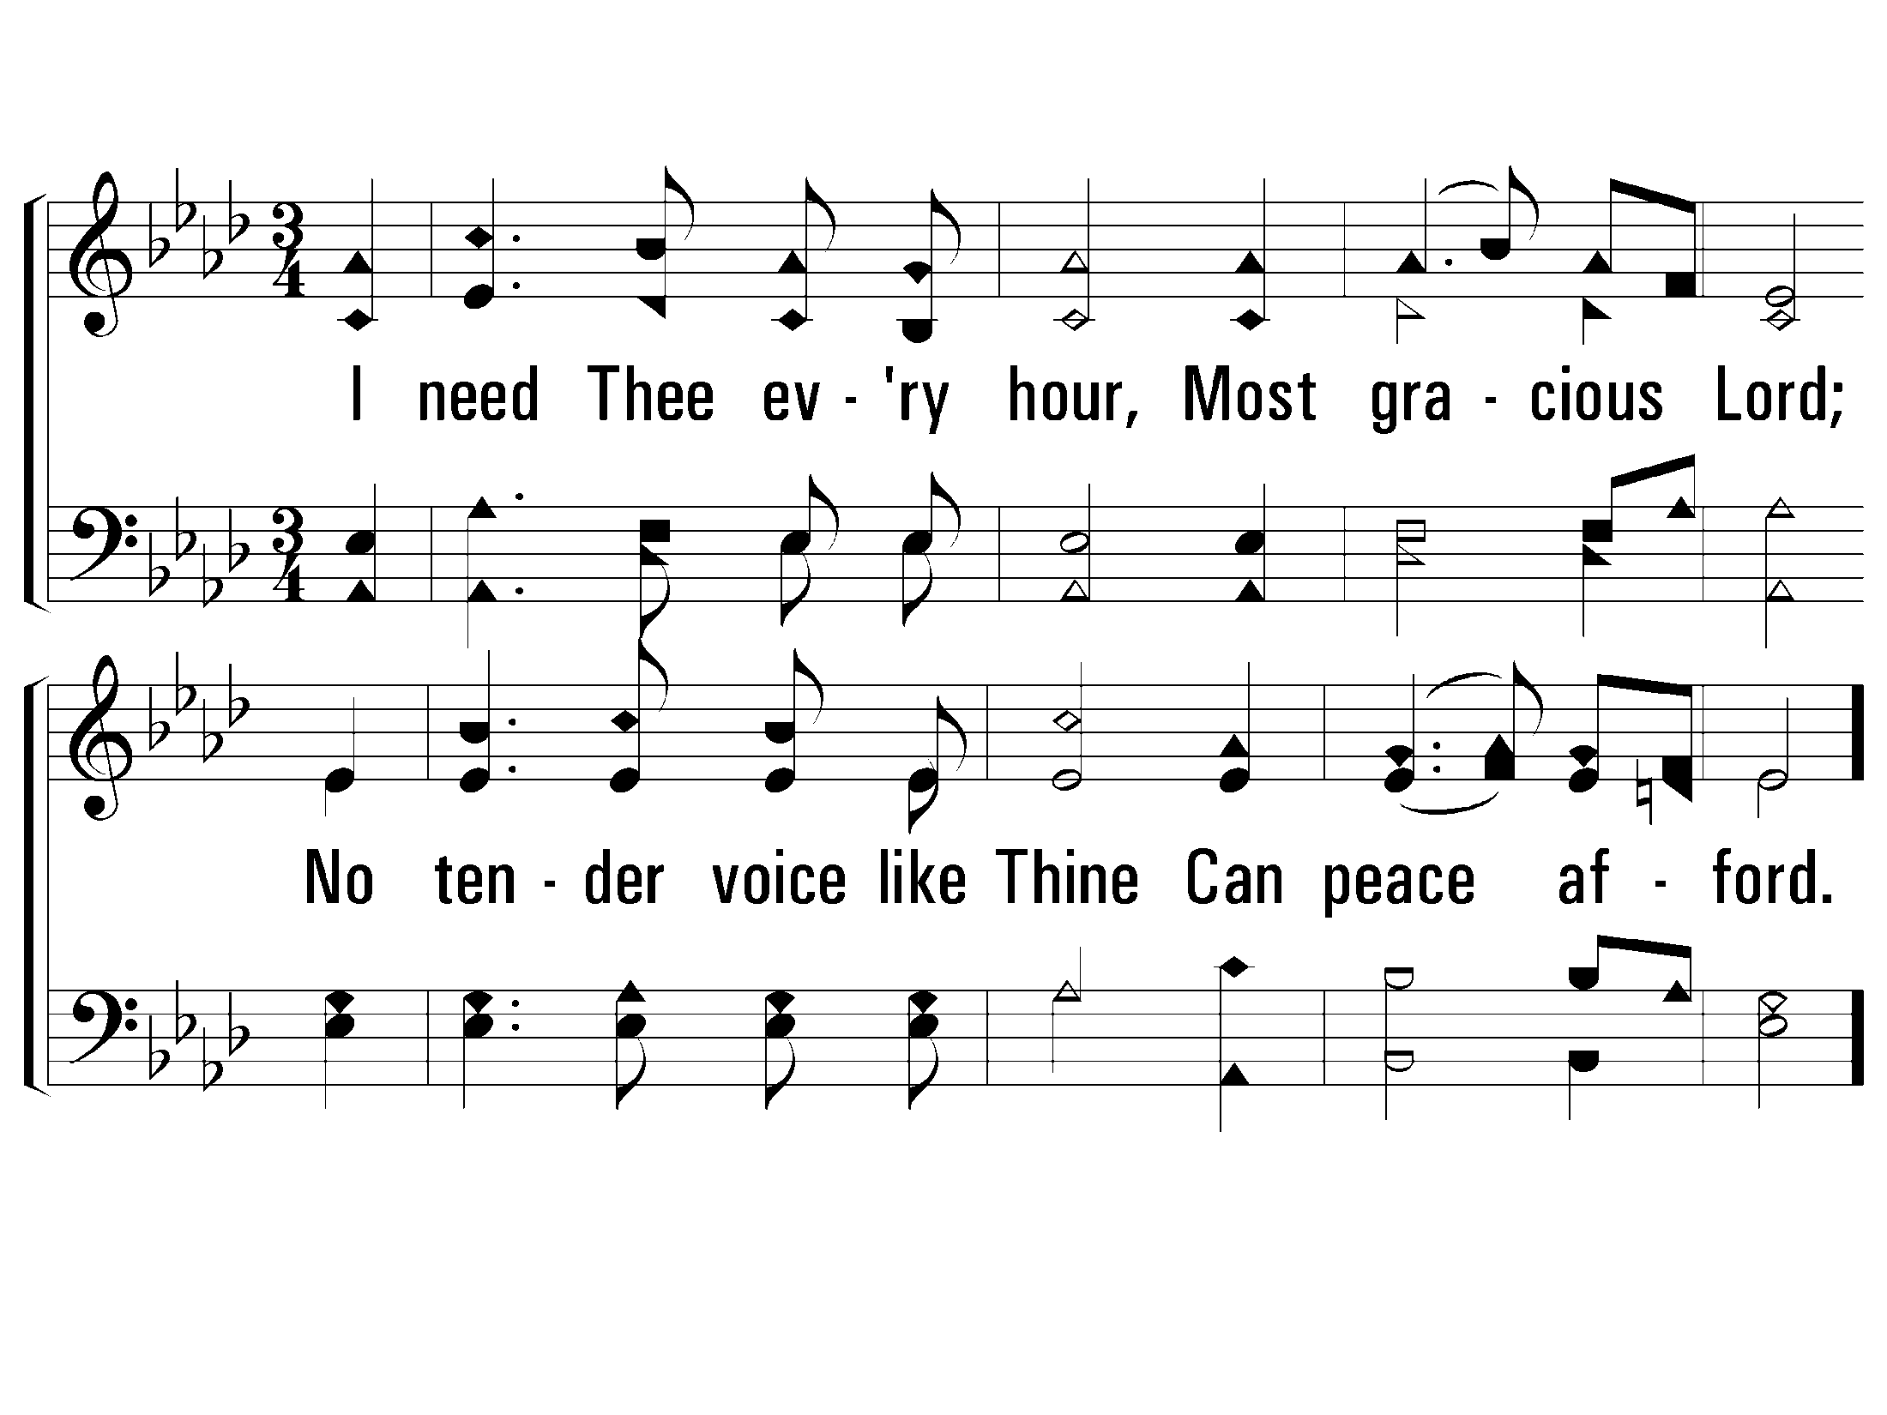
1 - I Need Thee Every Hour
1.
I need Thee every hour,
Most gracious Lord;
No tender voice like Thine
Can peace afford.
Words: Annie S. Hawks
Music: Robert Lowry
© 2001 The Paperless Hymnal™

Slide 32
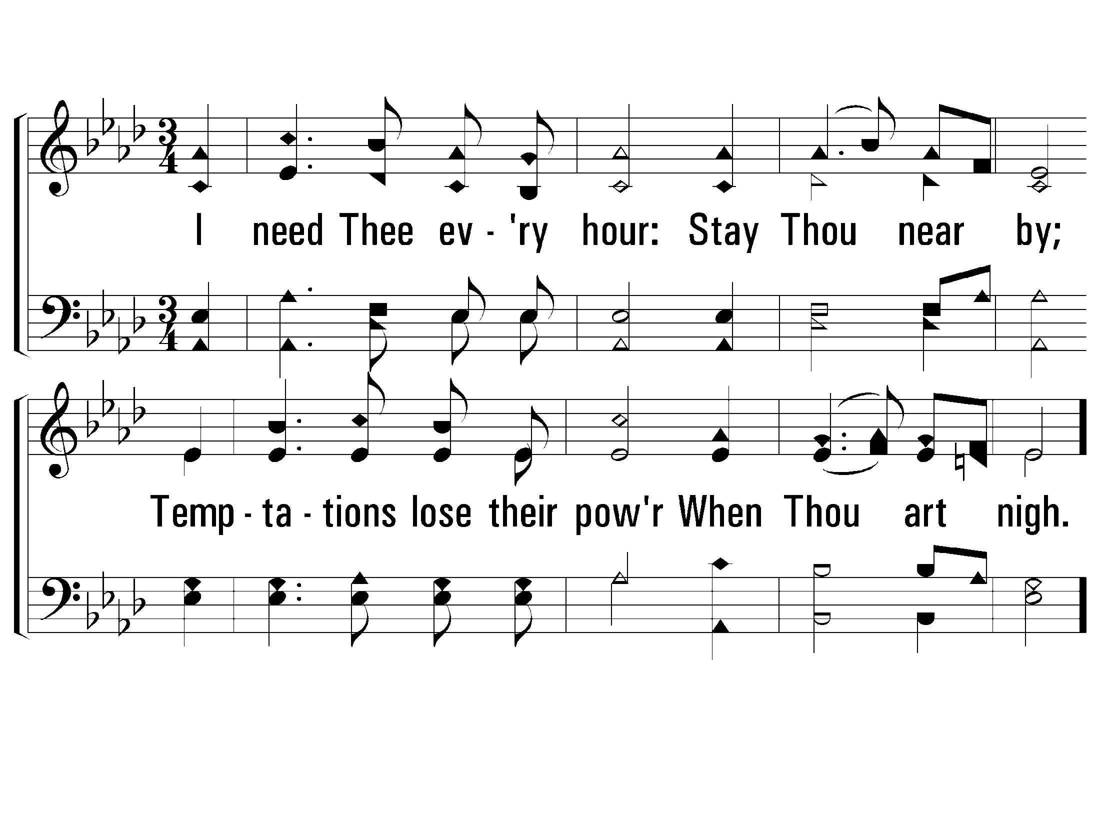
2 - I Need Thee Every Hour
2.
I need Thee every hour:
Stay Thou near by;
Temptations lose their power
When Thou art nigh.
Words: Annie S. Hawks
Music: Robert Lowry
© 2001 The Paperless Hymnal™

Slide 33
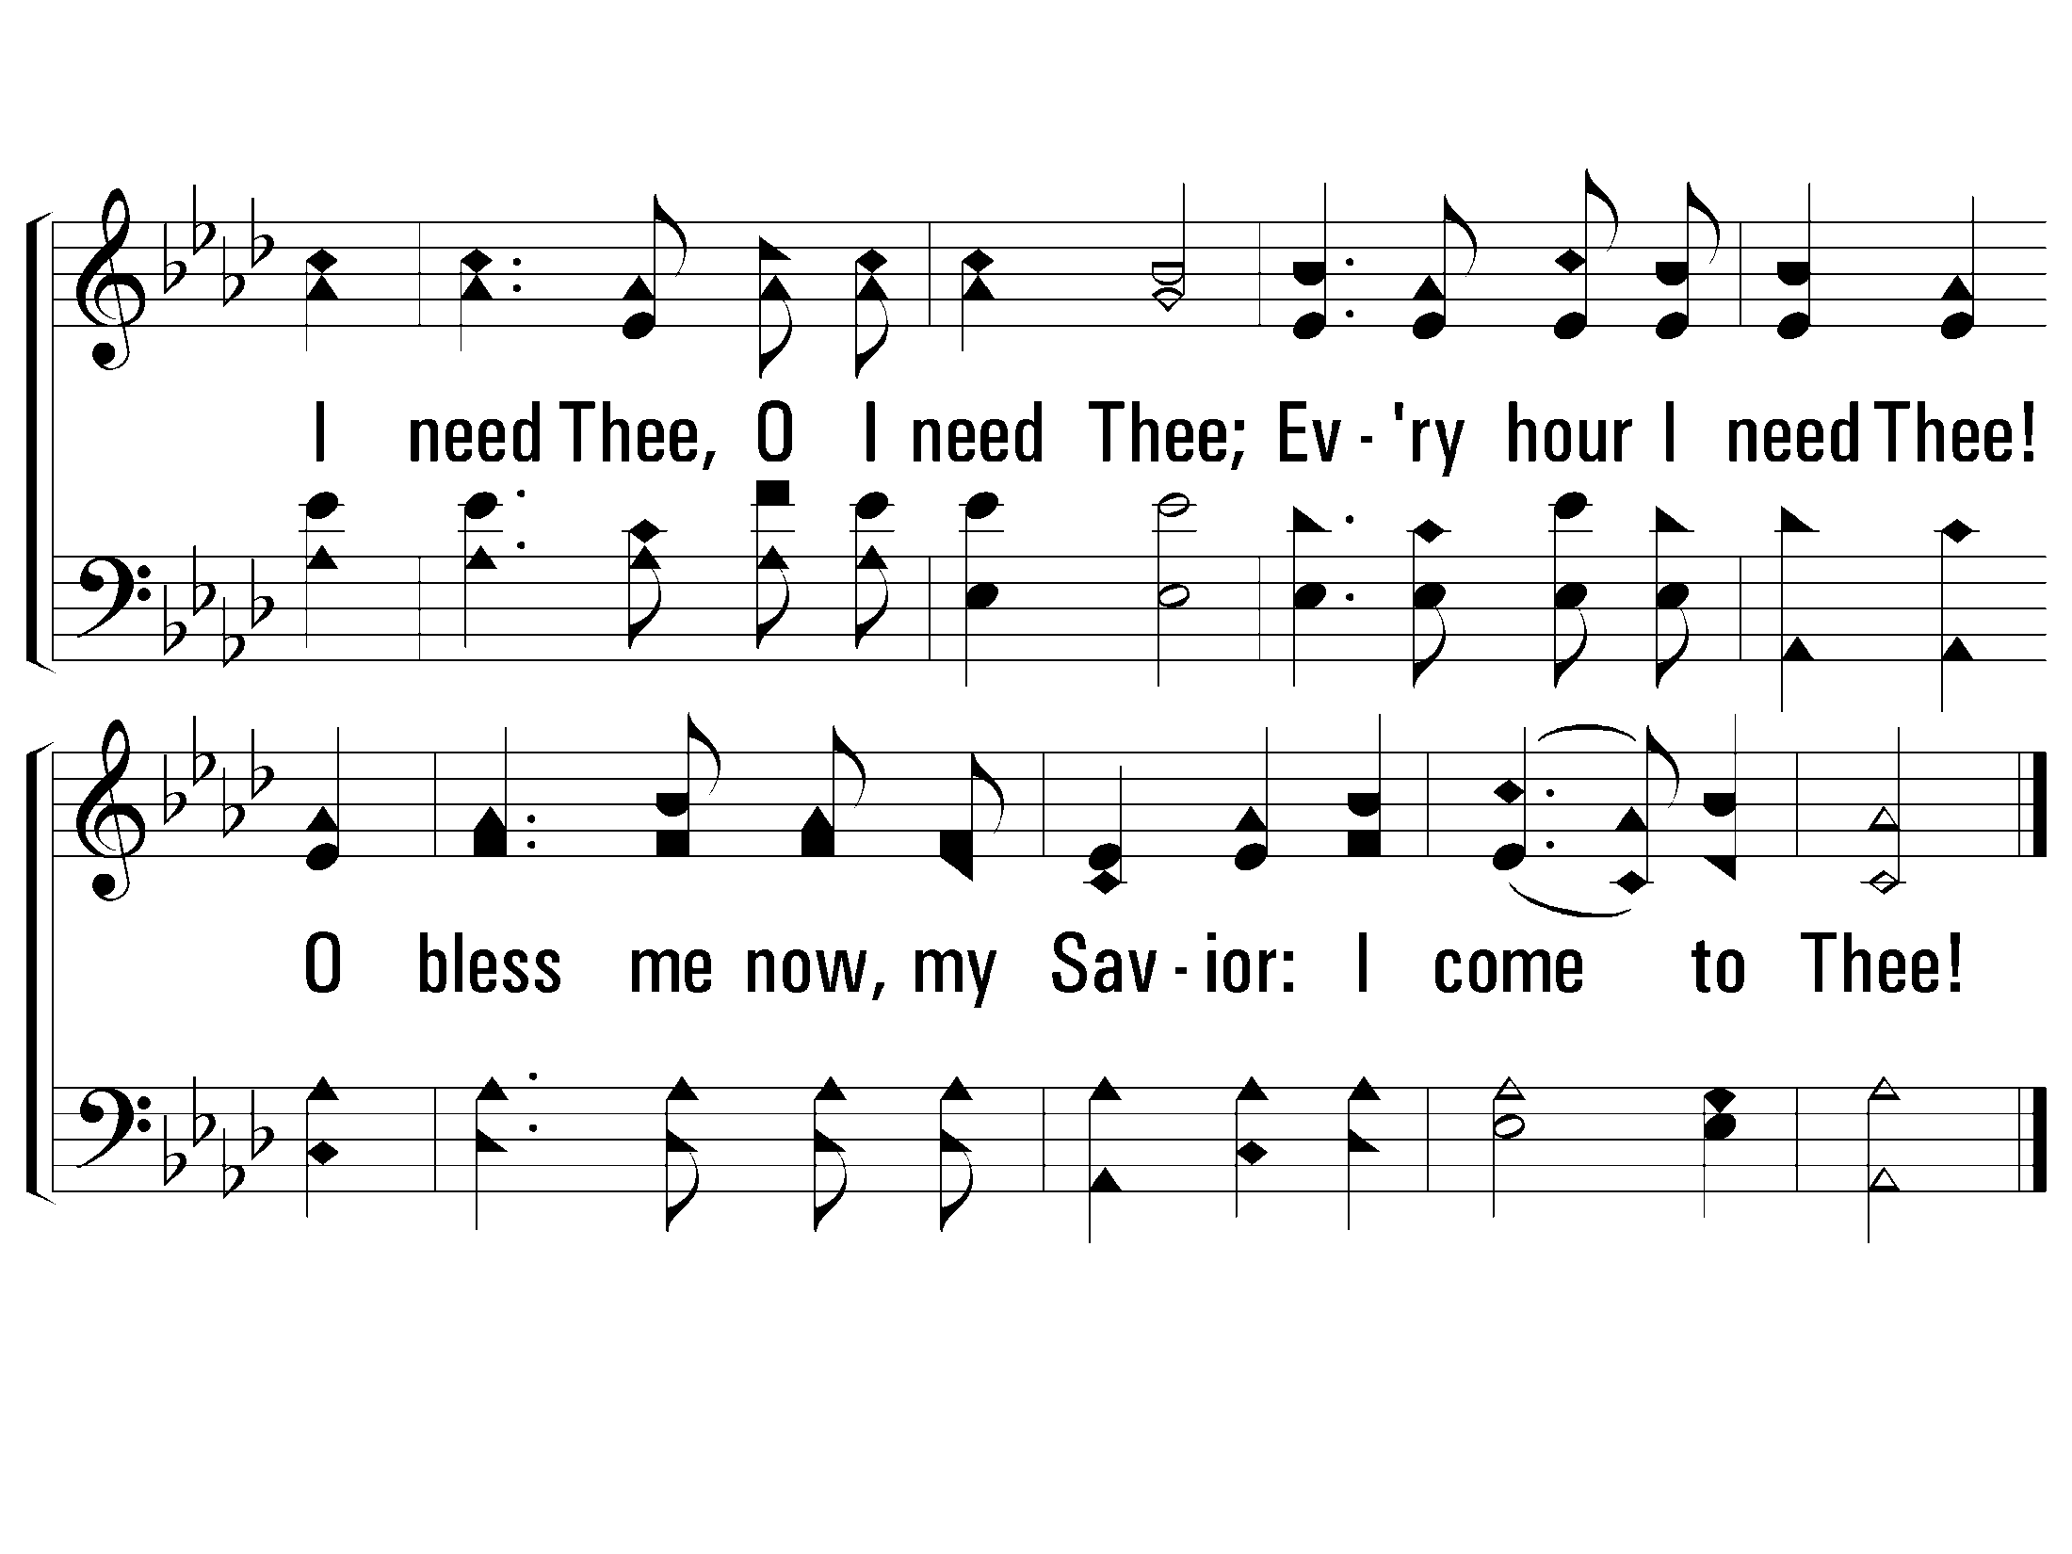
c - I Need Thee Every Hour
I need Thee, O I need Thee;
Every hour I need Thee!
O bless me now, my Savior:
I come to Thee!
© 2001 The Paperless Hymnal™

Slide 34
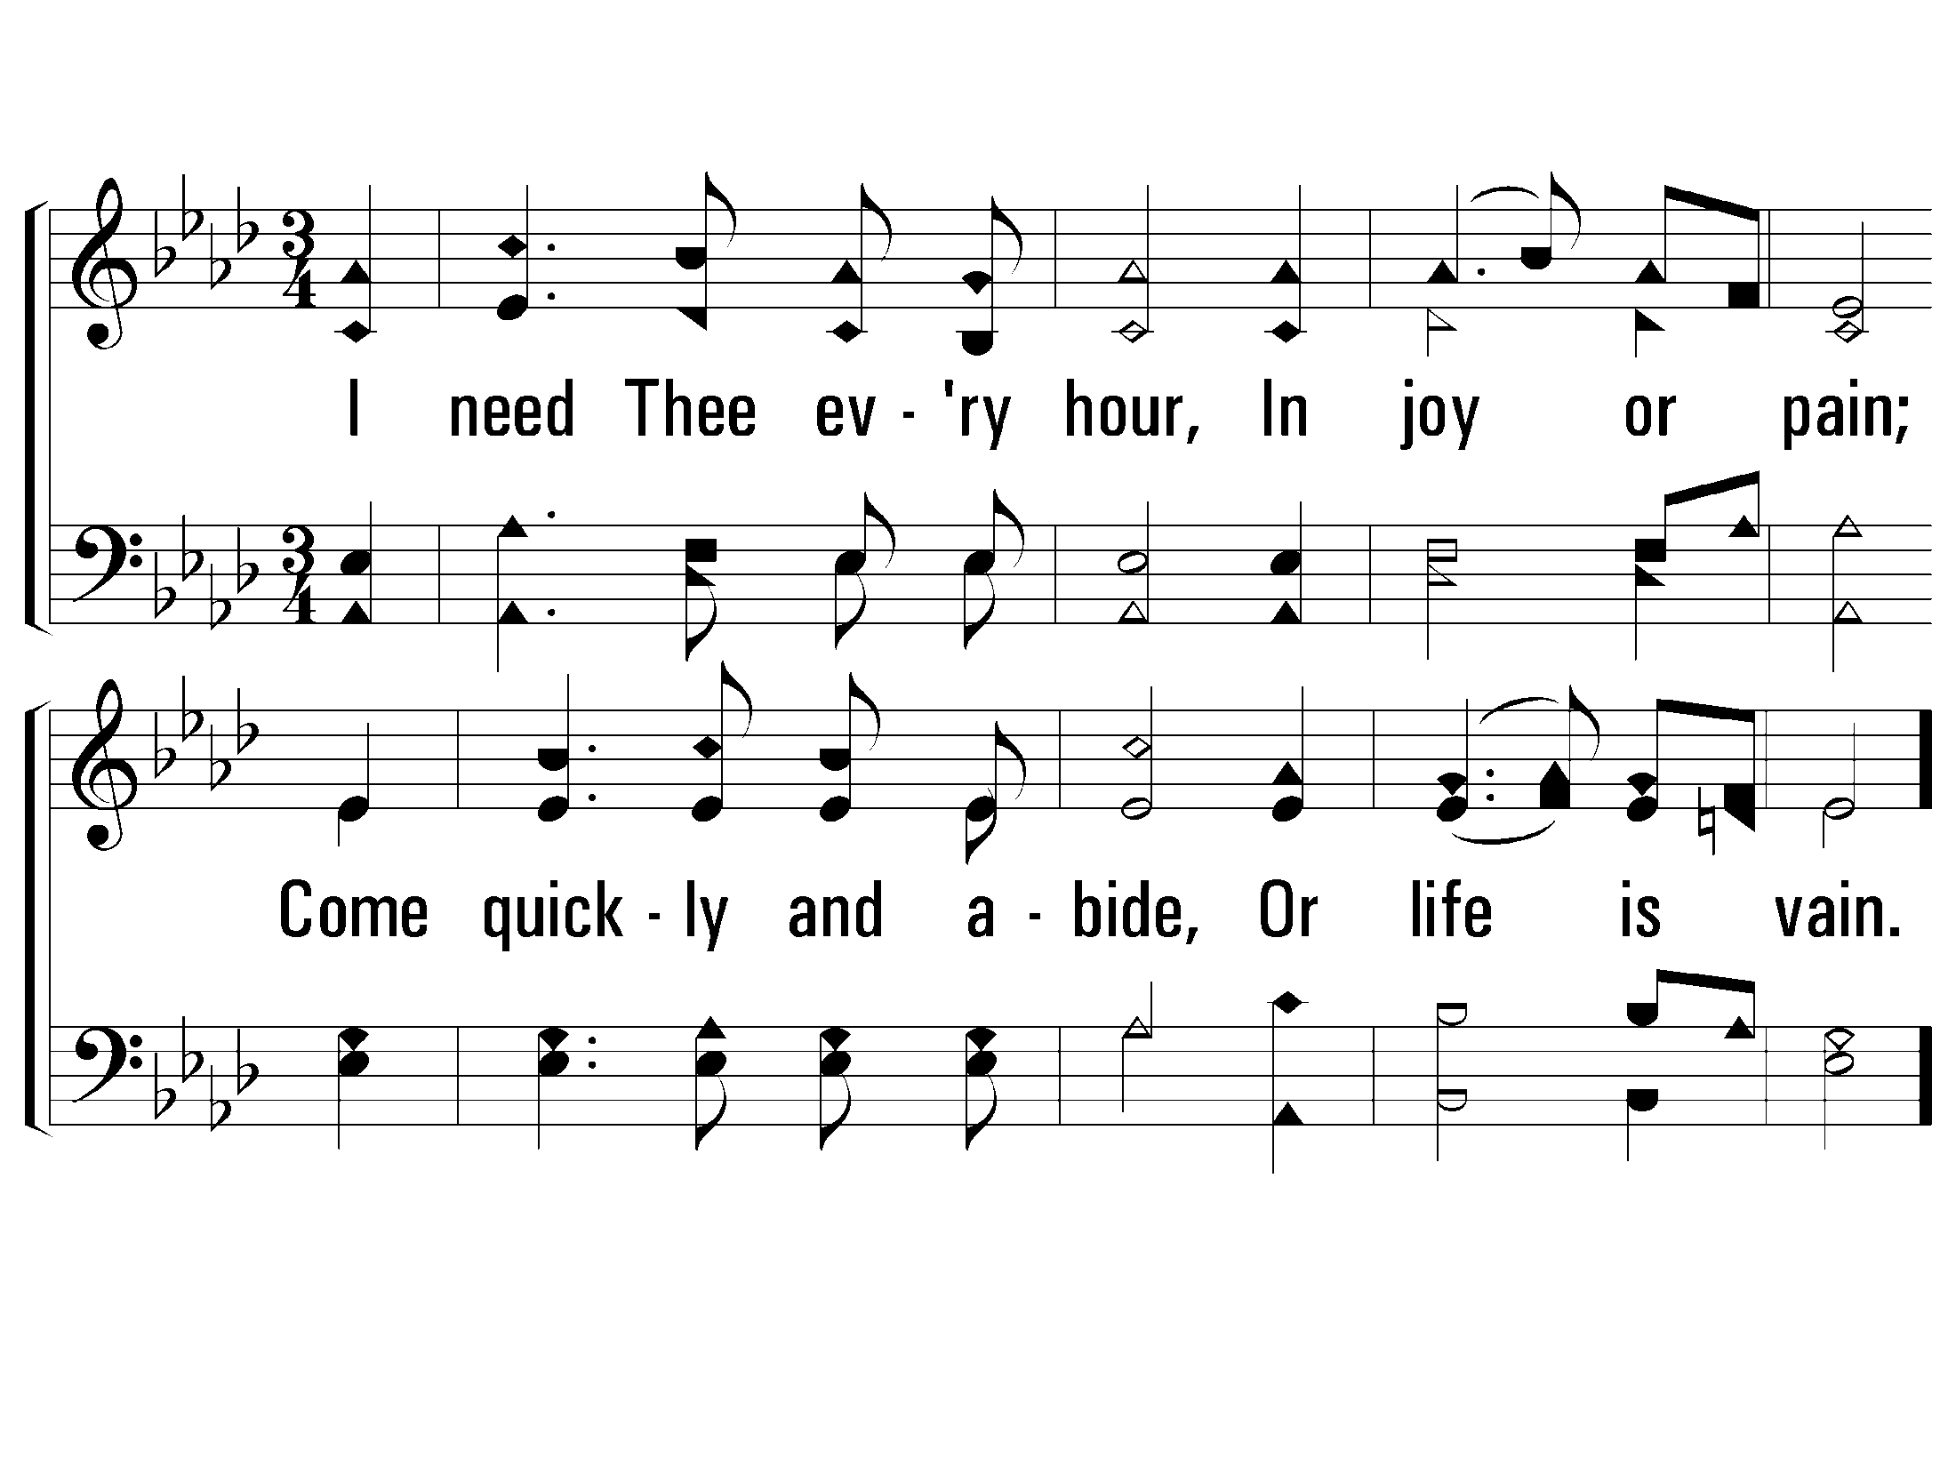
3 - I Need Thee Every Hour
3.
I need Thee every hour,
In joy or pain;
Come quickly and abide,
Or life is vain.
Words: Annie S. Hawks
Music: Robert Lowry
© 2001 The Paperless Hymnal™

Slide 35
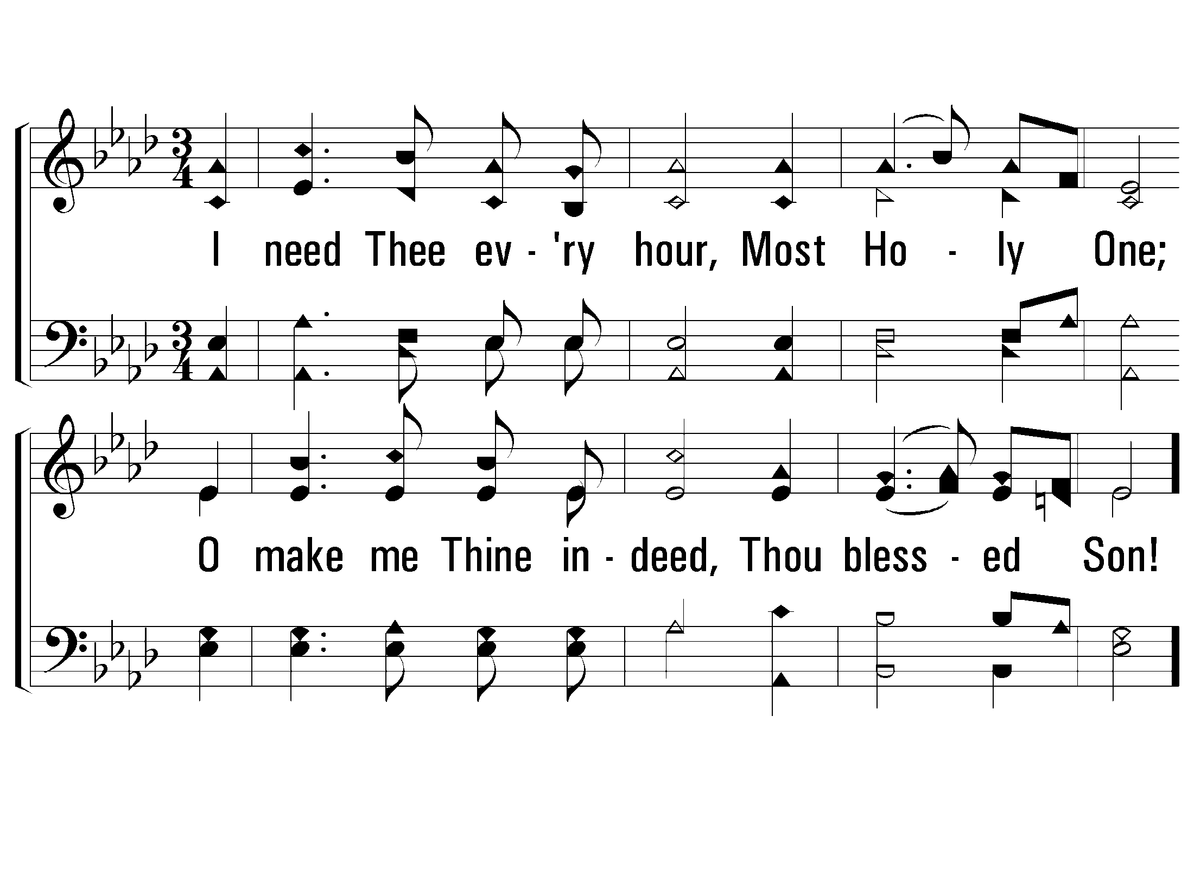
4 - I Need Thee Every Hour
4.
I need Thee every hour,
Most Holy One;
O make me Thine indeed,
Thou blessed Son!
Words: Annie S. Hawks
Music: Robert Lowry
© 2001 The Paperless Hymnal™

Slide 36
c - I Need Thee Every Hour
I need Thee, O I need Thee;
Every hour I need Thee!
O bless me now, my Savior:
I come to Thee!
© 2001 The Paperless Hymnal™

Slide 37
In Christ
Does Belief alone save?
Satan?
Does belief & confession alone save?
Satan & demons
Rom. 10:9
Romans 10:10 For with the heart one believes unto righteousness, and with the mouth confession is made unto salvation.

Slide 38
Romans 6
3 Or do you not know that as many of us as were
baptized into Christ Jesus were
baptized into His death?
4 Therefore we were
buried with Him through baptism into death, that just as Christ was raised from the dead by the glory of the Father, even so we also should walk in newness of life.
5 For if we have been united together in the likeness of His death, certainly we also shall be in the likeness of His resurrection,
6 knowing this, that our old man was crucified with Him, that the body of sin might be done away with, that we should no longer be slaves of sin.
7 For he who has died has been freed from sin.

